Slide 1

Pupil Premium for Financial Year 2016/17 Importing and Maintaining
Version 1.0

Slide 2
Downloading the DfE CSV file for Financial Year 2016/17

Slide 3
Downloading the DfE CSV File for Financial Year 2016/17
  We expect the DfE to make two versions of the CSV file available to schools

Slide 4
Downloading the DfE CSV File for Financial Year 2016/17
  We expect the first version to be made available by the DfE in July and the second in November
    The first download makes use of a list of looked after pupils based on a LA collection that took place some while ago, while the second download uses an up to date list of looked after pupils.

Slide 5
Downloading the DfE CSV File for Financial Year 2016/17
  We expect the first version to be made available by the DfE in July and the second in November
    The first download makes use of a list of looked after pupils based on a LA collection that took place some while ago, while the second download uses an up to date list of looked after pupils.
    The first download makes use of a list of looked after pupils based on a LA collection that took place some while ago, while the second download uses an up to date list of looked after pupils.

Slide 6
Downloading the DfE CSV File for Financial Year 2016/17
  We expect the first version to be made available by the DfE in July and the second in November
    The first download makes use of a list of looked after pupils based on a LA collection that took place some while ago, while the second download uses an up to date list of looked after pupils.
    The first download makes use of a list of looked after pupils based on a LA collection that took place some while ago, while the second download uses an up to date list of looked after pupils.
    However, from a financial point of view the second download is likely to be of interest as it reflects the total amount of Pupil Premium funding provided to the school.

Slide 7
Downloading the DfE CSV File
  It is important to download the DfE CSV file to a secure folder, as it includes UPN and other information that is usually regarded as sensitive, e.g. adopted from care.

Slide 8
Downloading the DfE CSV File
  The DfE does not include Early Years Pupil Premium in its CSV file.

Slide 9
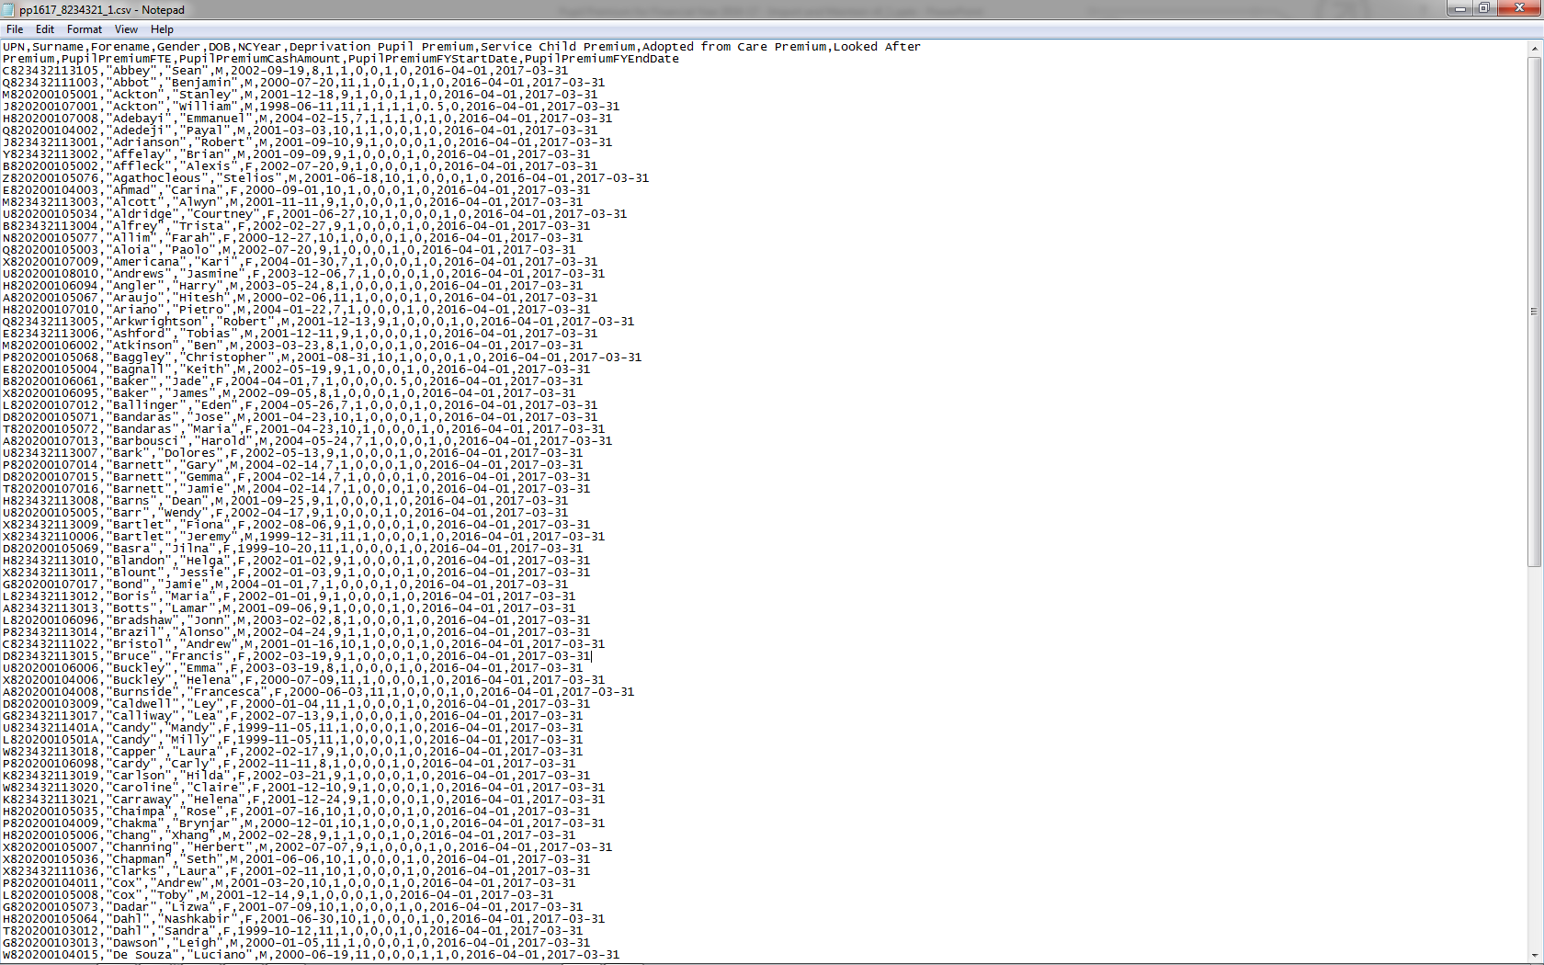
This is what we expect the DfE CSV file to look like when opened in Notepad

Slide 10
Importing Information from the DfE CSV file

Slide 11
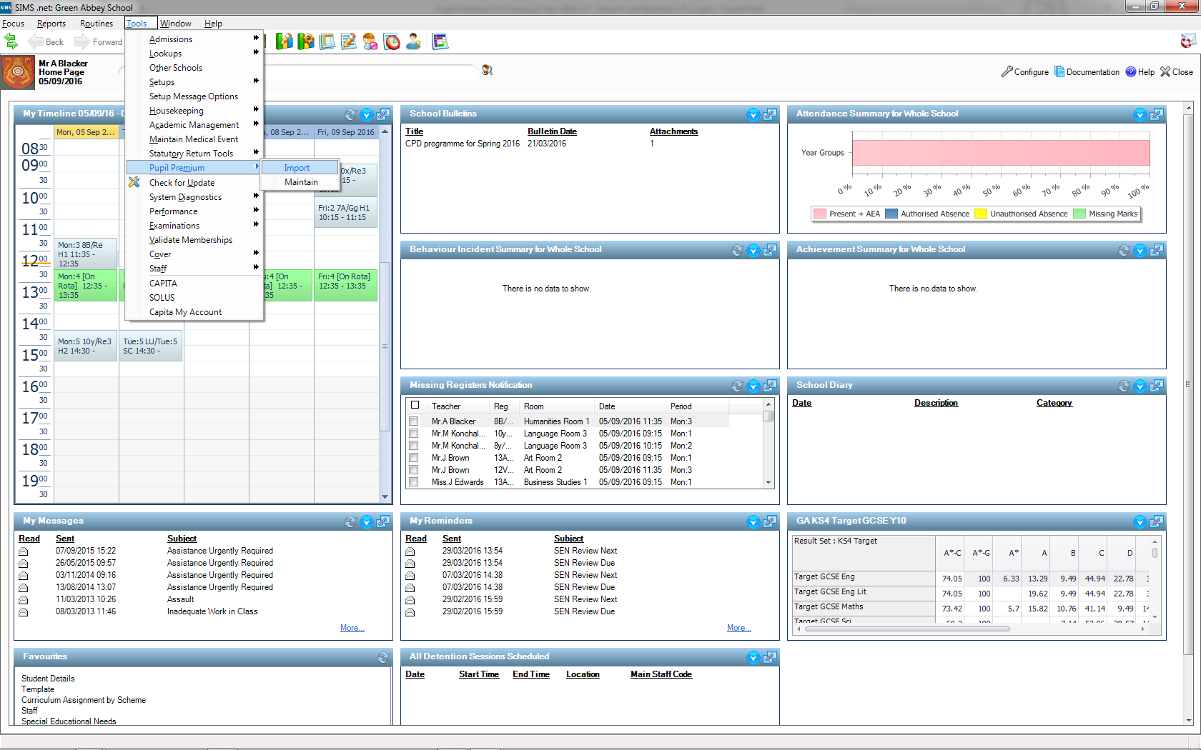

Slide 12
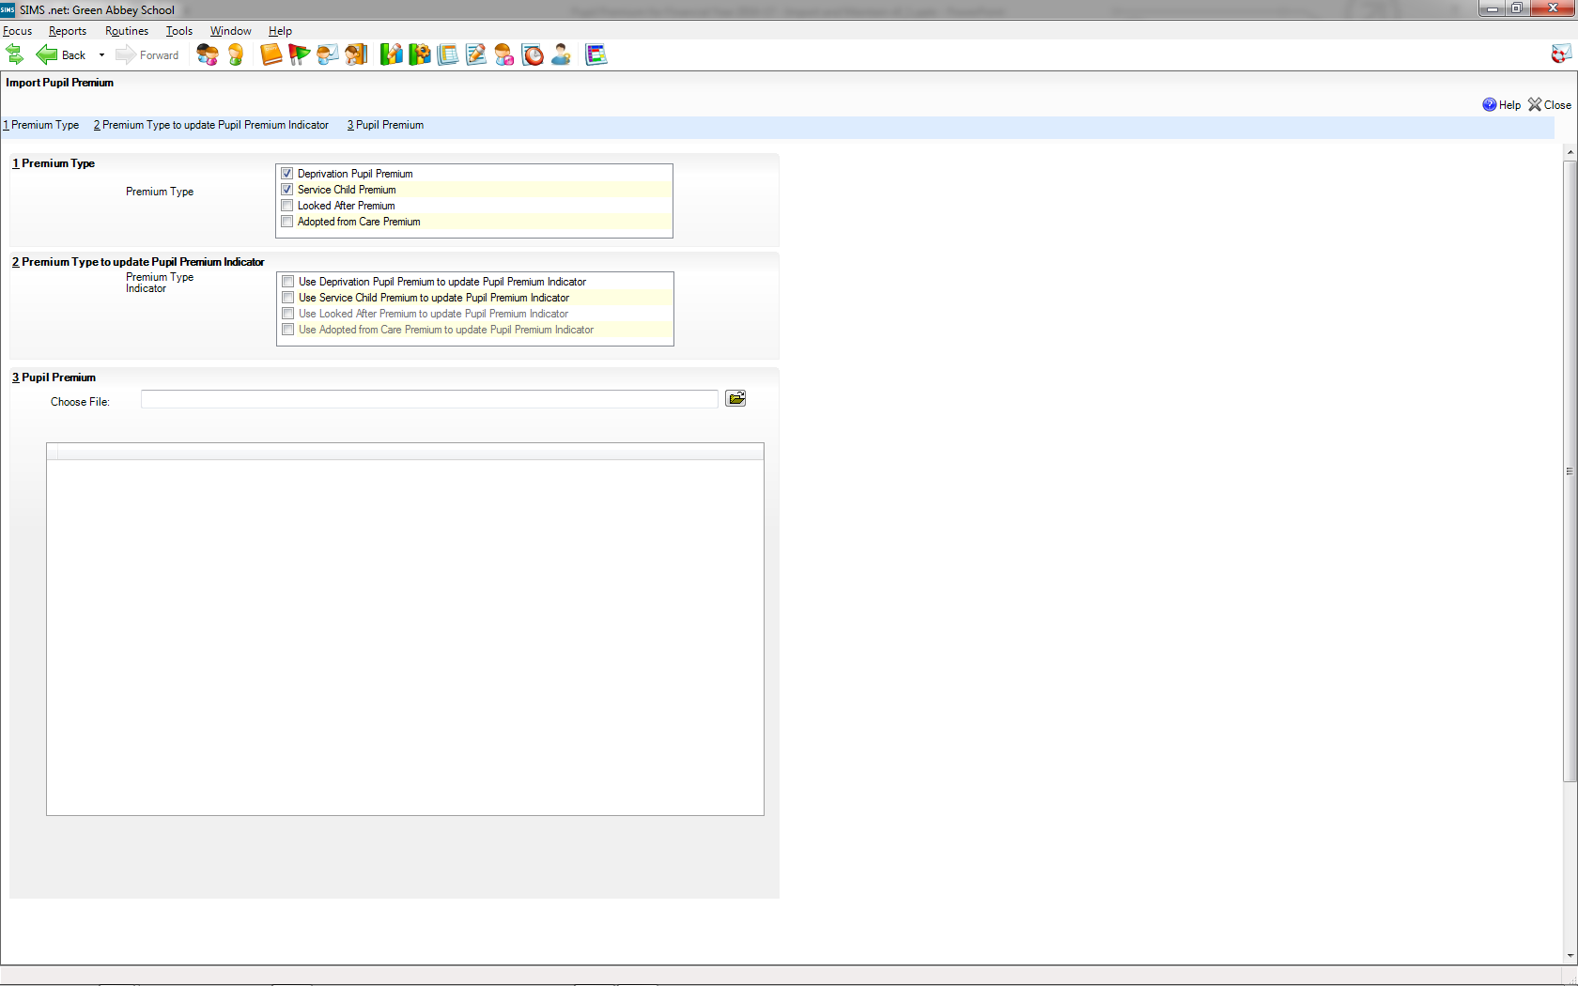
We can tick to indicate which types of Pupil Premium we want to import from the DfE file. The Deprivation Pupil Premium and Service Child Premium are ticked by default, as these are the most likely types that schools will want to import.
We suggest that Looked After Premium is not worth importing, as it is likely to provide an incomplete and out of date picture, i.e. it is only included where it is stopping the school from receiving other premiums and it is not based on School Census information

Slide 13
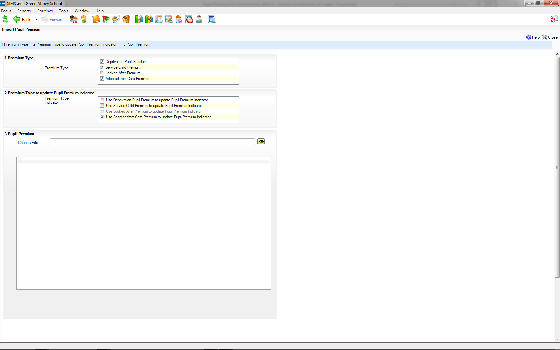
Updating of the Pupil Premium Indicator always excludes the types that the user has decided not to import, but we have made it possible to import the premium type without updating the Indicator. This can be helpful where the school wants to import the information but doesn’t want the information to be readily available via the Indicator

Slide 14


Slide 15

Once we have indicated what we want to import and update we must choose the CSV file to import

Slide 16
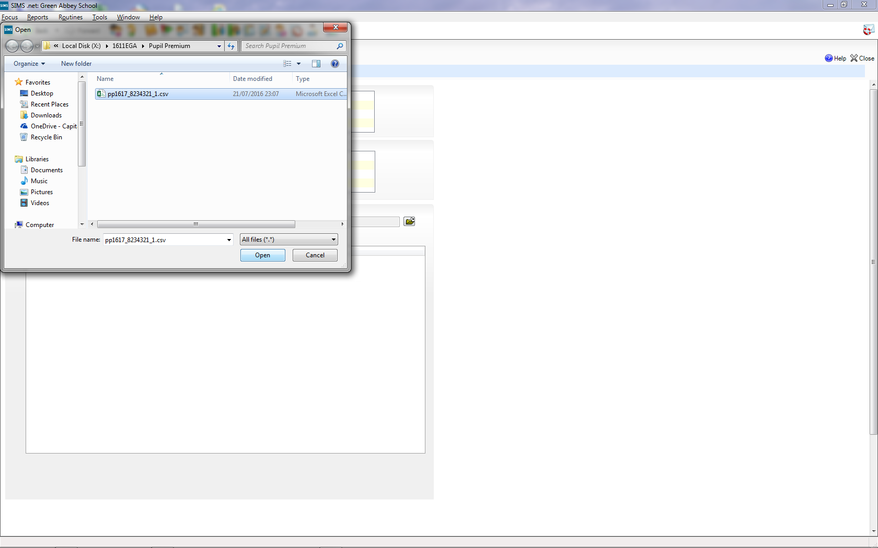
Please note that this Green Abbey CSV files is available from the ZIP that provided this presentation

Slide 17
We have modified validation of the file so that we now check the columns in the CSV file and not the name of the file.
The validation will accept a file with and without the Adopted from Care column being present. This is important where the school also imports CSV files for pupils who joined their school after the Spring Census. Such imports are helpful, as pupils are still “deprived”, even though the new school does not obtain the premium money. In line with data protection regulations for adopted pupils, the DfE does not include Adopted from Care information obtained from the previous schools

Slide 18
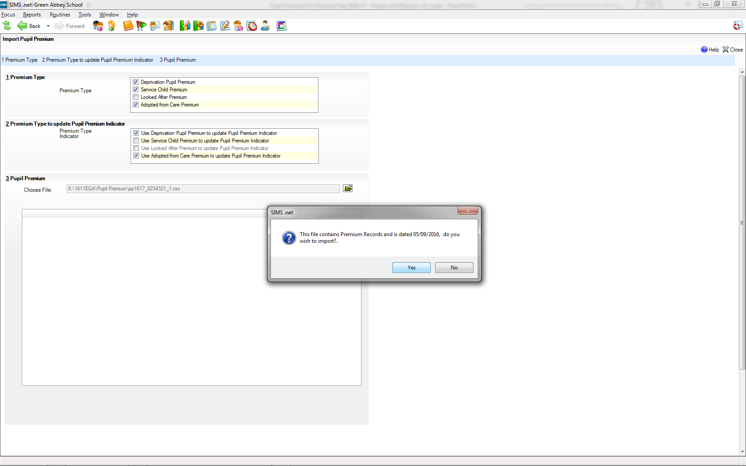

Slide 19
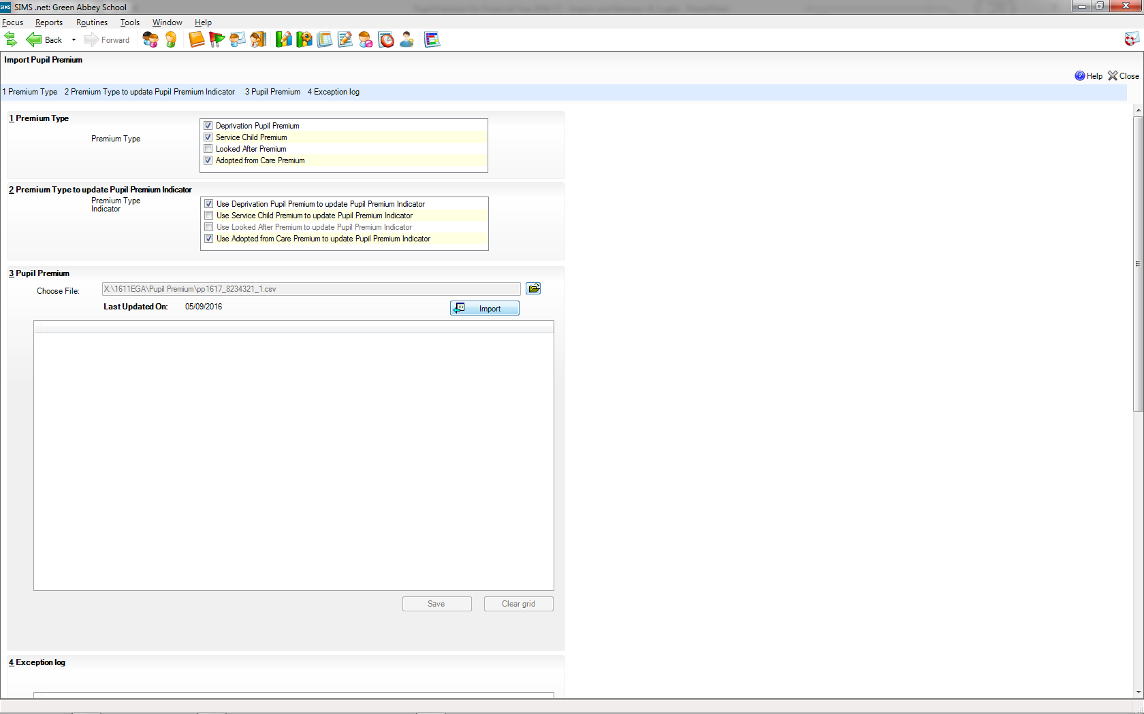
Once we are happy that we have selected the right file, we tick import to bring the information in from the file.

Slide 20
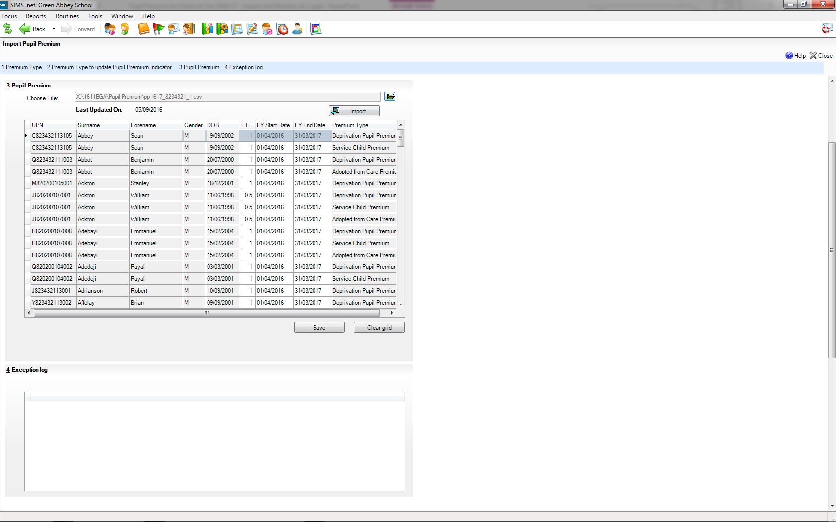
Sean Abbey has two different Premium Types so this is display as two rows in the table

Slide 21
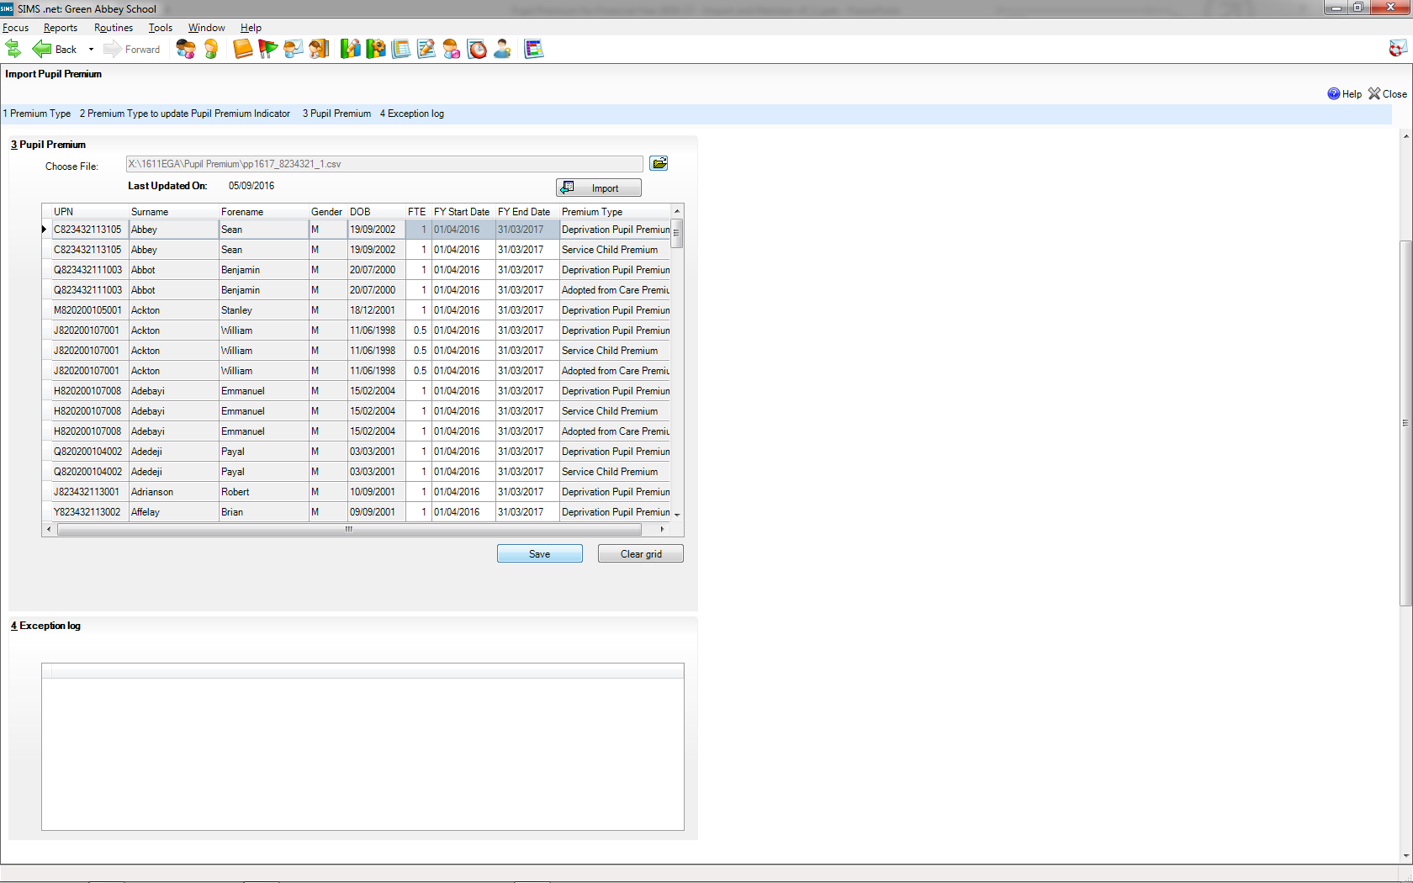
At this point the information has just been added to a temporary table and we must click Save to add this to the “real” tables

Slide 22
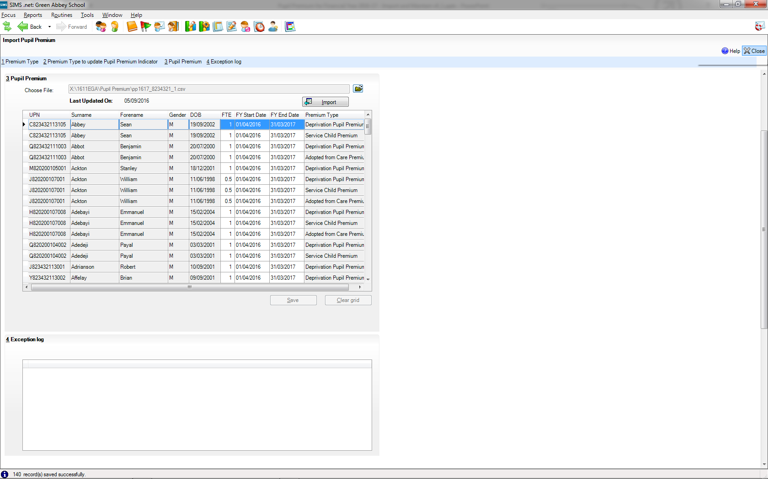

Slide 23
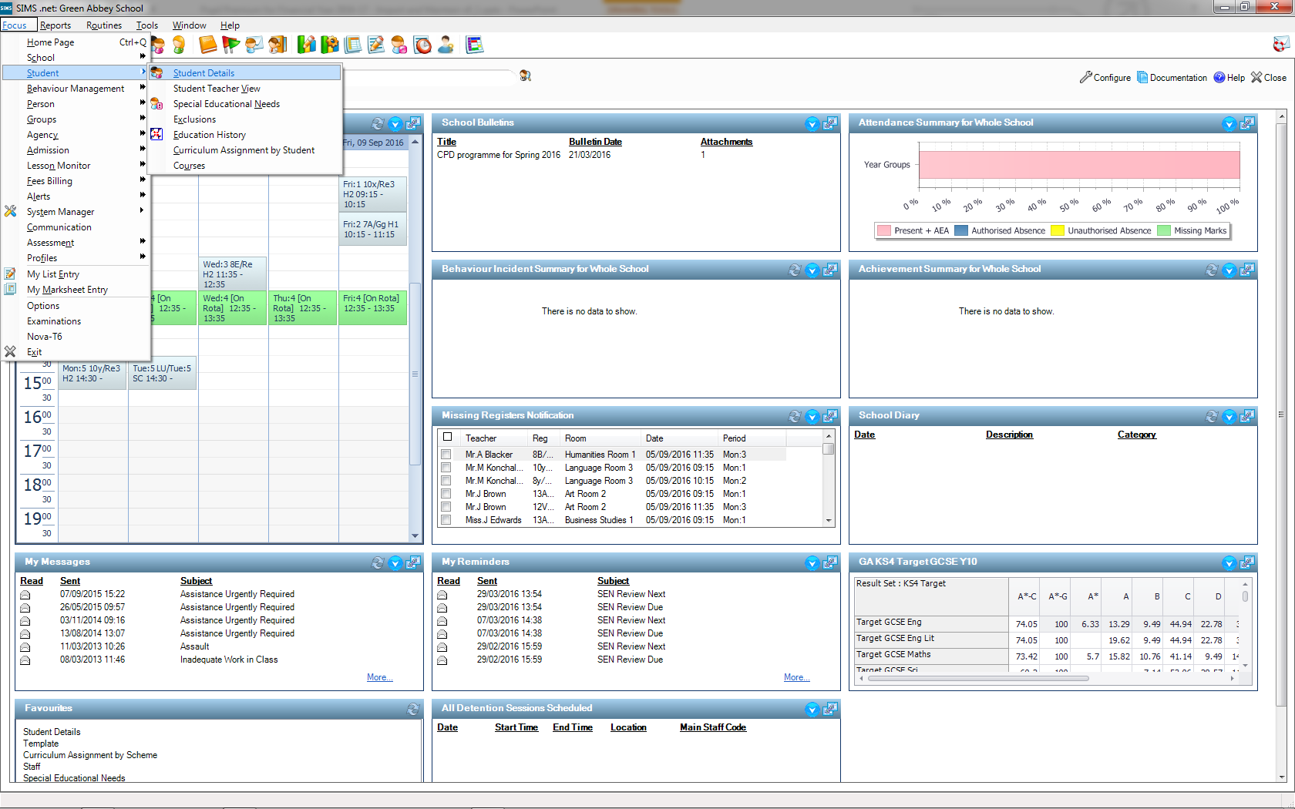
We can check the Pupil Premium Indicator for Sean Abbey in Student Details

Slide 24
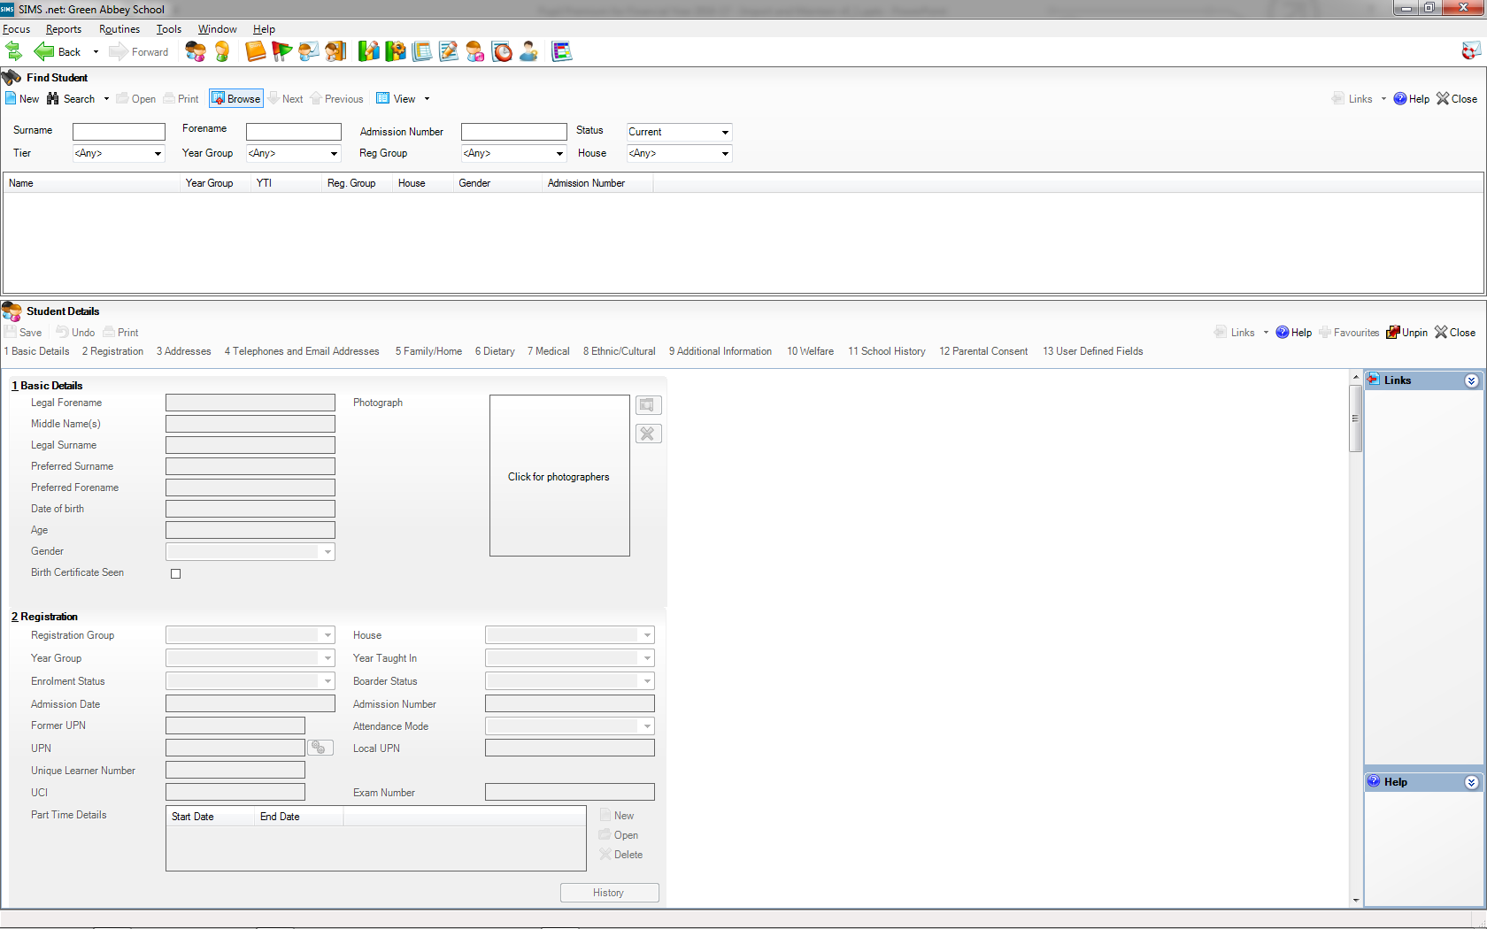

Slide 25
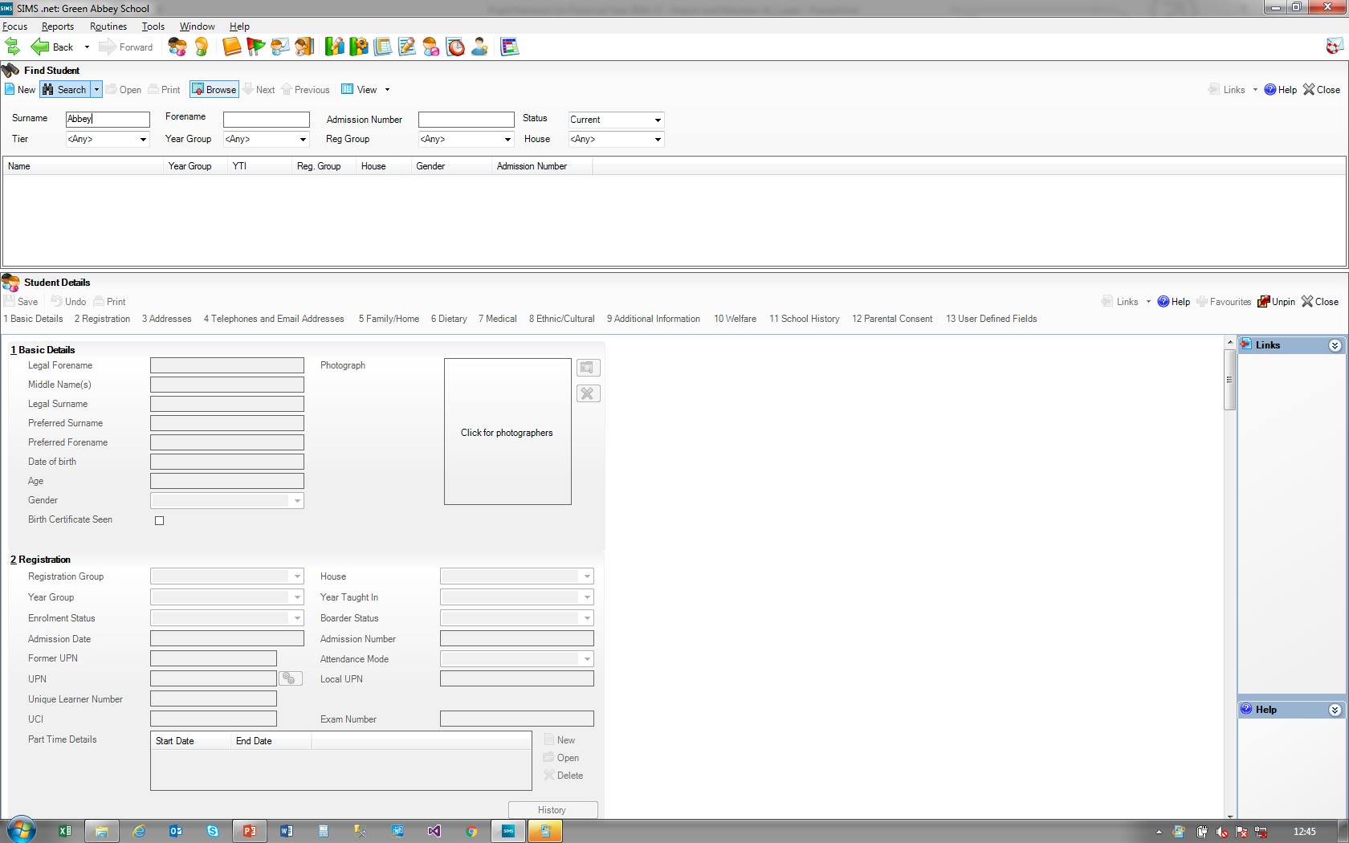

Slide 26
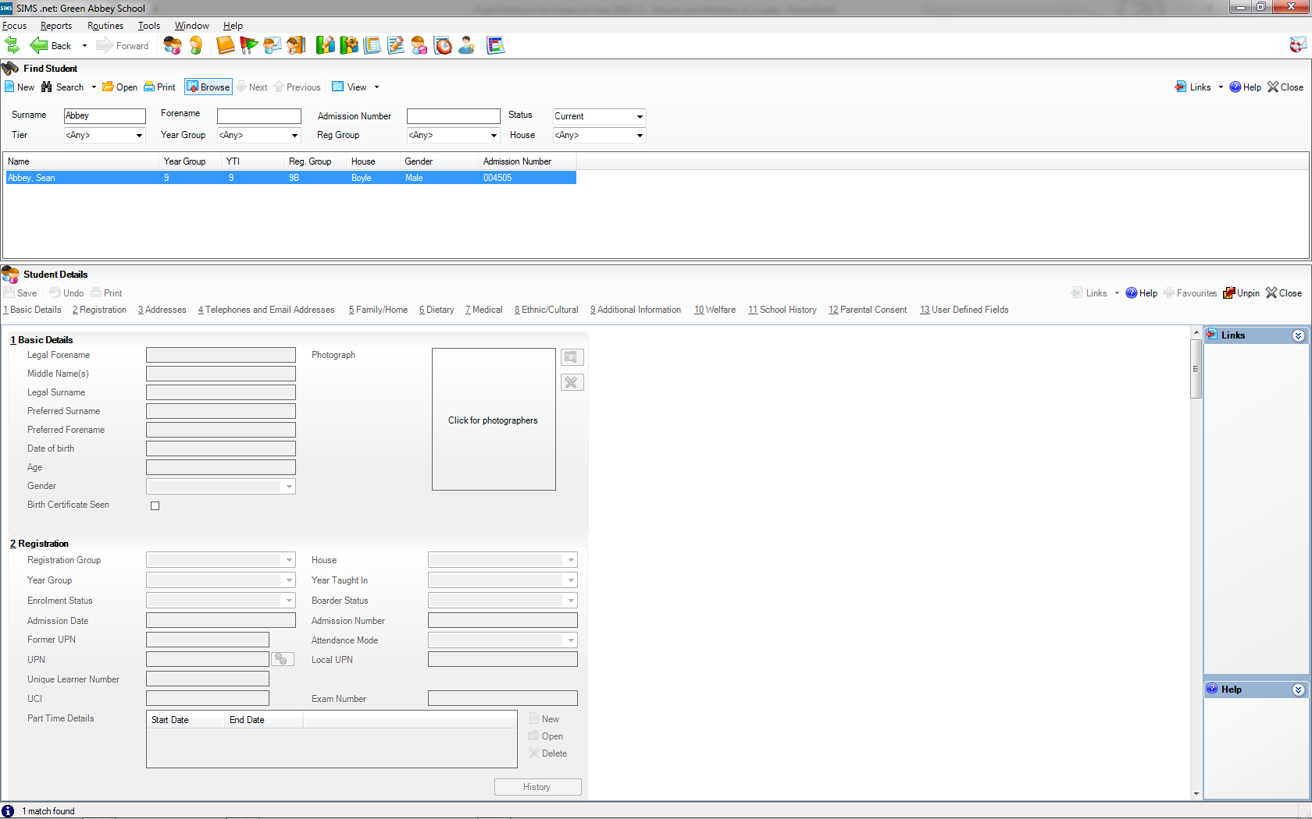

Slide 28
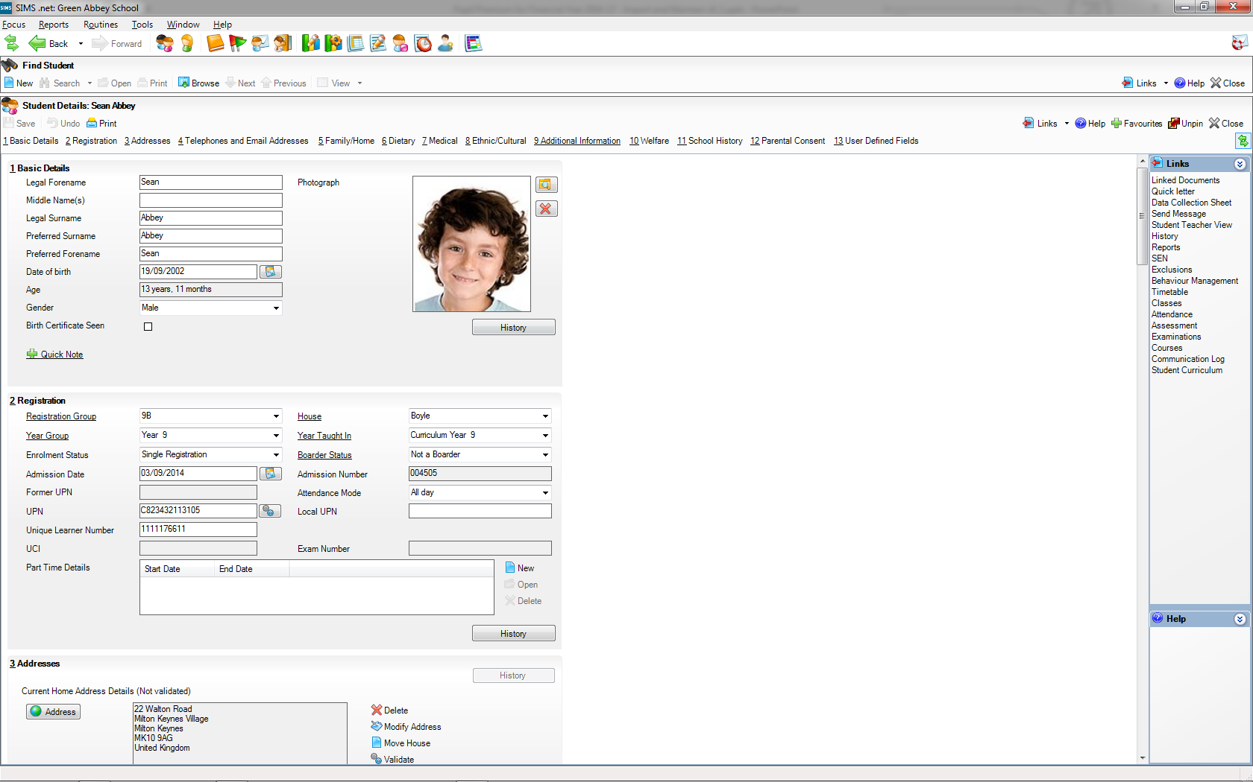

Slide 29
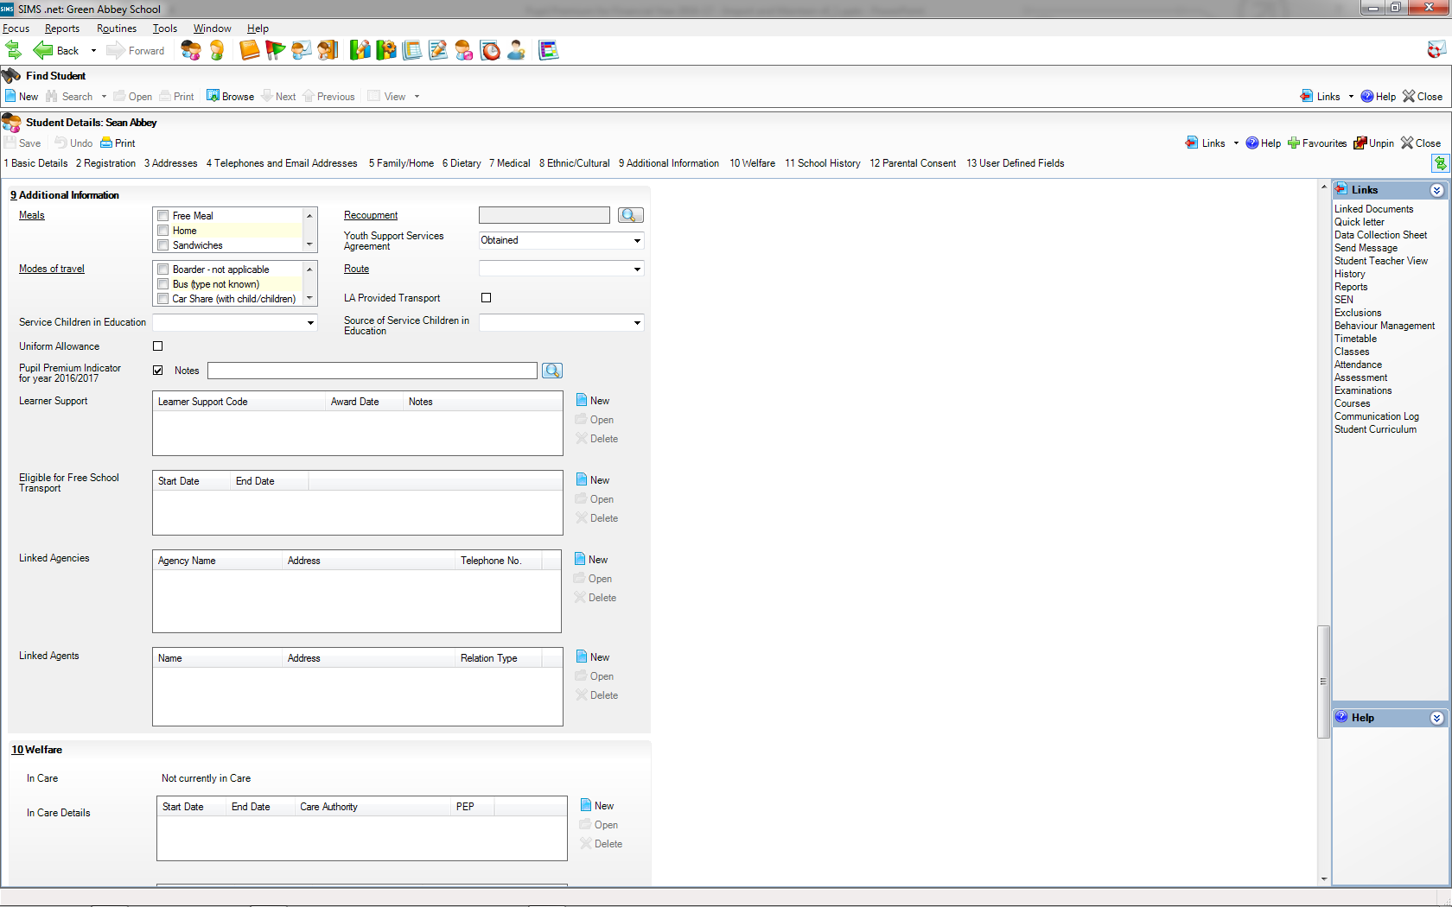

Slide 30
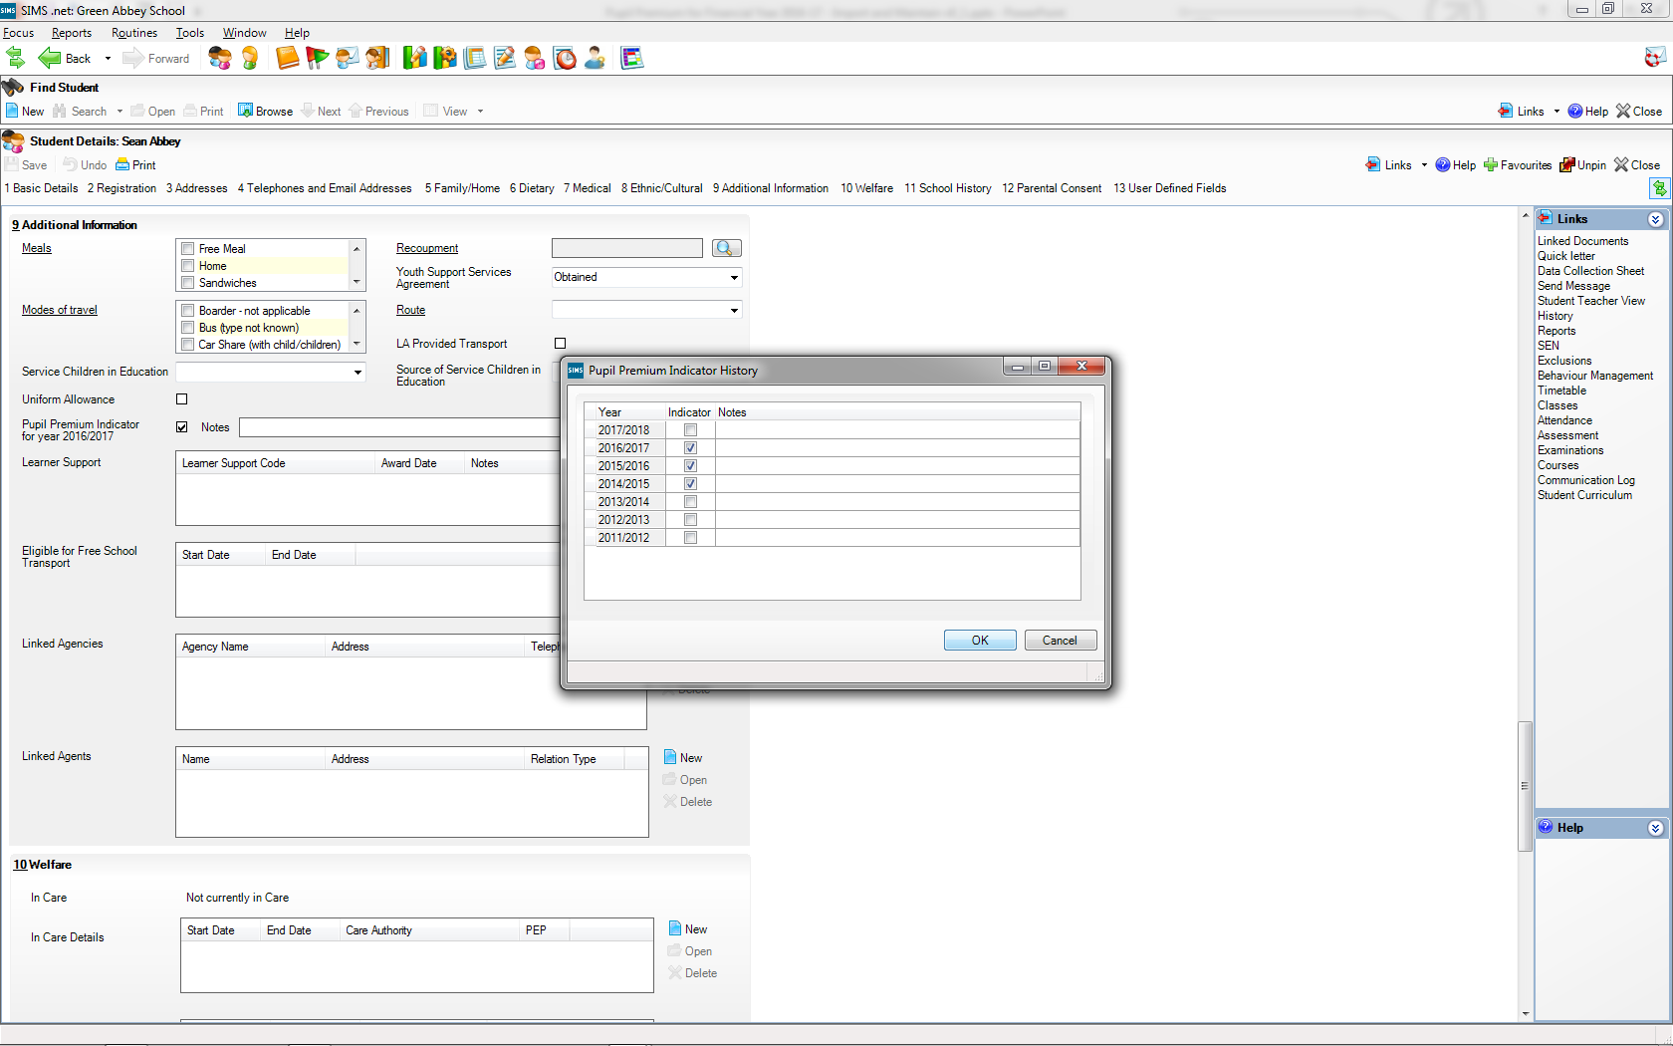
The ticks are as we expect as a financial year crosses two academic years

Slide 31
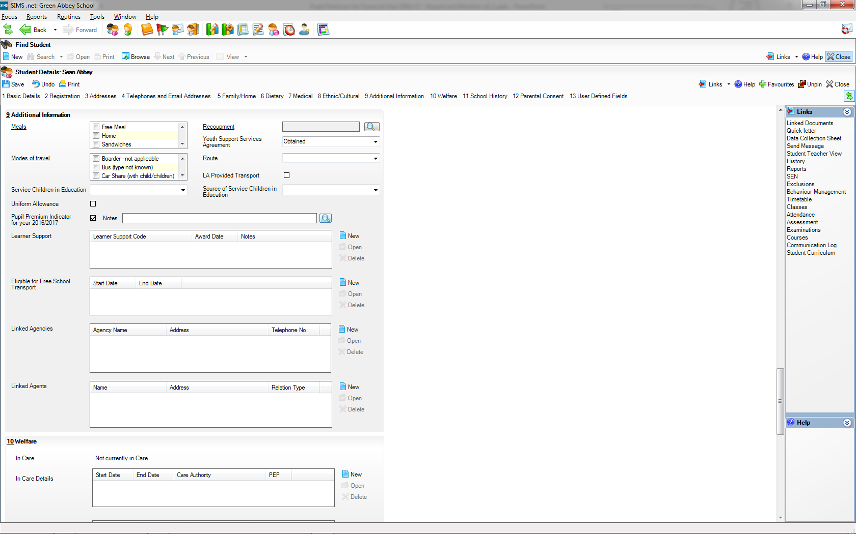

Slide 32
Maintaining Pupil Premium information

Slide 33
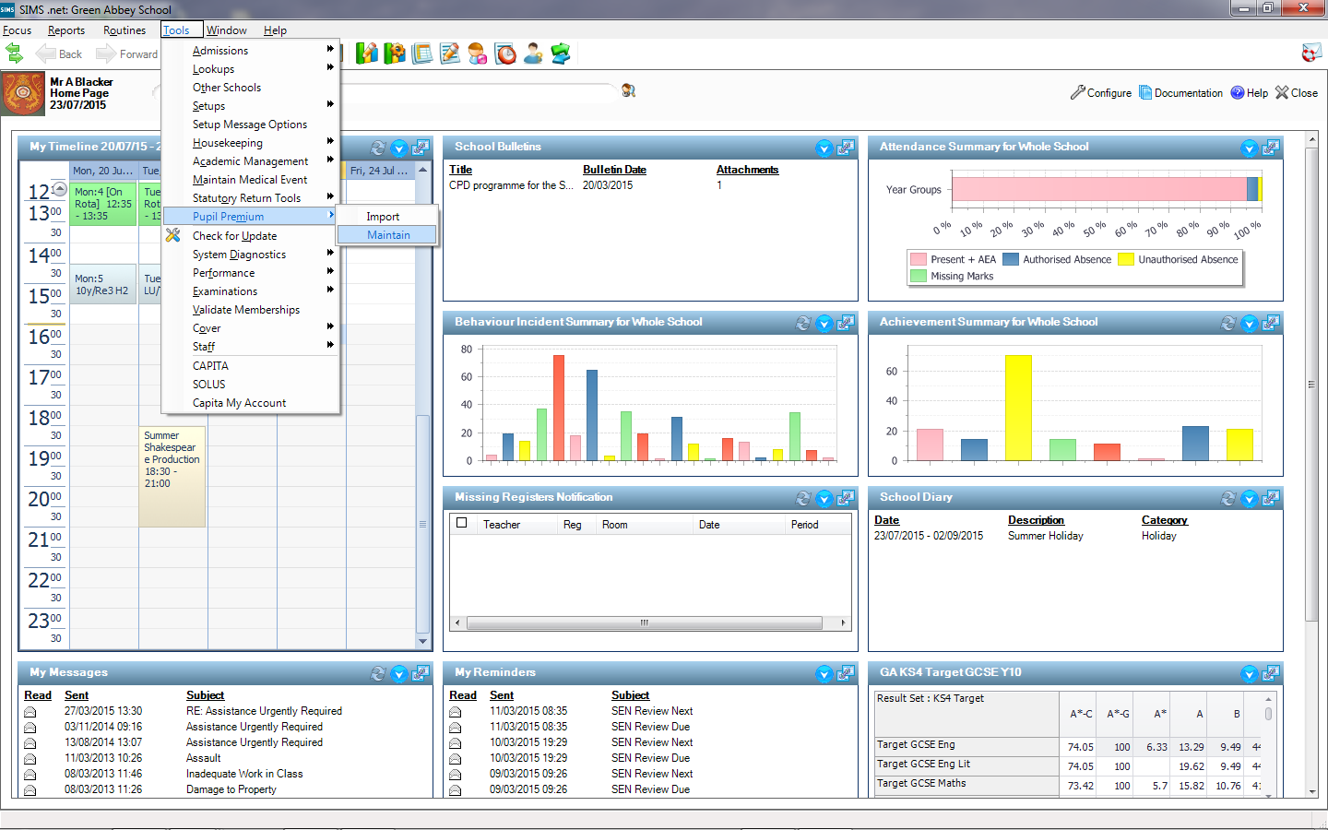

Slide 34
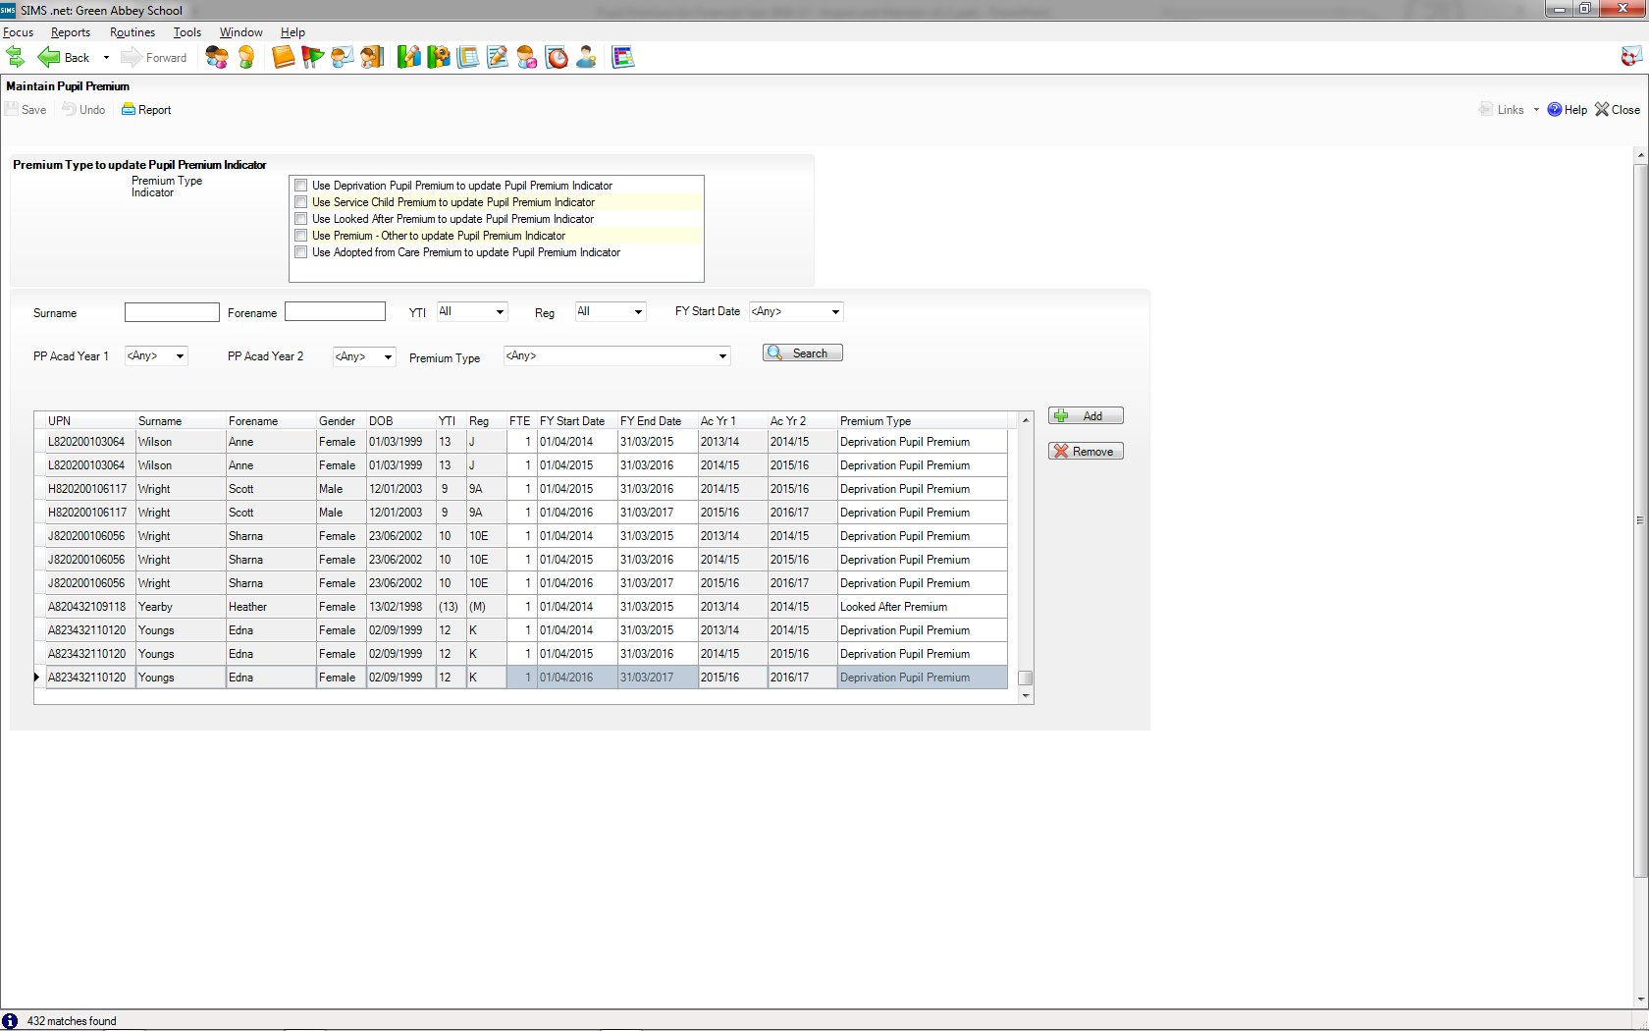
By default saving Maintain Pupil Premium information will not update the Pupil Premium Indicator, but we can add ticks for each Pupil Premium Type as desired.

Slide 35
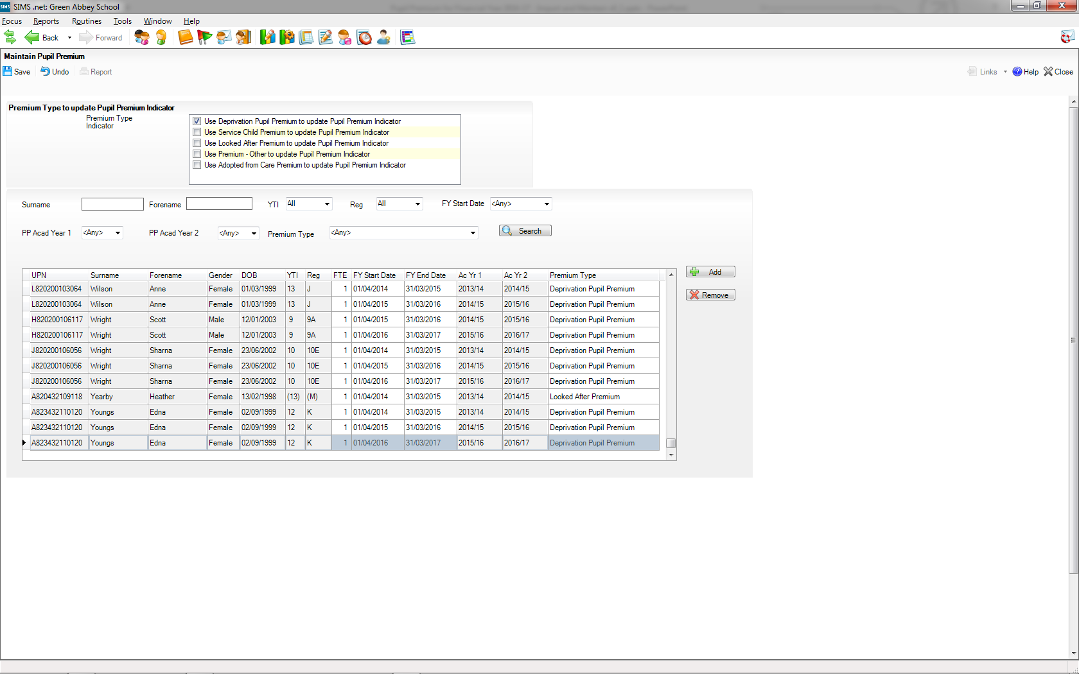

Slide 36


Slide 37
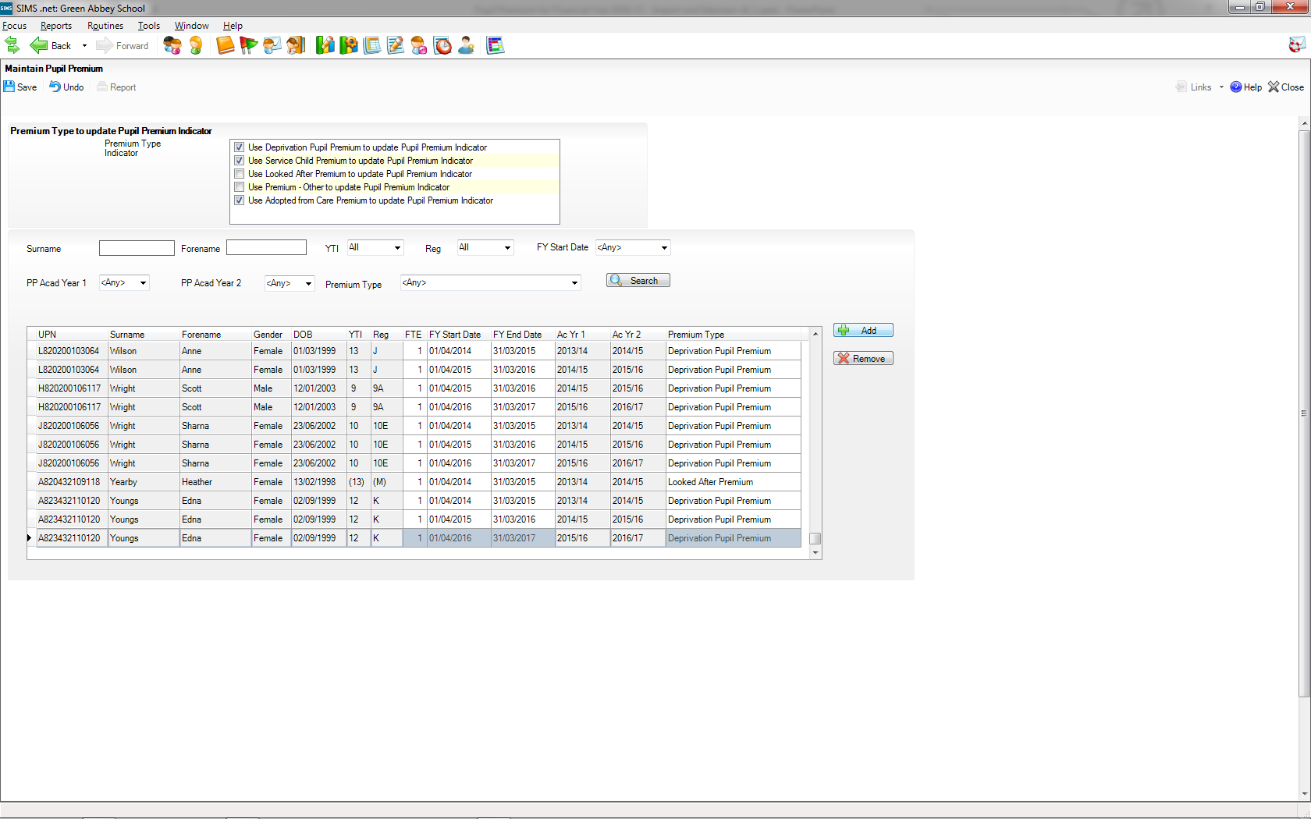
We can add pupils as necessary, We might do this for the new intake, as such pupils will not be included in the normal CSV file, which only includes pupils on roll for the January Censuss

Slide 38
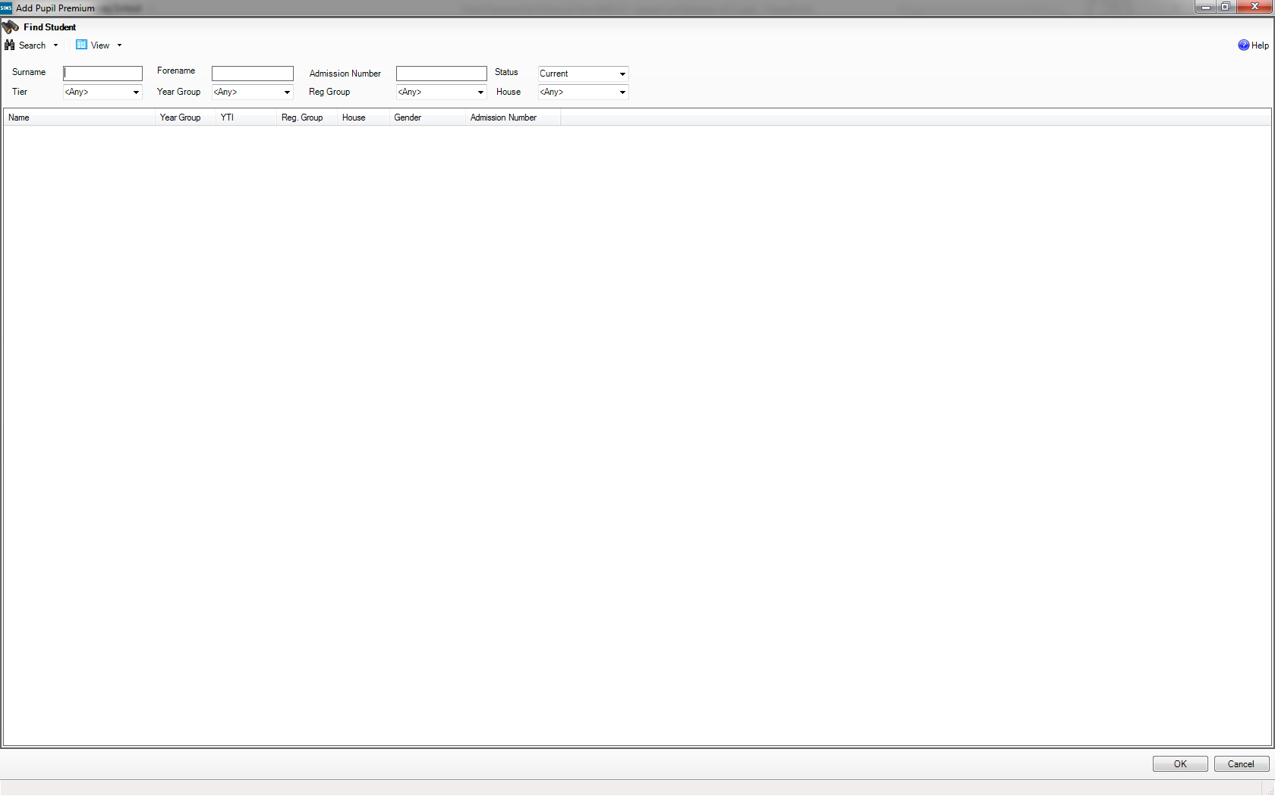

Slide 39
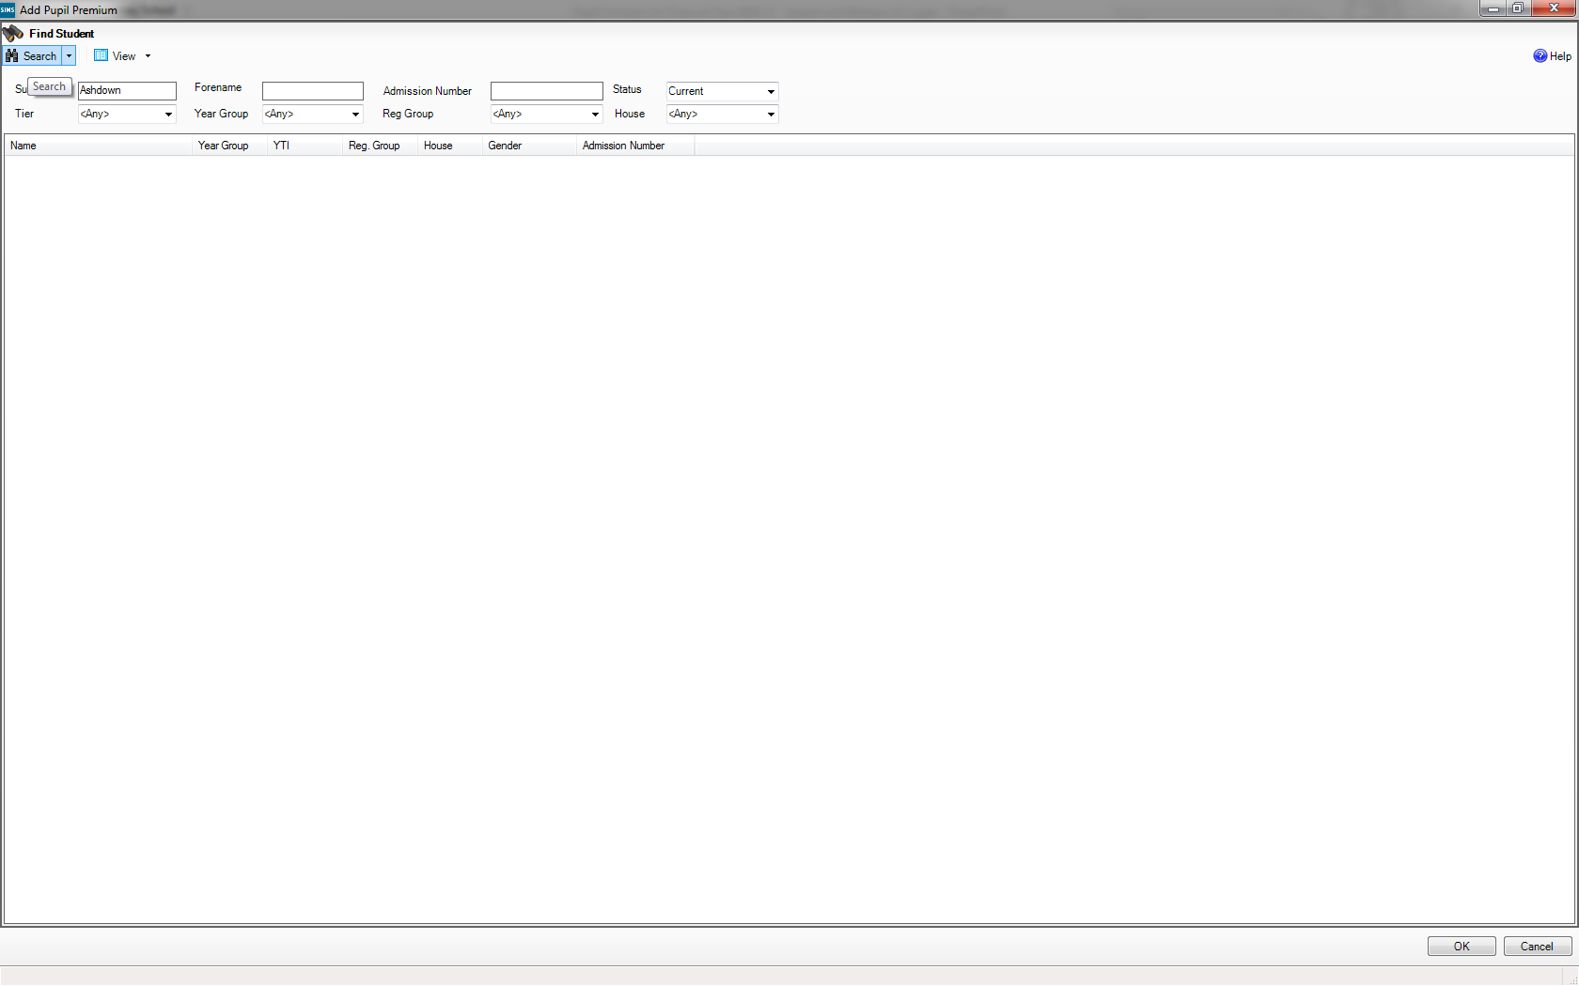

Slide 40
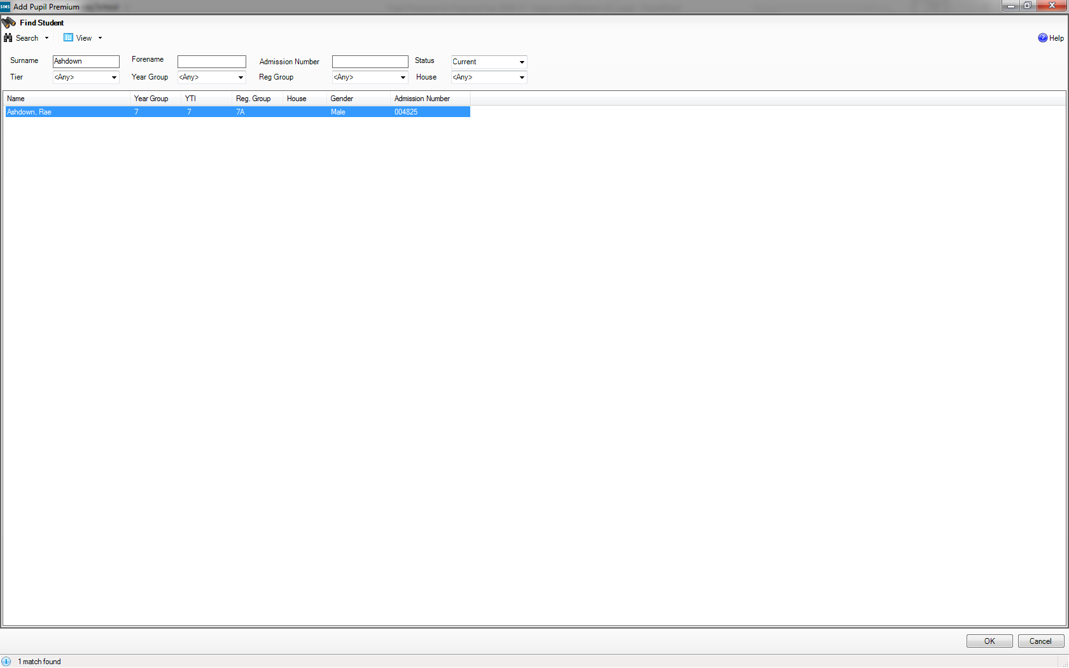

Slide 41
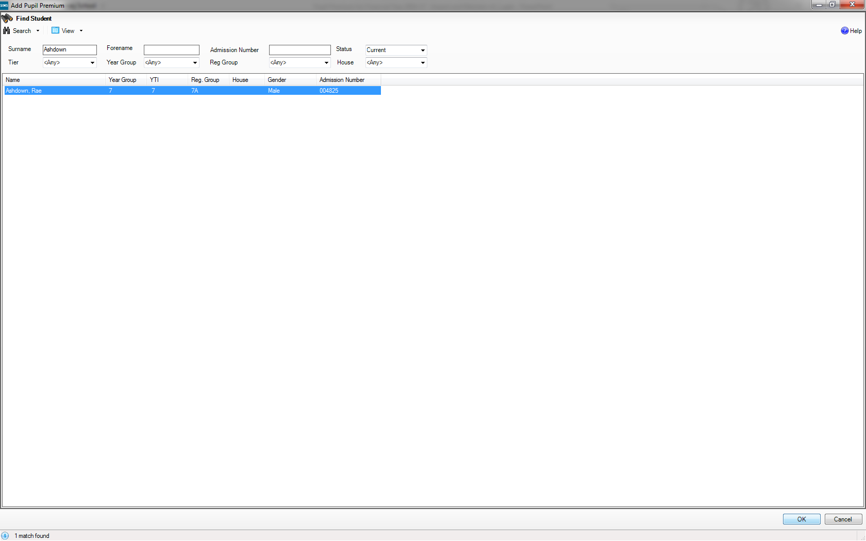

Slide 42
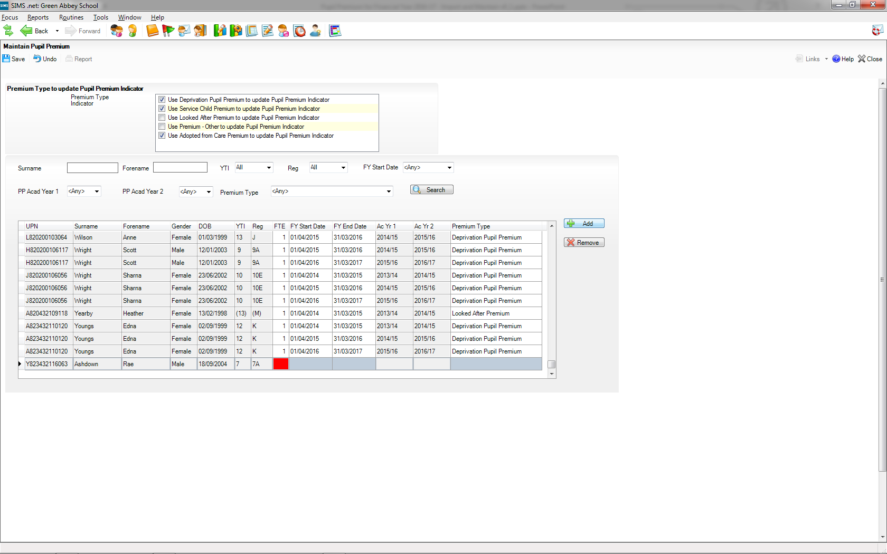
One record is needed for each of the pupil’s Pupil Premiums, so multiple rows will need to be added for pupils with more that one Pupil Premium

Slide 43
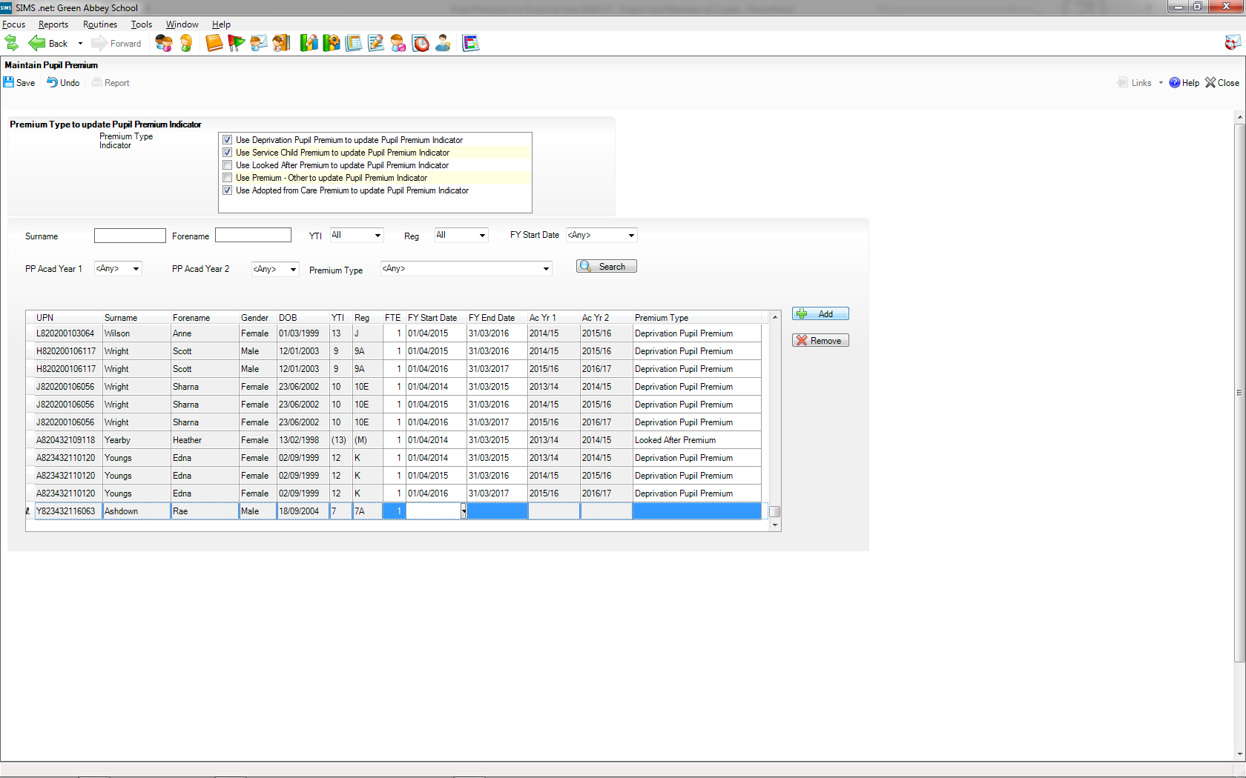

Slide 44
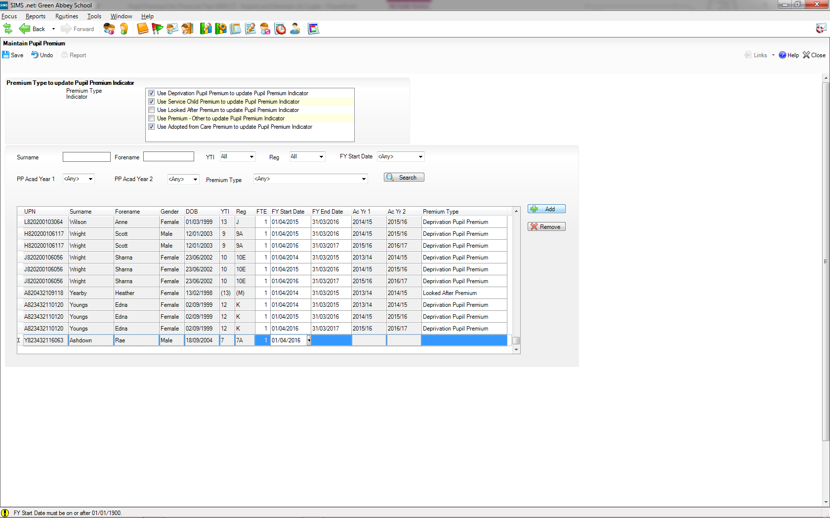

Slide 45
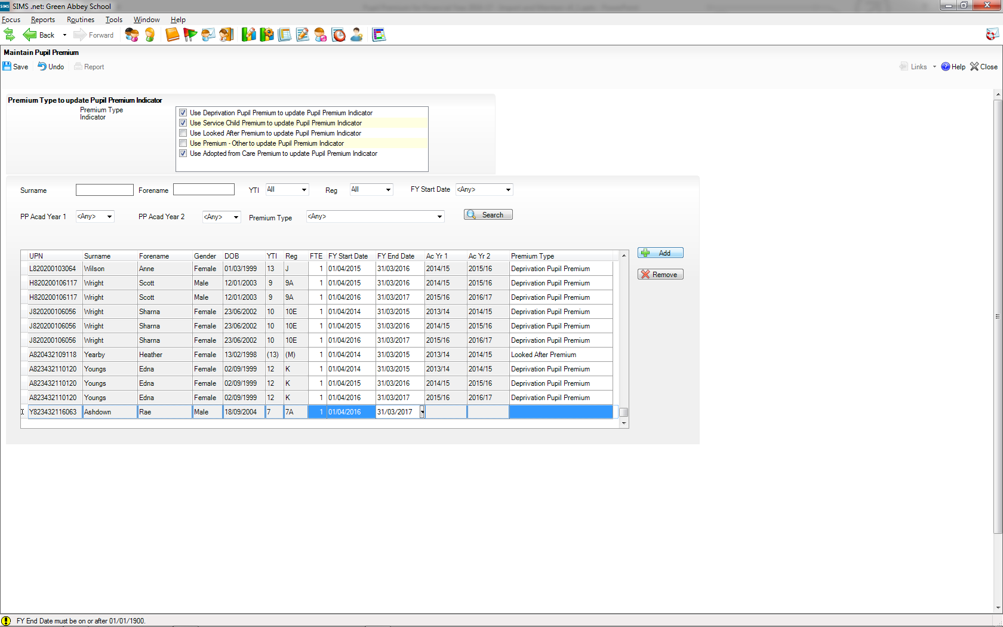

Slide 46
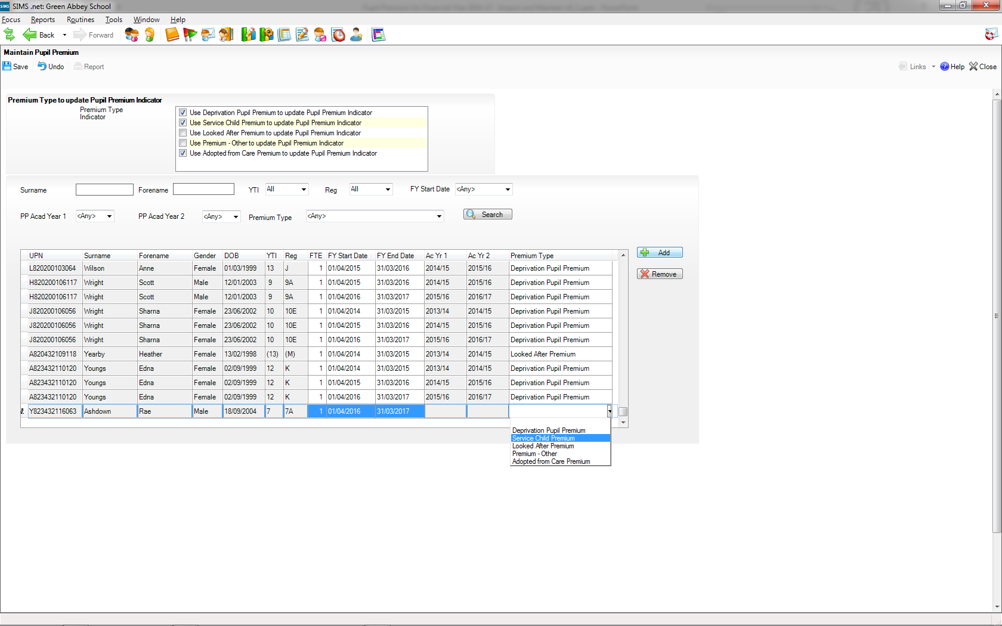

Slide 47
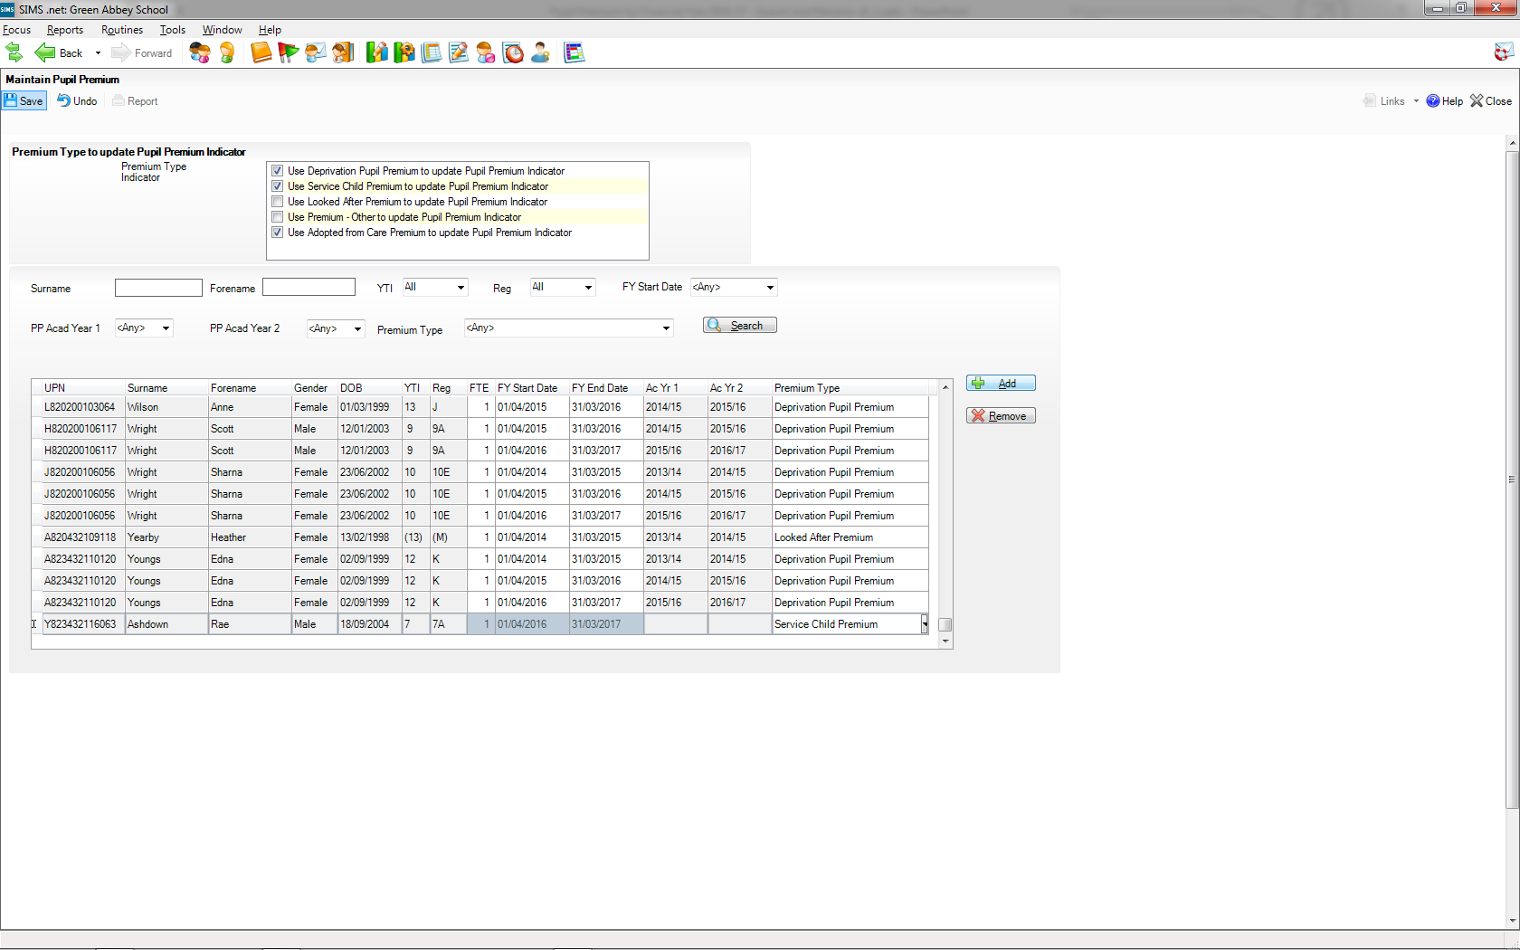
We don’t fill in the Academic Years, as the application will use the Financial Year start and end dates to calculate this for us when we save.

Slide 48
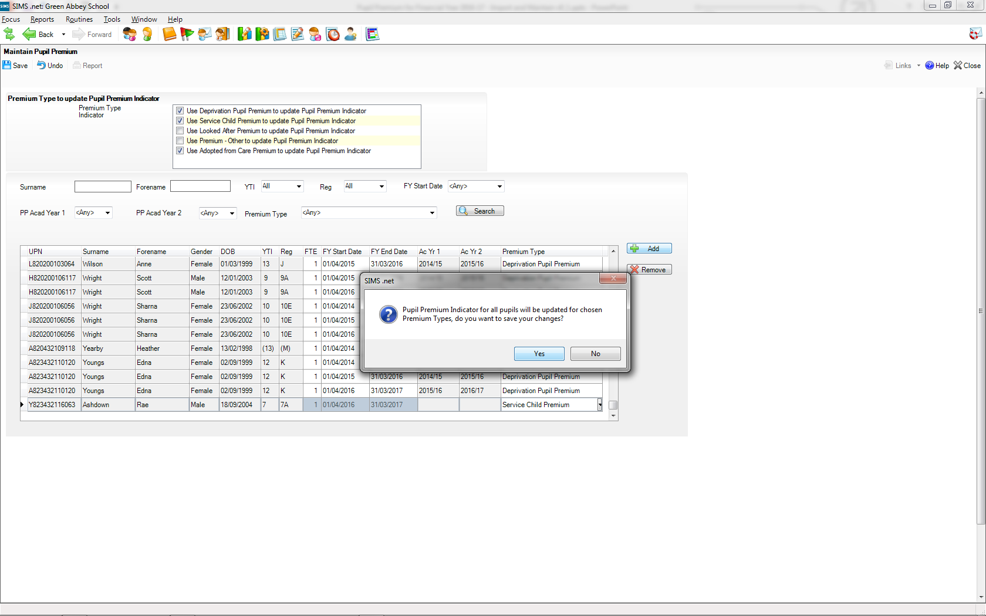

Slide 49
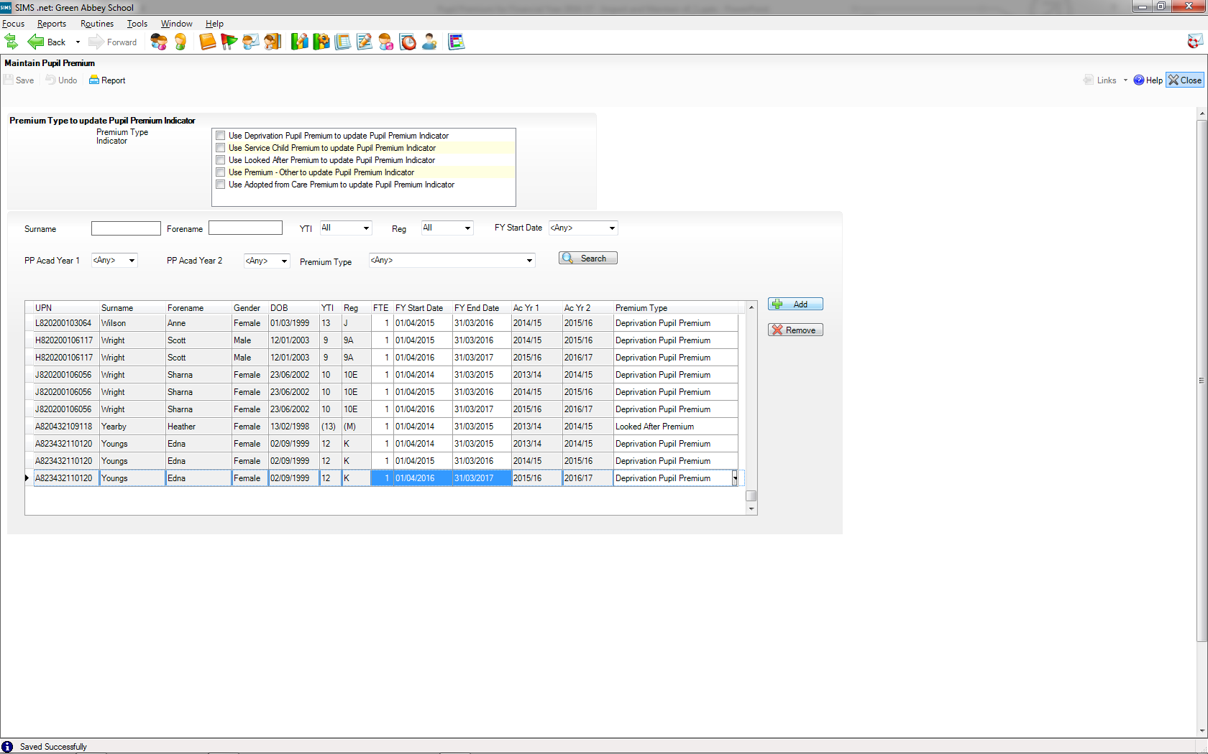

Slide 50


Thank you for your time

