Slide 1
School Workforce Census 2016 Overview of Changes
Version 1.1

Slide 2
Spot Allowances
Spot Allowances

Slide 3
Spot Allowances
Non Consolidated Payments
This became important last year when many staff on the NJC Service Term were given non consolidated payments instead of a “consolidated” pay rise.
Many schools entered this information into SIMS as Spot Allowances

Slide 4
Spot Allowances
Non Consolidated Payments
The two main methods for entering such Spot Allowances are as follows
Enter the Allowance Award in the Service Term as zero so the Actual Amount can be entered directly into the Spot Allowance for the Contract
Enter the Allowance Award in the Service as twelve times the Actual Amount for the month of the allowance, so that the application calculates the actual amount via pro-rata and pay factor; pay factor is helpful for part-time staff.

Slide 5
Spot Allowances in Autumn Release 2015
Spot Allowances in Autumn Release 2015 and Earlier

Slide 6
Spot Allowances Autumn Release 2015
Methods Used
Prior to the Spring Release 2016 there where two main methods used for indicated a spot allowance
For convenience, we will refer to these methods as Method 1 and Method 2

Slide 7
Spot Allowances Autumn Release 2015
Method 1
We set up the allowance in the relevant Service Term

Slide 8
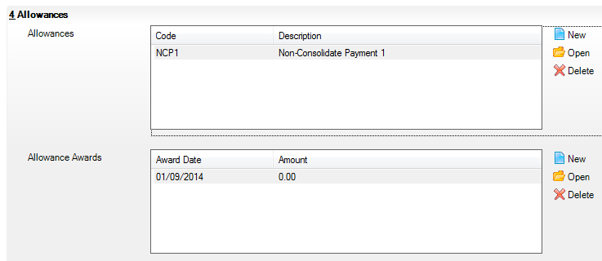
Spot Allowances Autumn Release 2015
Method 1
For this method we set the amount to 0 so it can be input directly for the workforce member’s contract

Slide 9
Spot Allowances Autumn Release 2015
Method 1

Slide 10
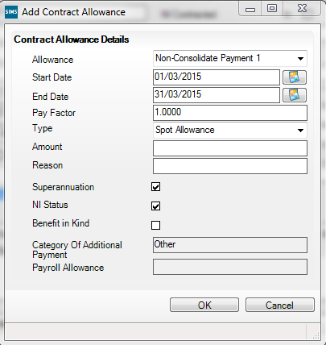
Spot Allowances Autumn Release 2015
Method 1
The start and end dates are entered to indicate a particular month

Slide 11
Spot Allowances Autumn Release 2015
Method 1
The amount is shown as 0 ready to be filled in by the user

Slide 12
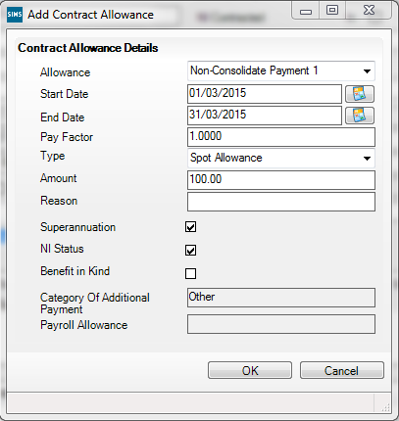
Spot Allowances Autumn Release 2015
Method 1
The amount is entered as the actual amount for the month

Slide 13
Spot Allowances Autumn Release 2015
Method 2
For this method we set the amount to the annualised amount, i.e. twelve times what we intend for amount for the month

Slide 14
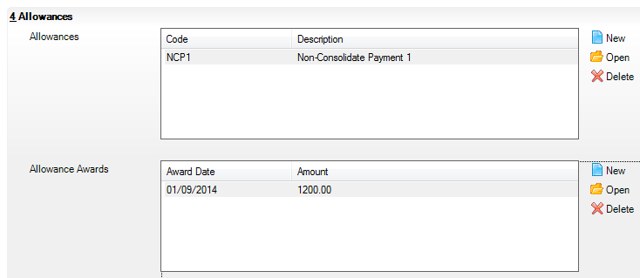
Spot Allowances Autumn Release 2015
Method 2
We have set this to £1200 so the allowance for the month is £100

Slide 15
Spot Allowances Autumn Release 2015
Method 2

Slide 16
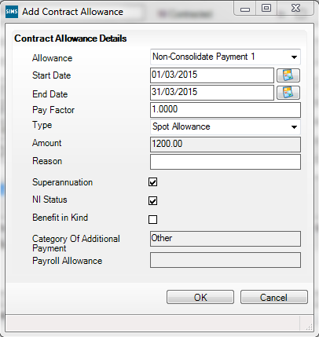
Spot Allowances Autumn Release 2015
Method 2
The annual amount is shown, but this will be interpreted as £100 for the month; this is a bit confusing

Slide 17
Spot Allowances in Spring Release 2016
Spot Allowances in Spring Release 2016

Slide 18
Spot Allowances Spring Release 2016
Employment Parameters

Slide 19
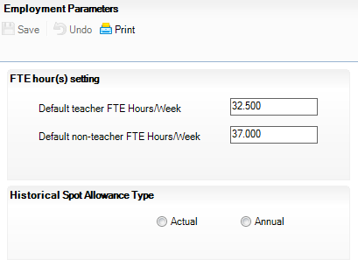
Spot Allowances Spring Release 2016
Employment Parameters
FTE hour(s) setting
These two default parameters have been available for many years and are used by the Cover application

Slide 20
Spot Allowances Spring Release 2016
Employment Parameters
Historical Spot Allowance Type
This parameter has been introduced in the Spring Release 2016 for the first time and is used for displaying Spot Allowances in the new format when they have been created in the old format
Once the user selects one of the choices they operate as “radio buttons” and allow users to change between the two methods of interpretation the historical data

Slide 21
Spot Allowances Spring Release 2016
Employment Parameters
Historical Spot Allowance Type
We will see that selecting:-
Actual is in line with Method 1 above
Annual is in line with Method 2 above

Slide 22
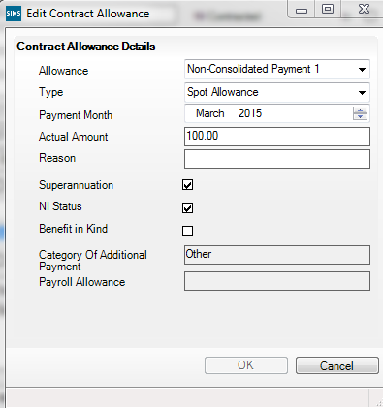
Spot Allowances Spring Release 2016
Employment Parameters
Selecting Actual
You would select this for method 1 above

Slide 23
Spot Allowances Spring Release 2016
Employment Parameters
Selecting Annual
You would select this for method 2 above

Slide 24
Spot Allowances Spring Release 2016
Entering a new Spot Allowance
Method 1 has improved by forcing payment in one month and the use of the label Actual Amount

Slide 25
Spot Allowances Spring Release 2016
Entering a new Spot Allowance
Method 2 has improved even more by forcing payment in one month and the use of the label Actual Amount

Slide 26
Spot Allowances in Summer Release 2016
Spot Allowances in Summer Release 2016

Slide 27
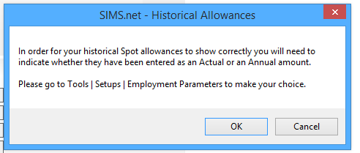
Spot Allowances Summer Release 2016
SWC Create & Validate

Slide 28
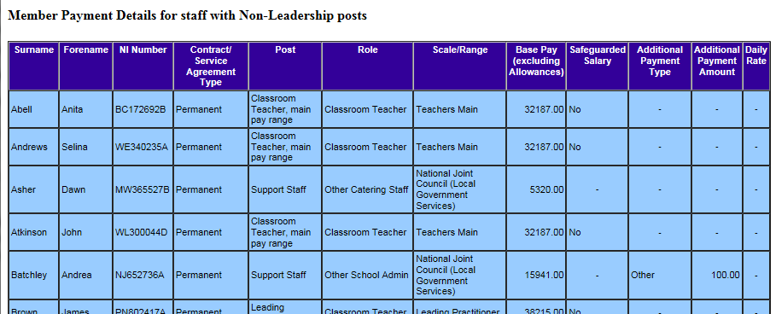
Spot Allowances Summer Release 2016
SWC Detail Report

Slide 29
Absence Type Summer Release 2016
Absence Type Summer Release 2016

Slide 30
Absence Type Summer Release 2016
Lookups

Slide 31
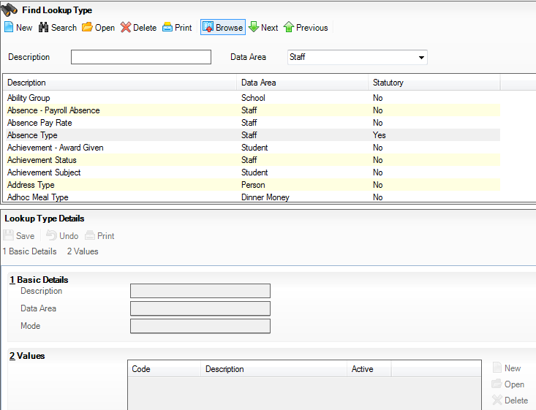
Absence Type Summer Release 2016
Lookups

Slide 32
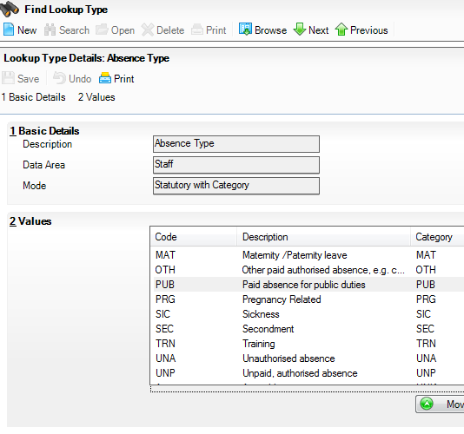
Absence Type Summer Release 2016
Lookups
“PRG - Pregnancy Related” has been added
This is not the same as “MAT - Maternity/Paternity Leave” and can be used for such absences as morning sickness

Slide 33
Absence Type Summer Release 2016
Staff Details

Slide 34
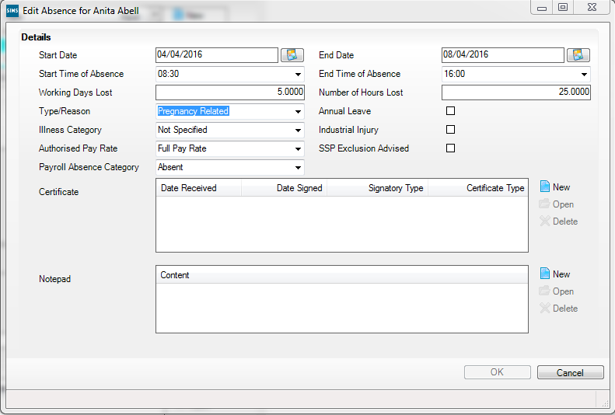
Absence Type Summer Release 2016
Staff Details

Slide 35
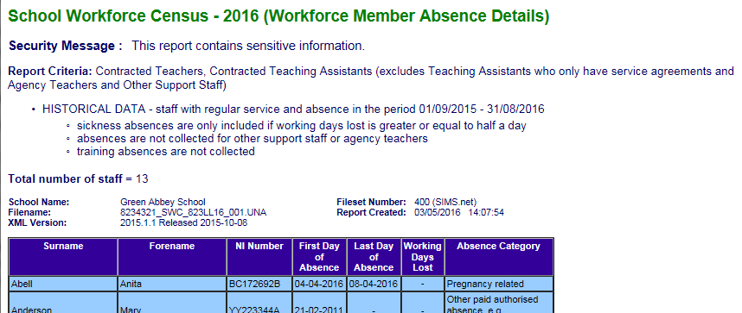
Absence Type Summer Release 2016
SWC Detail Report

Slide 36
Pay Details Panel in SWC 2016
Pay Details Panel in SWC

Slide 37
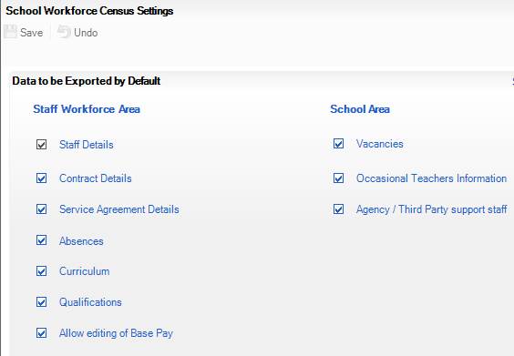
Pay Details Panel in SWC 2016
School Workforce Census Settings
By default Allow editing of Base Pay is not ticked
If it is ticked SWC will display the Pay Details and will allow the totals to be adjusted, but in most cases it will be better to correct the data the total has been derived from

Slide 38
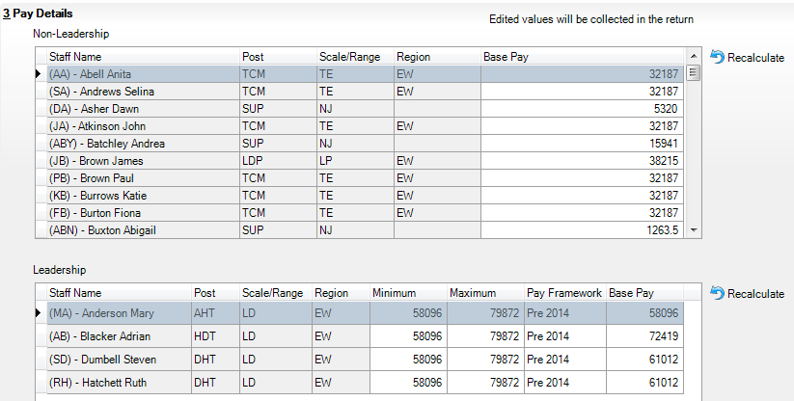
Pay Details Panel in SWC 2016
School Workforce Census 2016
Where Pay Details panel is displayed the non-greyed out items can be edited, but we suggest that such editing only takes place where absolutely necessary

Slide 39
Pay Details Panel in SWC 2016
School Workforce Census 2016
For the 2015 Return the DfE specified that the Pay Framework code must be “Pre2014” but for this return they specified “Pre 2014”, which is in line with CBDS

Slide 40
School Workforce Census 2016
School Workforce Census 2016

Slide 41
School Workforce Census 2016
DfE specification changes
Dates
Census Date
First Thursday of November as usual

Slide 42
School Workforce Census 2016
DfE specification changes
Dates
Absences
Between the DfEs notional start and end of the previous Academic Year (inclusive)

Slide 43
School Workforce Census 2016
DfE specification changes
Dates
Continuous Contracts
Between the DfEs notional start of the previous Academic Year and Census Day (inclusive)

Slide 44
School Workforce Census 2016
DfE specification changes
Vacancy information is now required for all teachers and not just qualified teachers; this has made no difference to the user interface as we have always left it up to the user to decide which vacancies to include

Slide 45
School Workforce Census 2016
DfE specification changes
Codeset of absence categories extended to identify pregnancy related absences

Slide 46
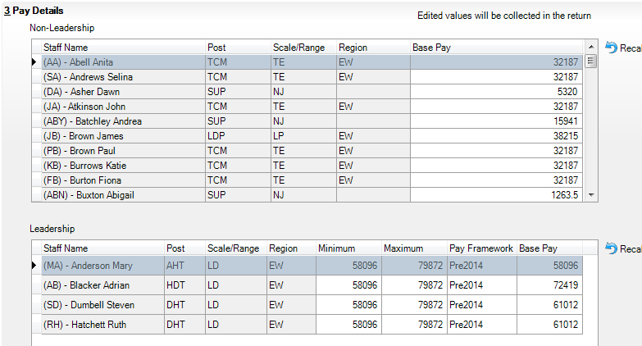
School Workforce Census 2016
DfE specification changes
Regional Pay Range no longer collected

Slide 47
School Workforce Census 2016
DfE specification changes
Validation removed
Rule number | Error/Query Messages | Amendment notes
4510 | Regional Pay Range is invalid | Rule removed for 2016
4511Q | Please Check: Regional Pay Range of ‘Inner London’ is inappropriate for this Local Authority. | Rule removed for 2016
4512Q | Please Check: Regional Pay Range of ‘Outer London’ is inappropriate for this Local Authority. | Rule removed for 2016
4513Q | Please Check: Regional Pay Range of ‘London Fringe’ is inappropriate for this Local Authority. | Rule removed for 2016

Slide 48
School Workforce Census 2016
DfE specification changes
Validation changed from Error to Query
Rule number | Error/Query Messages | Amendment notes
4238Q | HLTA Status is missing for a Teaching Assistant | Changed from an error to a query for 2016. Also looks for role = TASS
4480Q | The Pay Range supplied is not valid for a support staff or teaching assistant Post | Changed from an error to a query for 2016
4725Q | Role of TASS (Teaching Assistant) or HLTA (Higher Level Teaching Assistant) should normally be linked to post of TAS (Teaching Assistant) | Changed from an error to a query for 2016

Slide 49
School Workforce Census 2016
DfE specification changes
Validation updated
Rule number | Error/Query Messages | Amendment notes
4920 | First Day of absence must be in the previous academic year (01/09/2015 to 01/08/2016) | Wording of error message changed for greater clarity.
4521Q | Please supply the Framework under which this leadership teacher is being paid, ie ‘Pre 2014’ framework or ‘2014’ framework | Coding changed for 2016
4523Q | Please supply the Pay Range Minimum for this leadership teacher. | Coding changed for 2016
4524Q | Please supply the Pay Range Maximum for this leadership teacher. | Coding changed for 2016
4545Q | Staff member appears to be paid less than the minimum wage for apprentices, please check. | Updated in line with changes in National Minimum Wage rate, see https://www.gov.uk/national-minimum-wage-rates
4565Q | Staff member appears to be paid more than the maximum of the local government pay scale, please check. | Maximum updated to £47,000
4746Q | The open contract for this member of staff is for less than 0.5 hours per week. Please check, if this is a zero hours contract it should be removed from the return. | Changed to check individual contracts
5960Q | Please check - more than one absence record with absence category of sickness or pregnancy related absence covering the same date(s) | Message and coding changed to take account of the new “PRG - Pregnancy related absence”
6540Q | At least one staff record in this school’s return should show a role of Head Teacher or Executive Head Teacher. | A check for an open contract has been added to this rule

Slide 50
School Workforce Census 2016
DfE specification changes
Validation added
Rule number | Error/Query Messages | Amendment notes
4722Q | Post appears to be inconsistent with Role Identifier | New Rule, checking compatibility of post and role.
4723Q | Post appears to be inconsistent with Role Identifier | New Rule, checking compatibility of post and role.
6550Q | At least one staff record in this school’s return should show a role of SENCO (SEN Co-ordinator). | New Rule, checking that there is a SEN Co Ordinator within the school.
7240Q | Please note that this return contains no vacancy records. Please ensure that this is correct. | New Rule, checking compatibility of post and role.

Slide 51
School Workforce Census 2016
DfE specification changes
Summary Report
The DfE have not yet provided the specification for their Summary Report, but we expect this to be very similar to the 2015 version apart from the yearly update to dates

Slide 52
Thank you for your time
Thank you for your time

