Slide 1
Version 2.0
CTF Import to Pre-Admission Group - Dealing with Contact Data Issues
Jim Haywood
Product Manager for Statutory Returns

Slide 2
Dealing with Contact Data Issues
Content
Using DbDiagnose EXE to create the spreadsheet
Using Database Diagnostics to create the spreadsheet
Using the spreadsheet for correcting the contact data

Slide 3
Dealing with Contact Data Issues
Using DbDiagnose EXE to create the spreadsheet
Back to Content

Slide 4
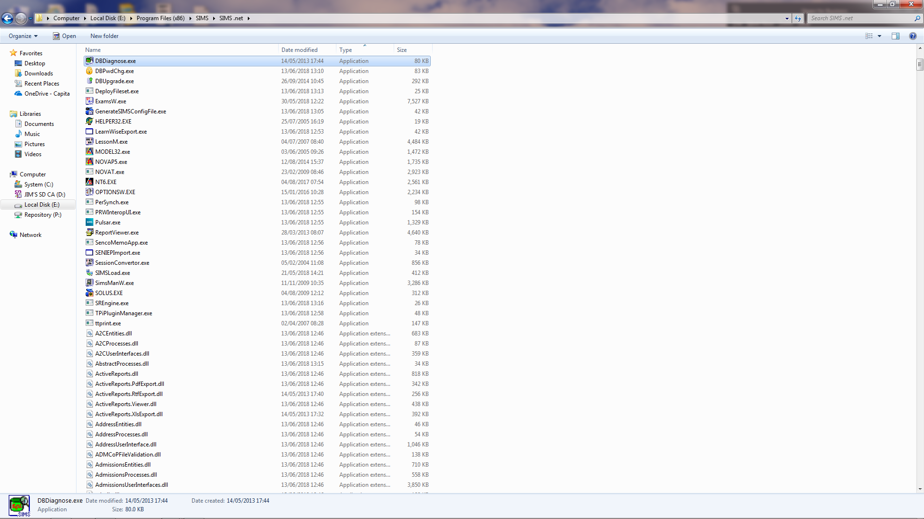
Dealing with Contact Data Issues
Navigate to your SIMS .NET folder and run the DBDiagnose executable

Slide 5
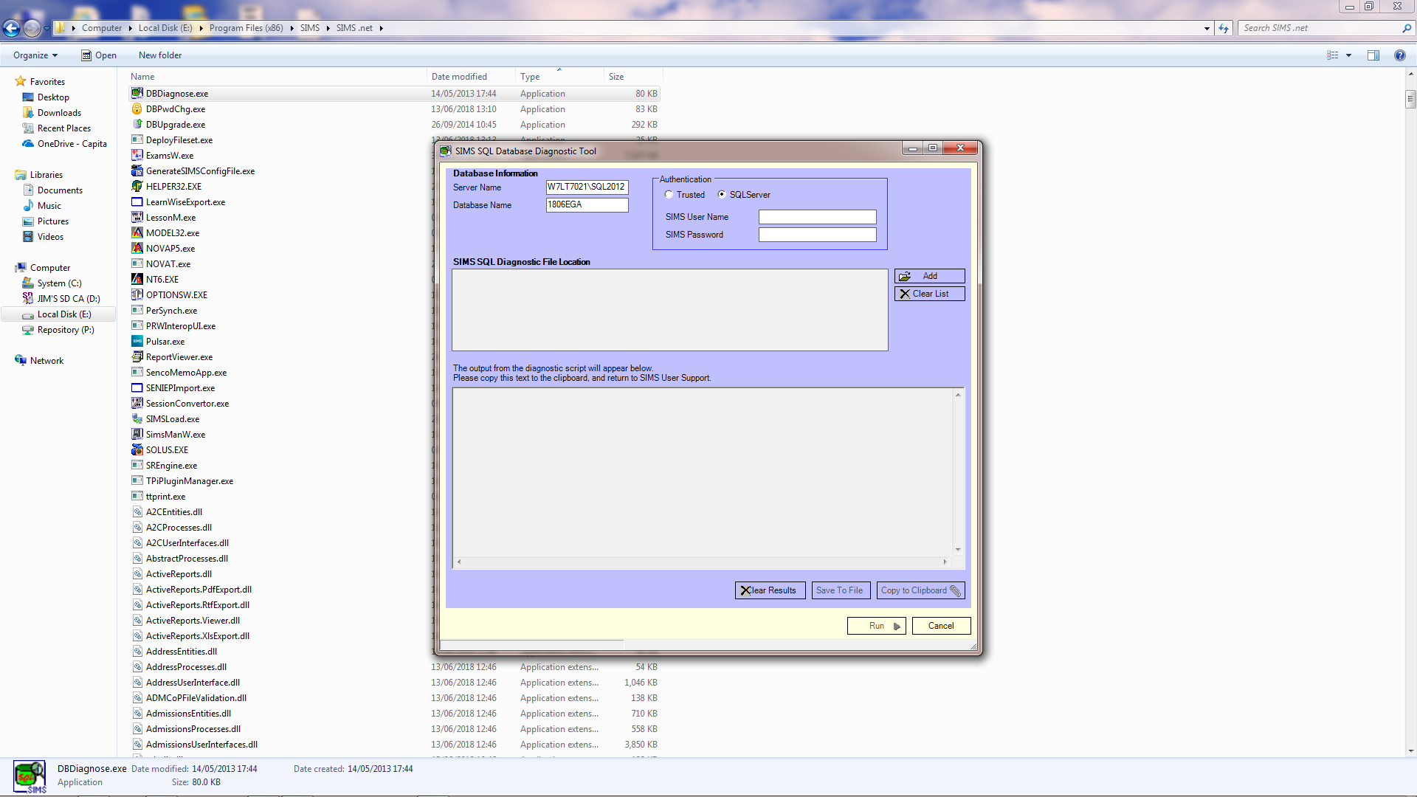
Dealing with Contact Data Issues
In most case the Server Name and Database Name will have defaulted to the correct settings, but they can be changed as necessary.

Slide 6
Dealing with Contact Data Issues
If you are using SQL Server authentication for you SIMS system you will need to enter your SIMS User Name and SIMS Password

Slide 7
Dealing with Contact Data Issues
If you are using SQL Server authentication for you SIMS system you will need to enter your SIMS User Name and SIMS Password

Slide 8
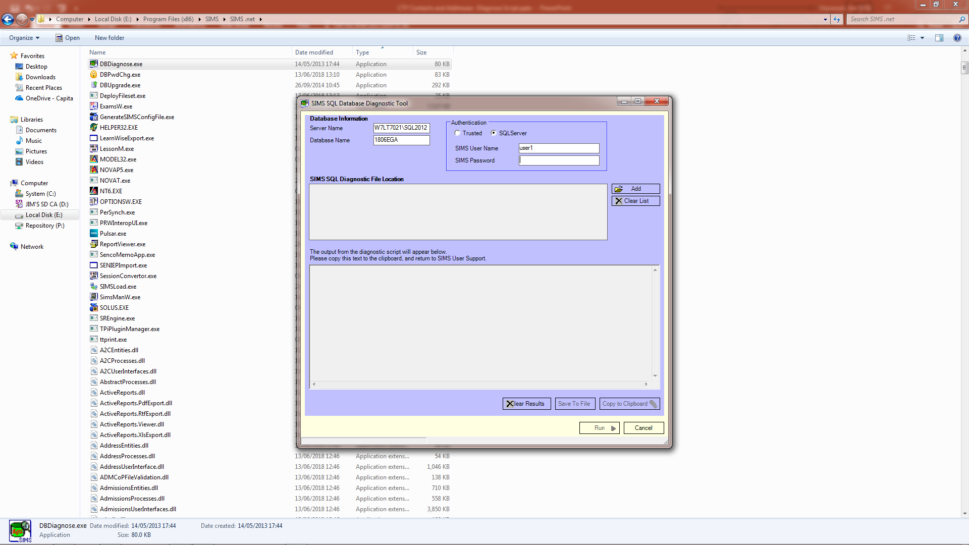
Dealing with Contact Data Issues
If you are using SQL Server authentication for you SIMS system you will need to enter your SIMS User Name and SIMS Password

Slide 9
Dealing with Contact Data Issues
Click on Add to open the Diagnose Script

Slide 10
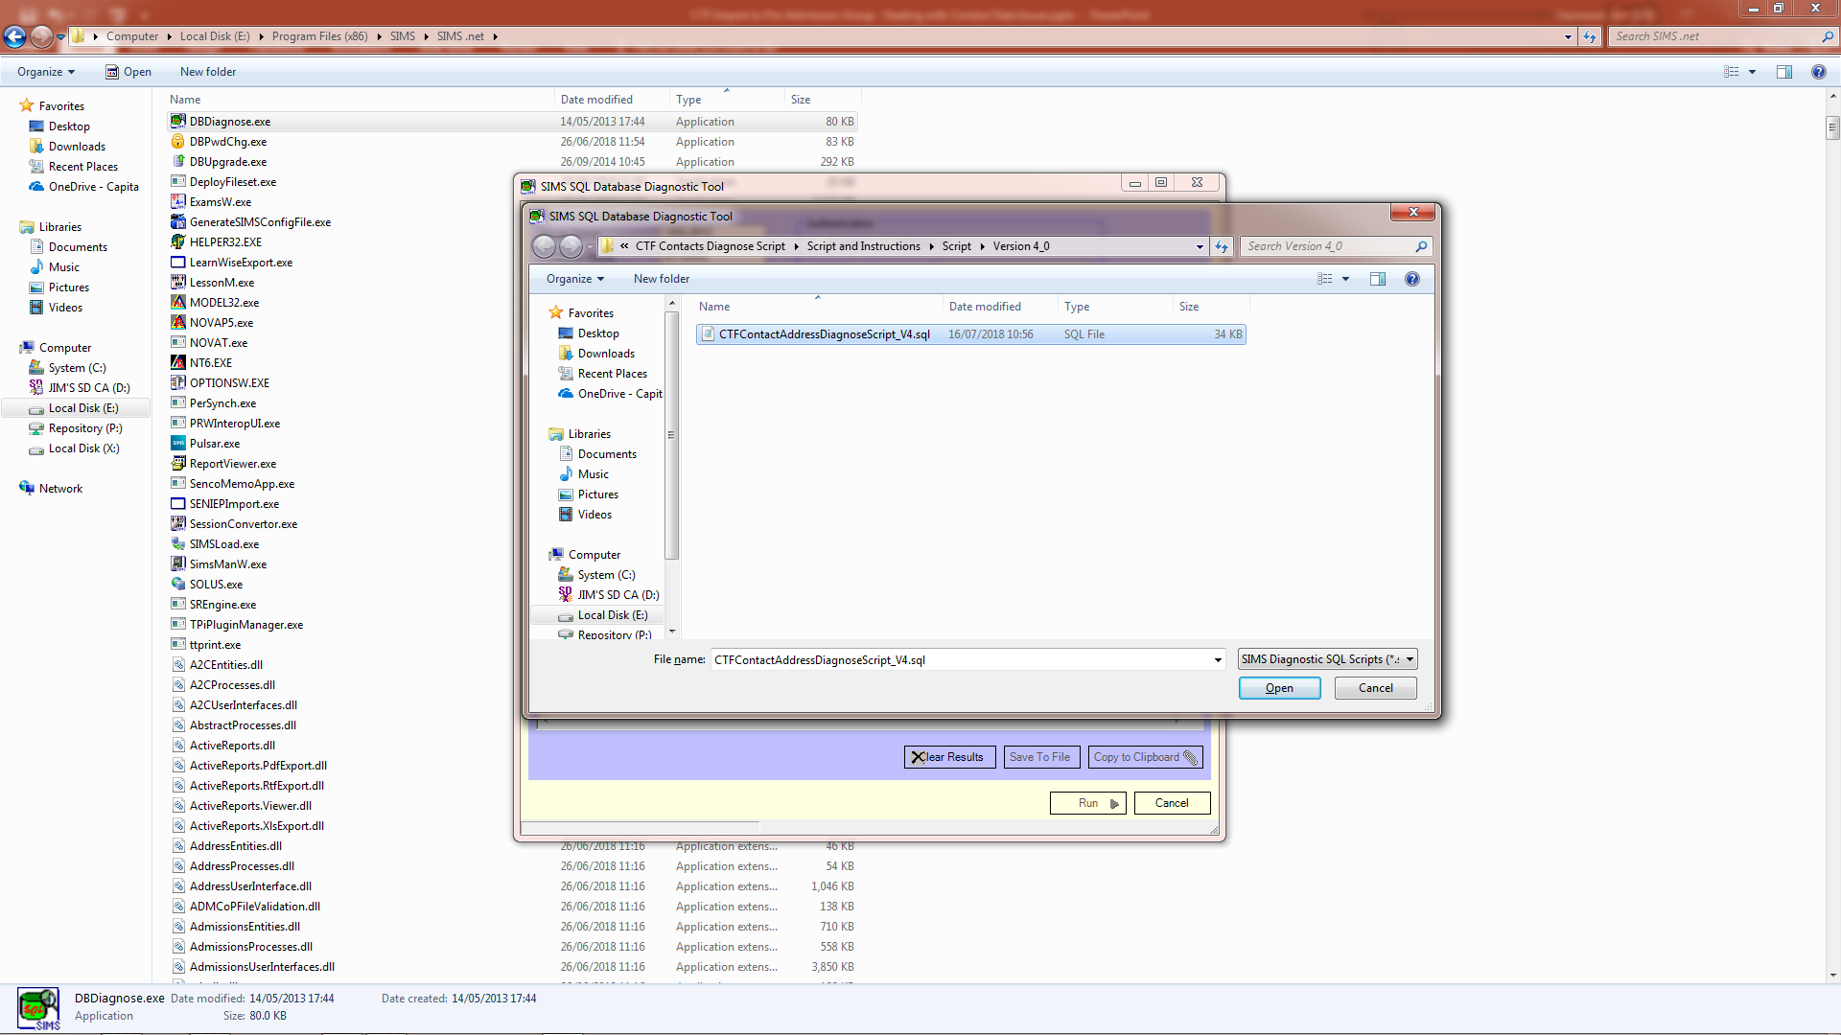
Dealing with Contact Data Issues
Navigate to the folder where you stored the script file and open that file

Slide 11
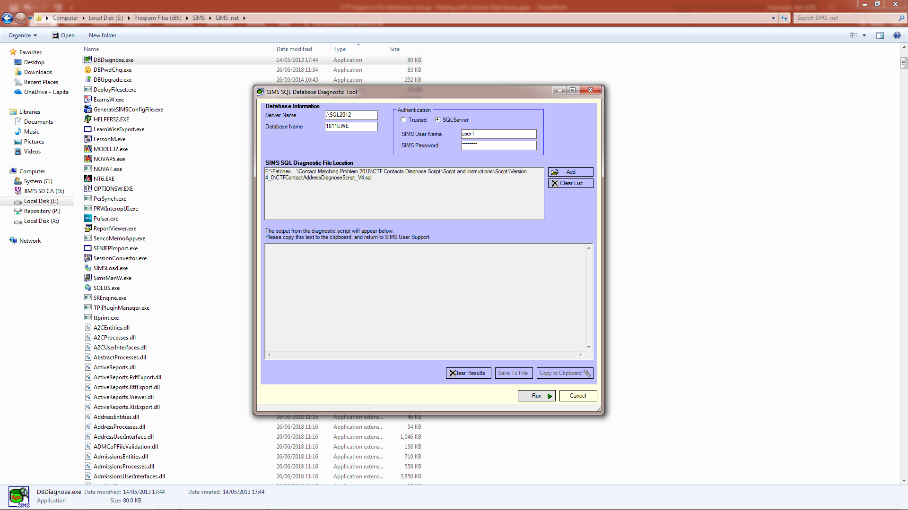
Dealing with Contact Data Issues
Click Run to run the script on your SIMS database

Slide 12
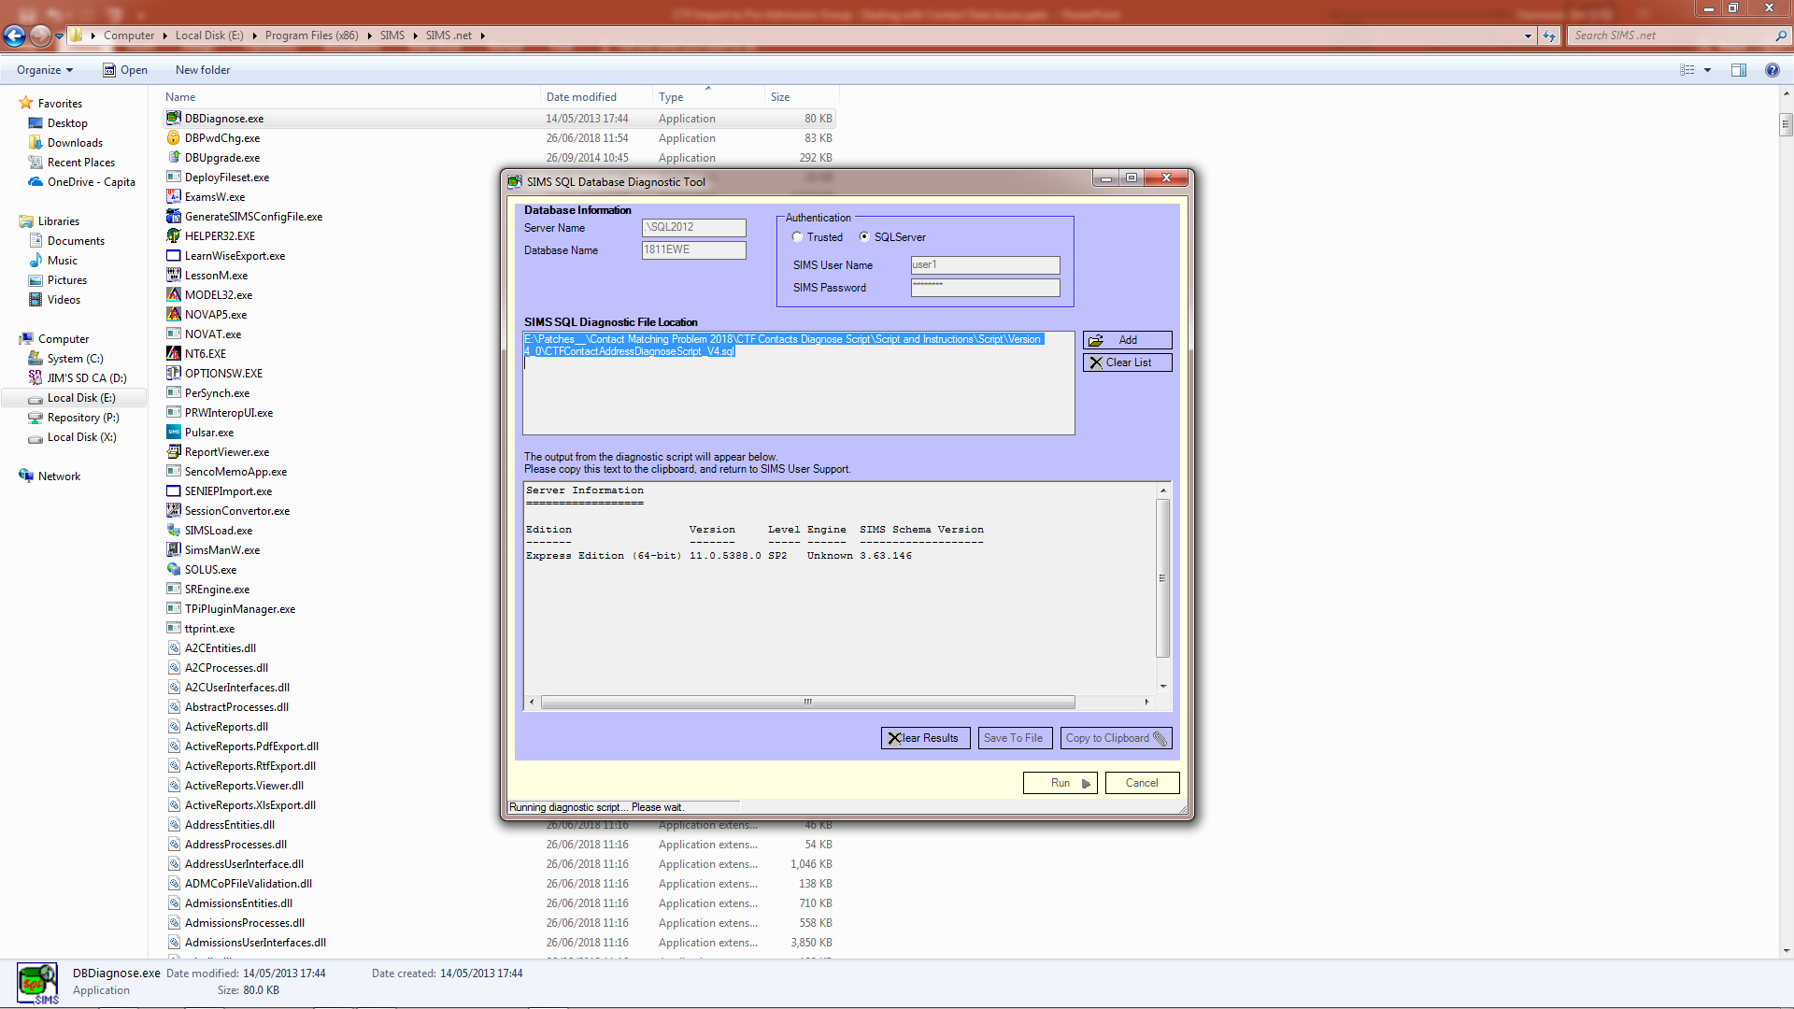
Dealing with Contact Data Issues
Depending on the size of you database, the running of the script could take some time.

Slide 13
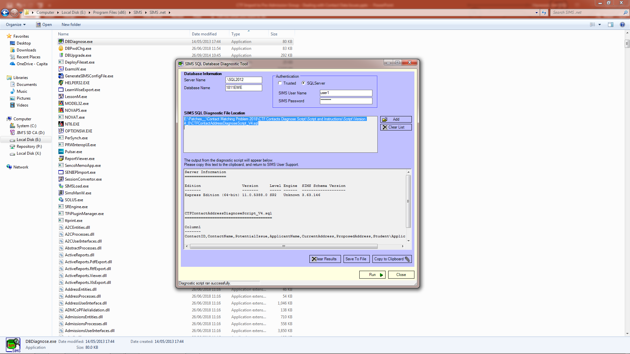
Dealing with Contact Data Issues
When the script has been successfly run, use Click and Shift-Click to select the tabular part of the output.

Slide 14
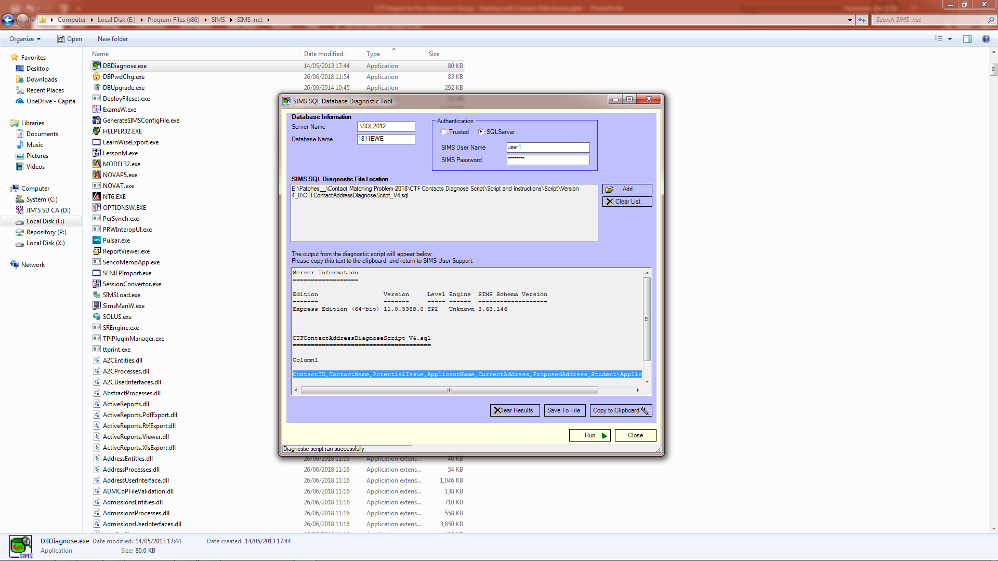
Dealing with Contact Data Issues
Use Ctrl-C to copy the selected text to the Clipboard

Slide 15
Dealing with Contact Data Issues
Open Notepad and use Ctrl-V to paste in the text you copied

Slide 16
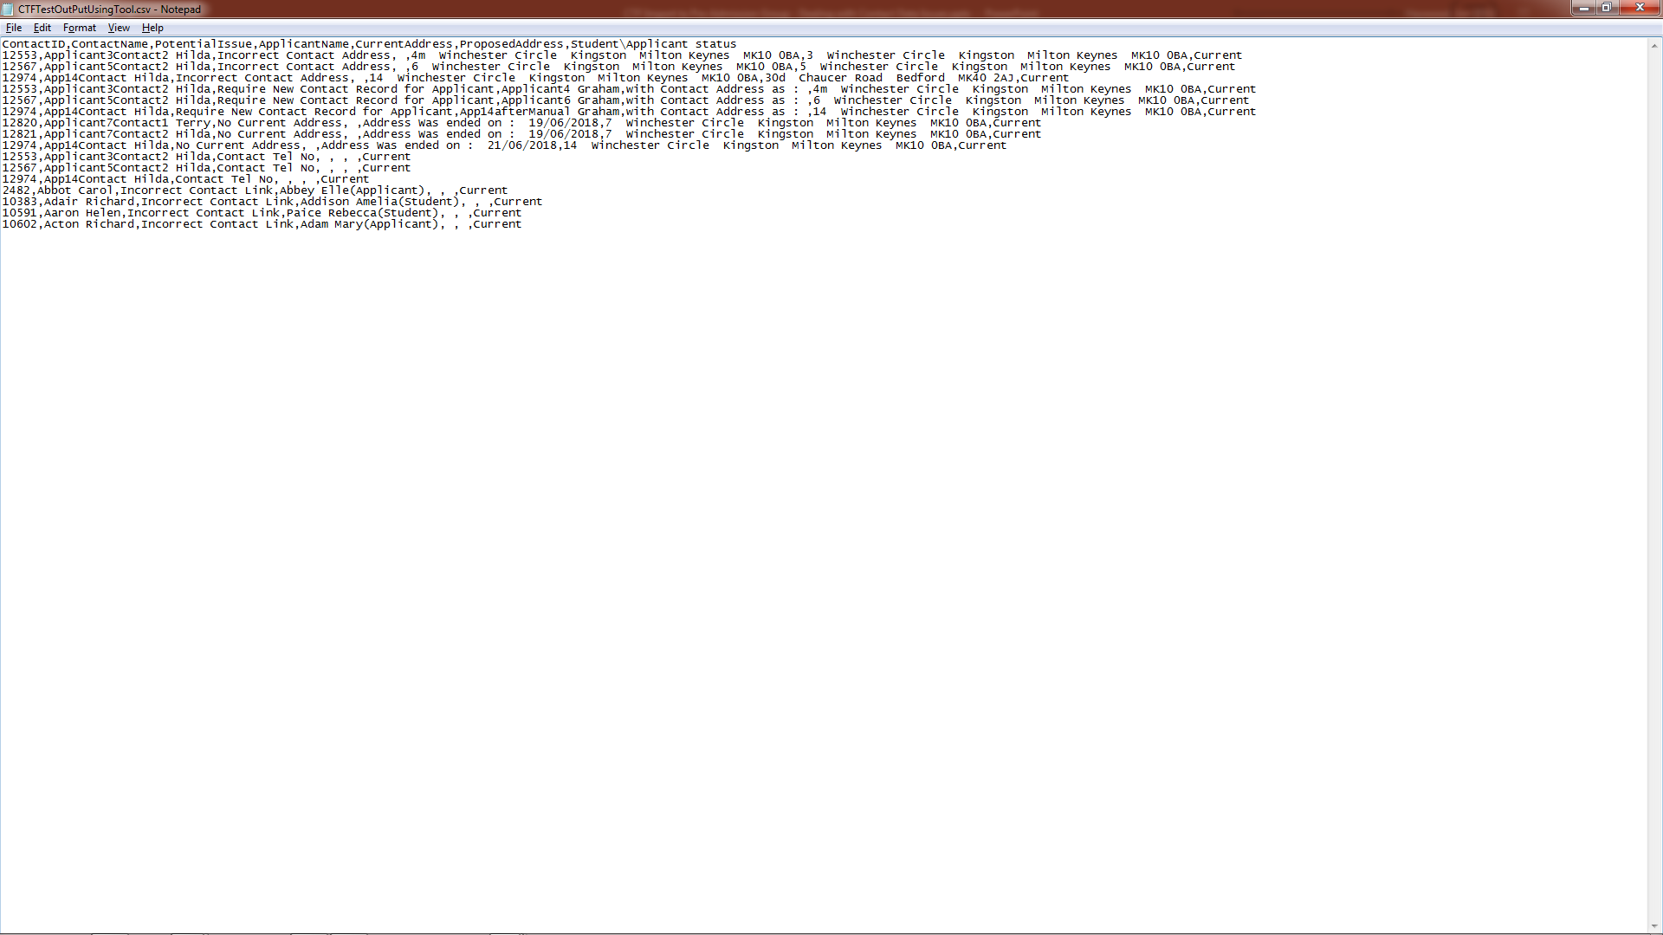
Dealing with Contact Data Issues
Save the file with a suitable name and with an extension of ‘.csv’

Slide 17
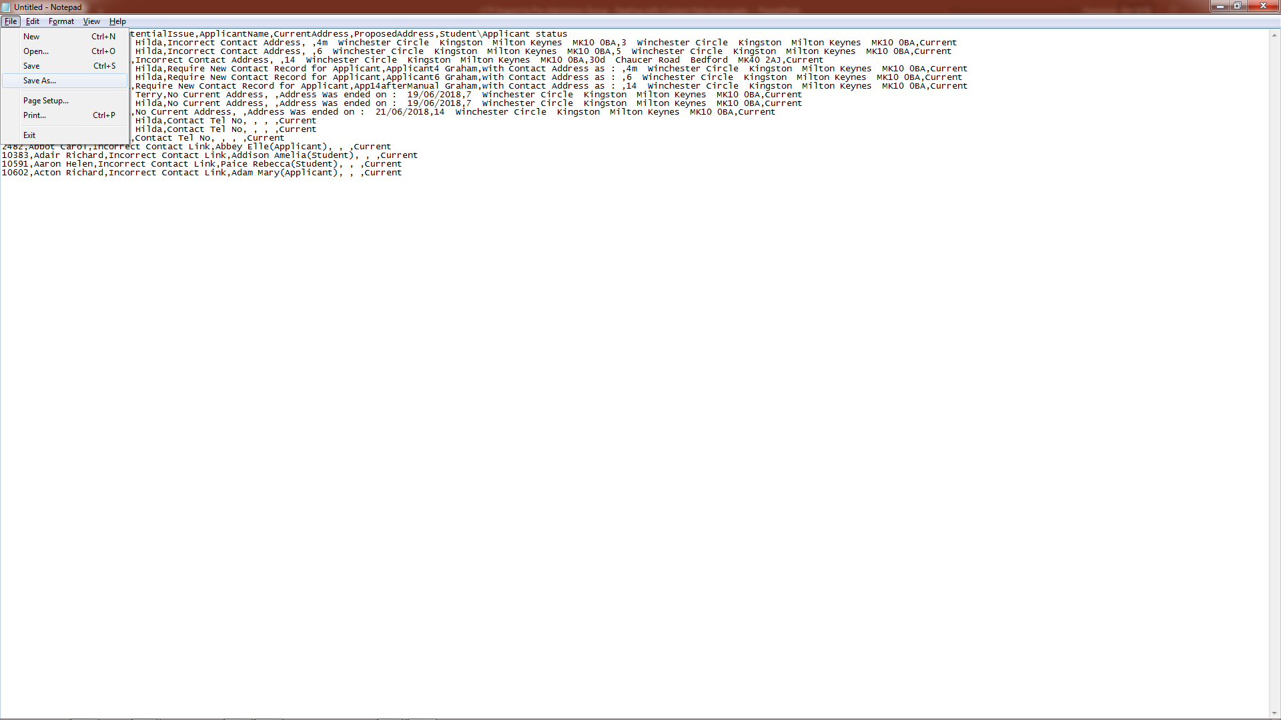
Dealing with Contact Data Issues
Save the file with a suitable name and with an extension of ‘.csv’

Slide 18
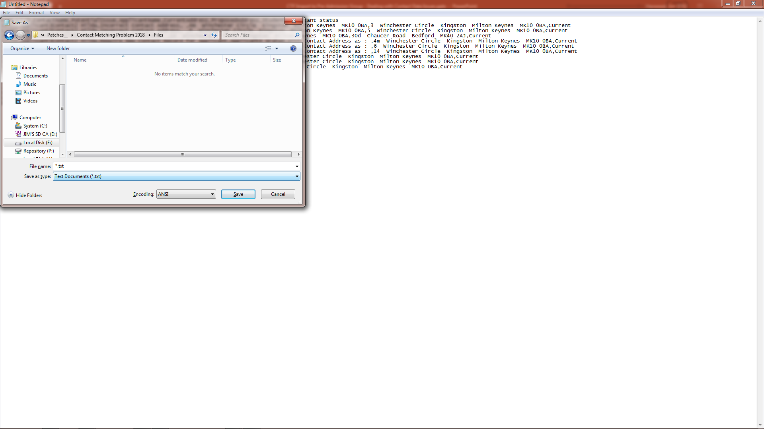
Dealing with Contact Data Issues
Save the file with a suitable name and with an extension of ‘.csv’

Slide 19
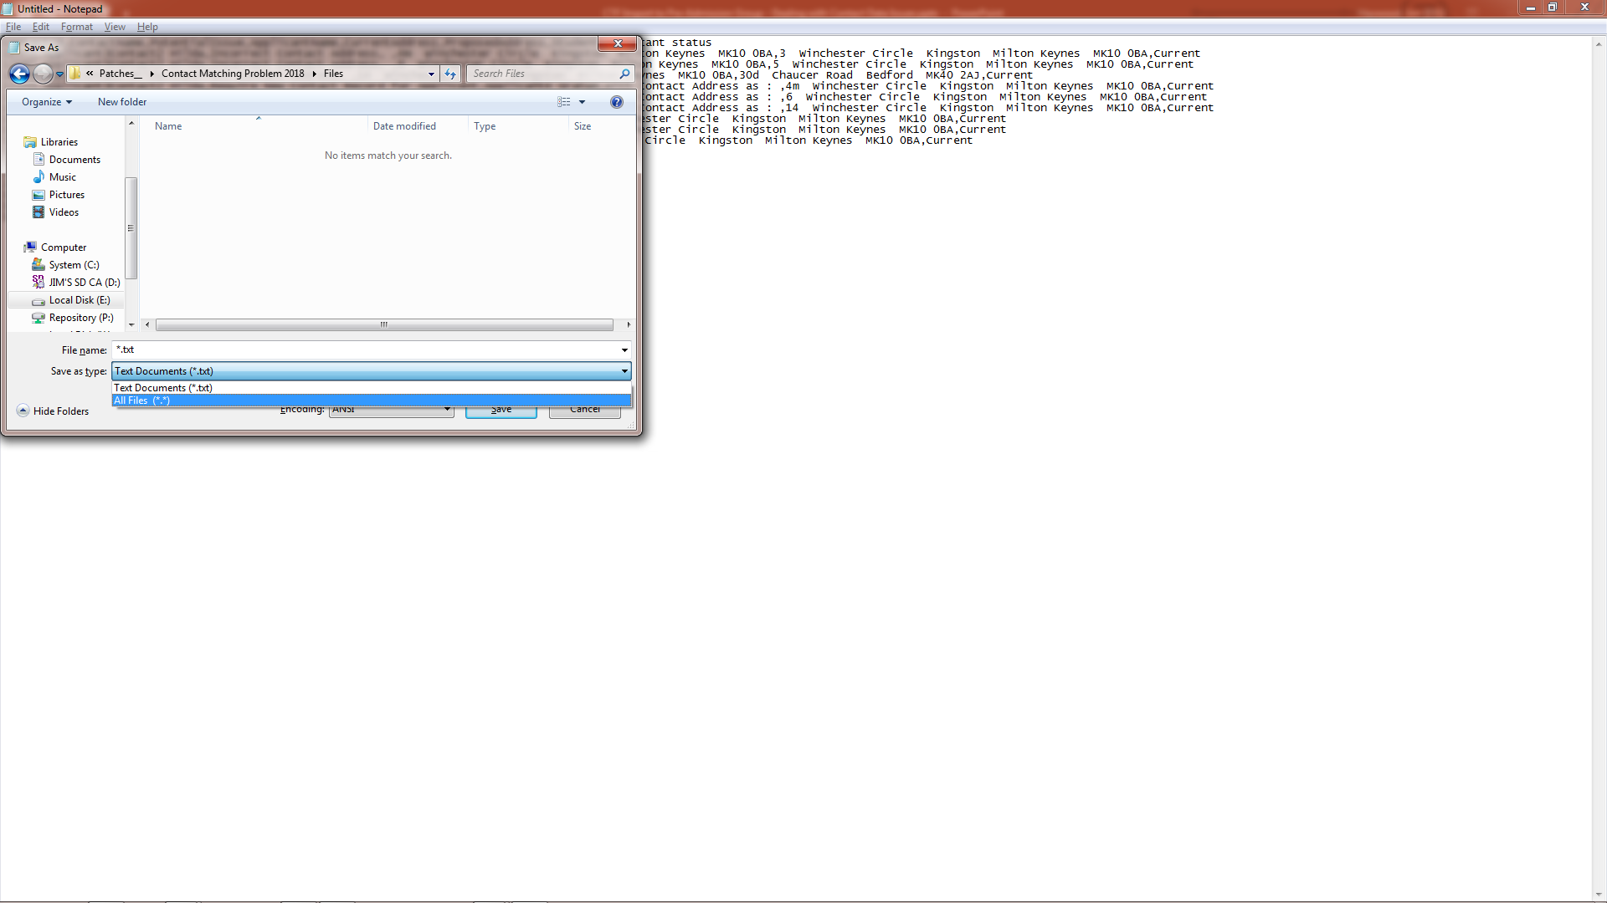
Dealing with Contact Data Issues
Save the file with a suitable name and with an extension of ‘.csv’

Slide 20
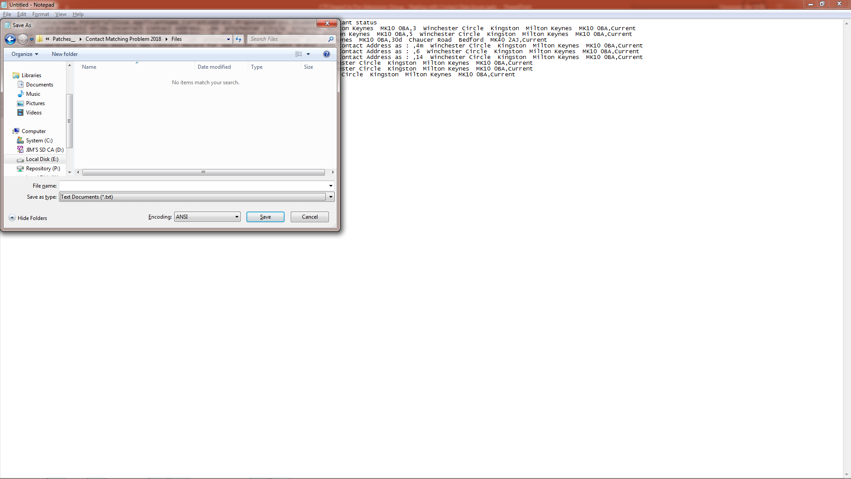
Dealing with Contact Data Issues
Save the file with a suitable name and with an extension of ‘.csv’

Slide 21
Dealing with Contact Data Issues
Save the file with a suitable name and with an extension of ‘.csv’

Slide 22
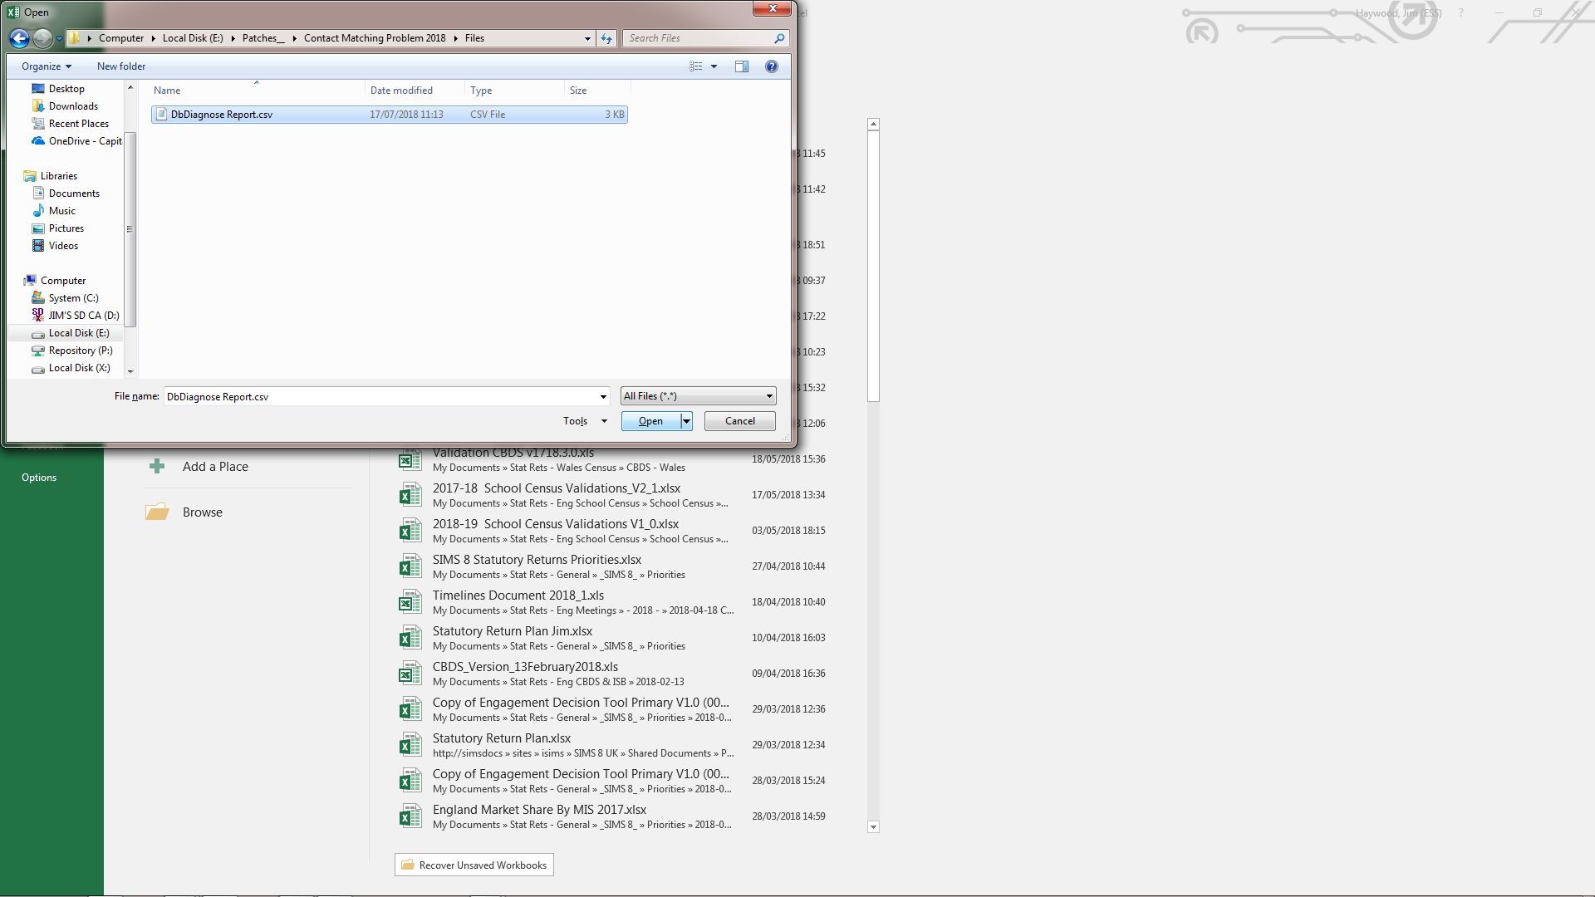
Dealing with Contact Data Issues
Open the CSV file in Microsoft Excel

Slide 23
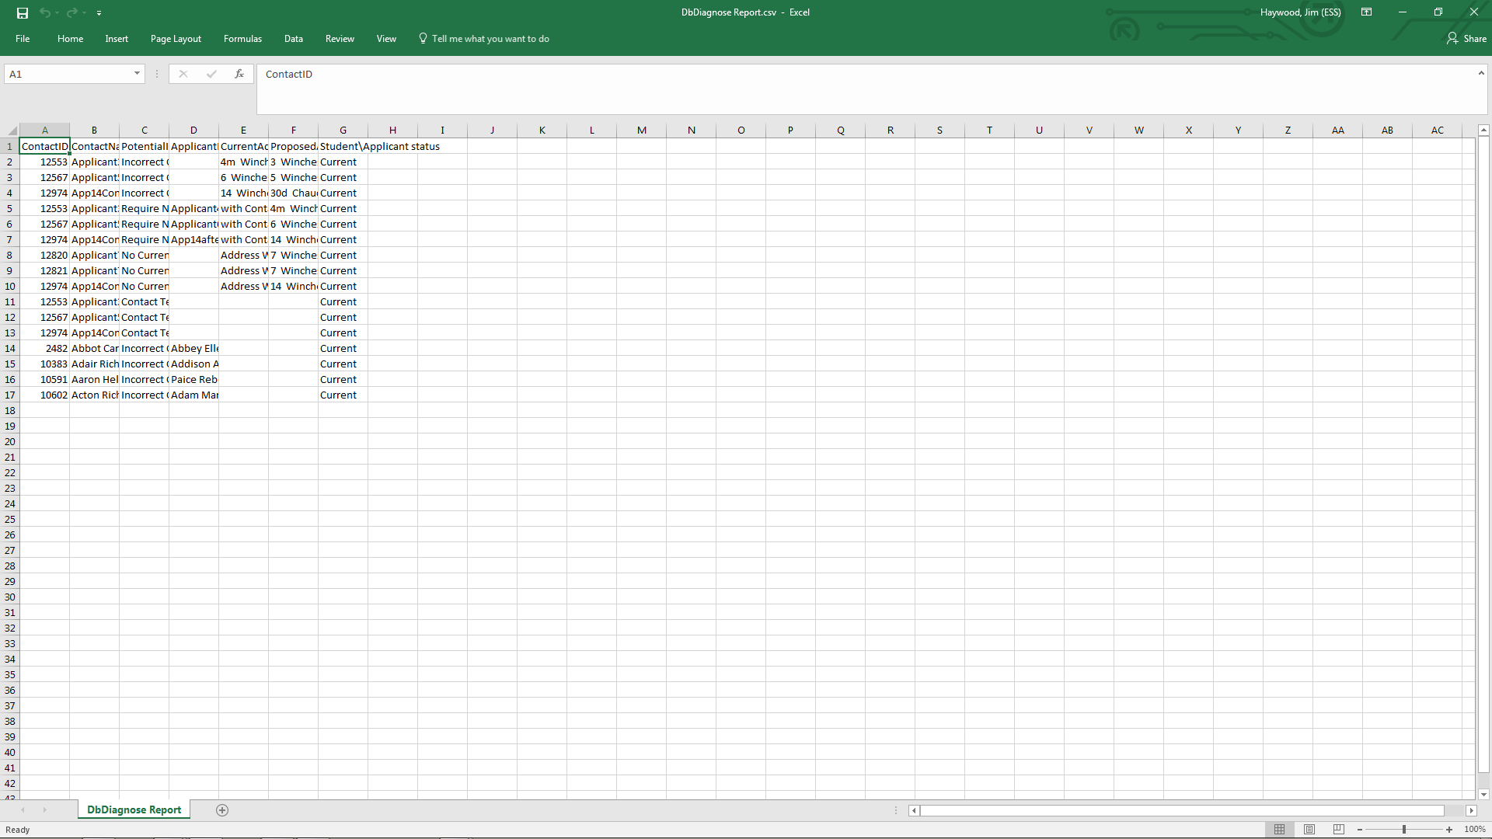
Dealing with Contact Data Issues
The next section illustrates how we can get to this same position using Database Diagnostics within SIMS .net

Slide 24
Dealing with the Contact Data Issues
Using Database Diagnostics to create the spreadsheet
Back to Content

Slide 25
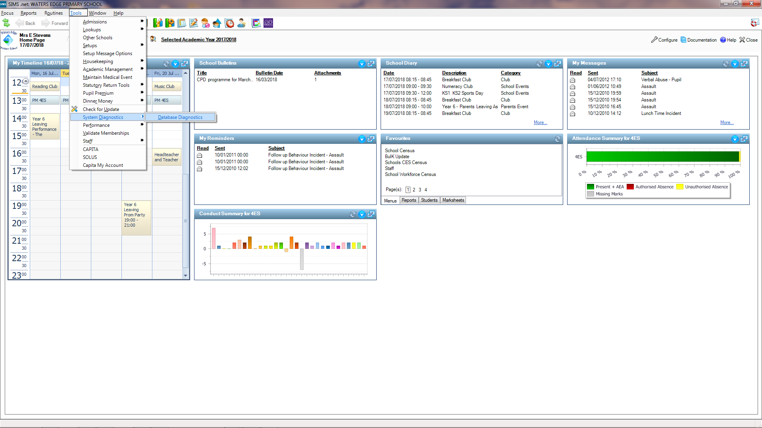
Dealing with Contact Data Issues
Providing that you have sufficient access permissions, you will be able to run
Tools | System Diagnostics | Database Diagnostics

Slide 26
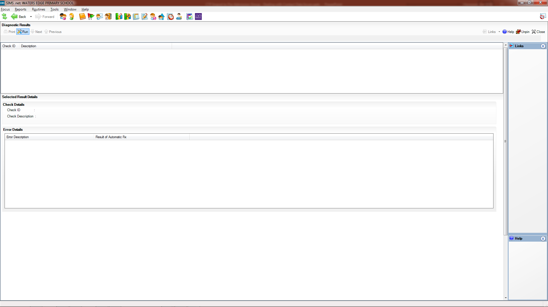
Dealing with Contact Data Issues
Click Run to start the diagnostic checking

Slide 27
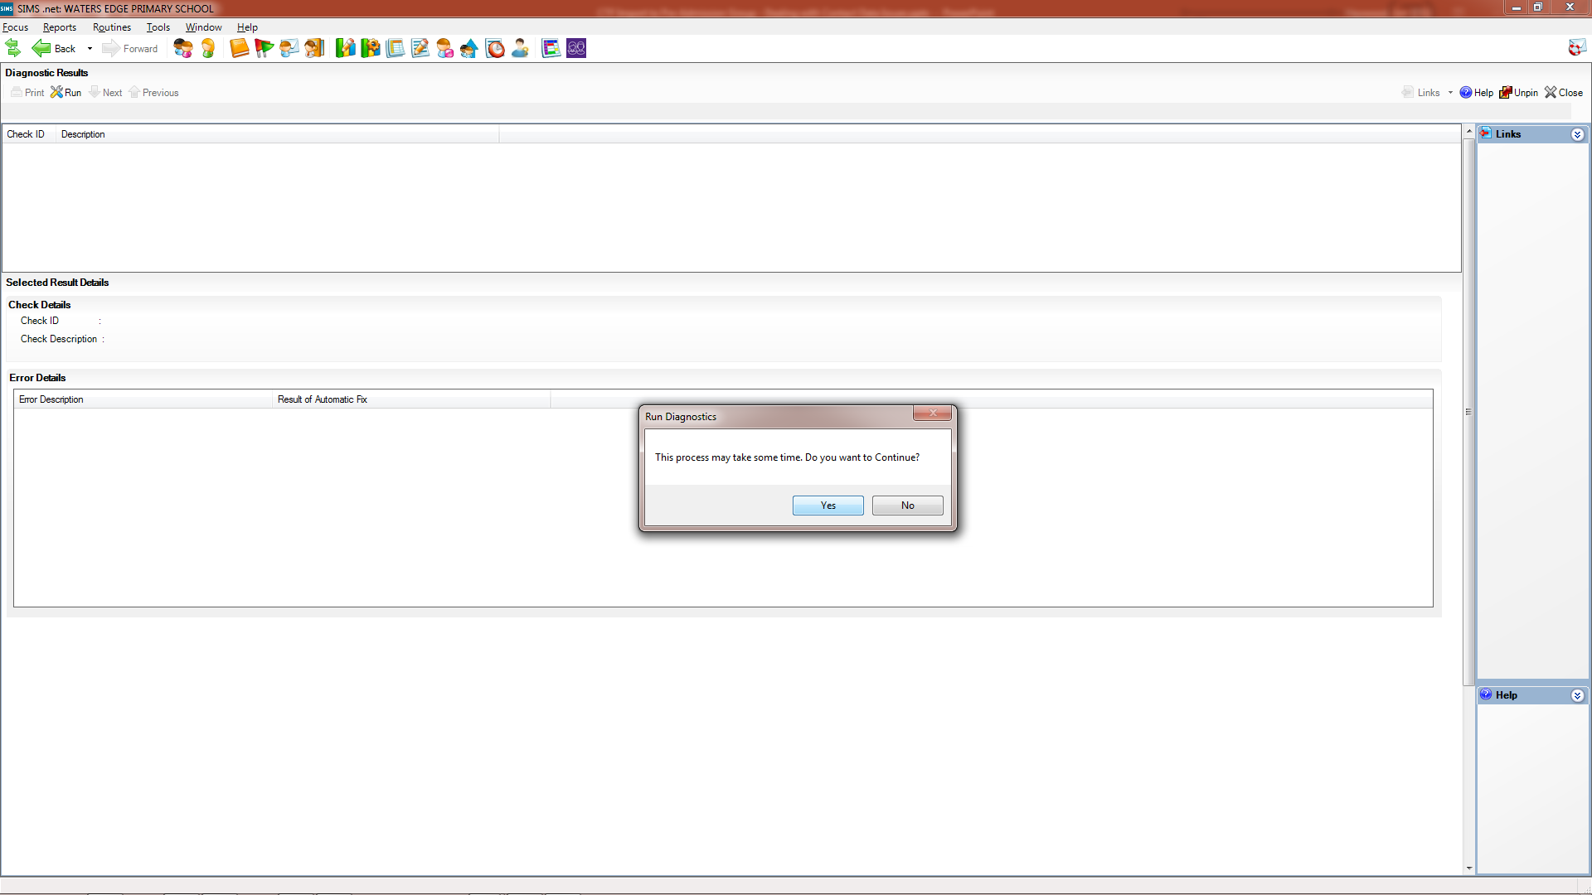
Dealing with Contact Data Issues
You can opt out at this point if you don’t have enough time available

Slide 28
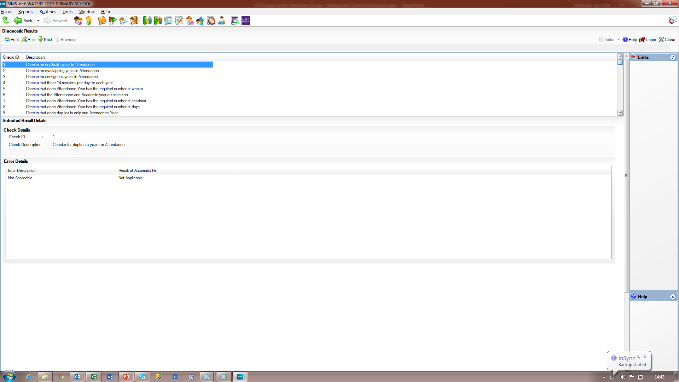
Dealing with Contact Data Issues
When the processing is complete, a list of all checks is provided and you can click on the check ID to see all the instances of data ‘failing’ that check.

Slide 29
Dealing with Contact Data Issues
When the processing is complete, a list of all checks is provided and you can click on the check ID to see all the instances of data ‘failing’ that check.
Where the description of the check is in black text the Error Details will always be shown as “Not Applicable”.

Slide 30
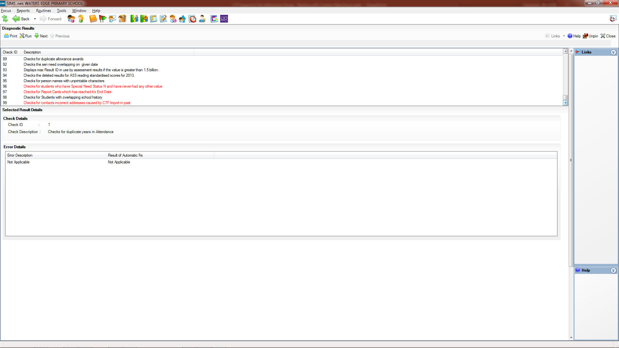
Dealing with Contact Data Issues
Normally red text indicates that are one of more instances where the check has been ‘failed’.

Slide 31
Dealing with Contact Data Issues
Normally red text indicates that are one of more instances where the check has been ‘failed’.
Check 99 has been added for checking Contact data the may have been damaged by CTF Import and is unusual in that it always has red text; even if no instance of ‘failure’ have been found.

Slide 32
Dealing with Contact Data Issues
Where lots of checks have been ‘failed’ it is best to use the Print routine to examine the ‘failures’ and that is certainly the case where lot of instances of check 99 ‘failures’.

Slide 33
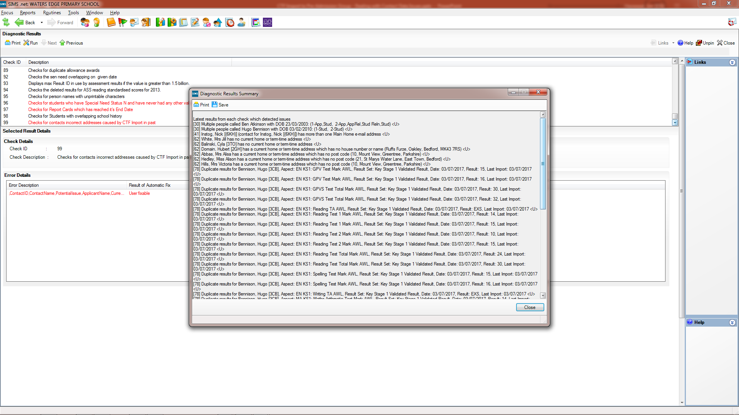
Dealing with Contact Data Issues
For the purposes of this presentation, we are only interested in the check 99 ‘issues’ and they will be at the end of the list of ‘issues’ detected.

Slide 34
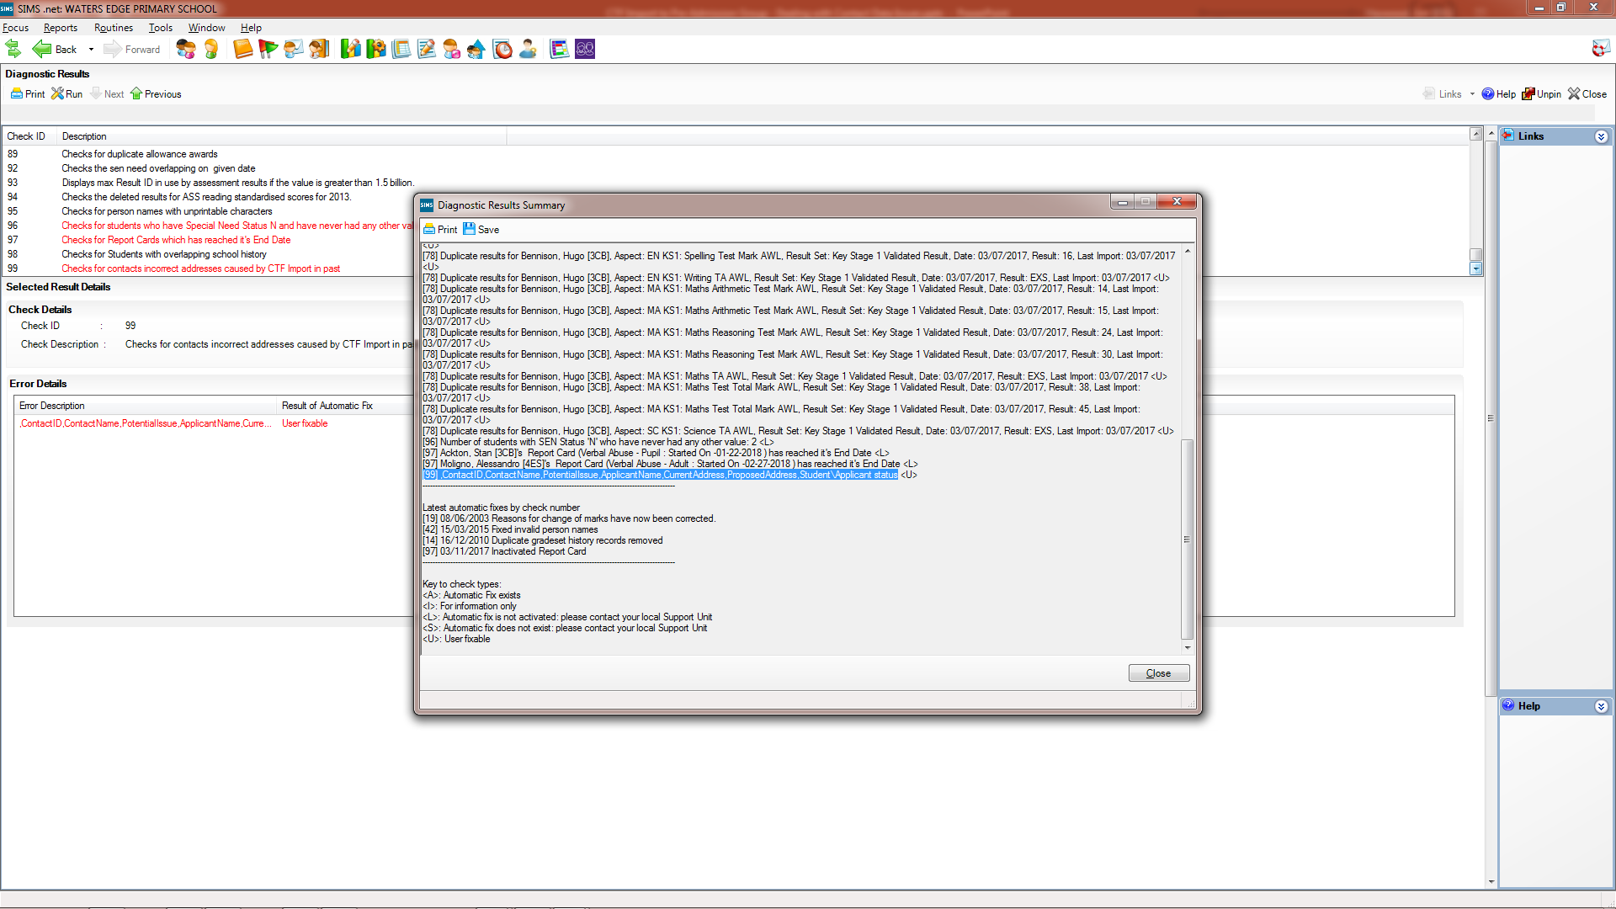
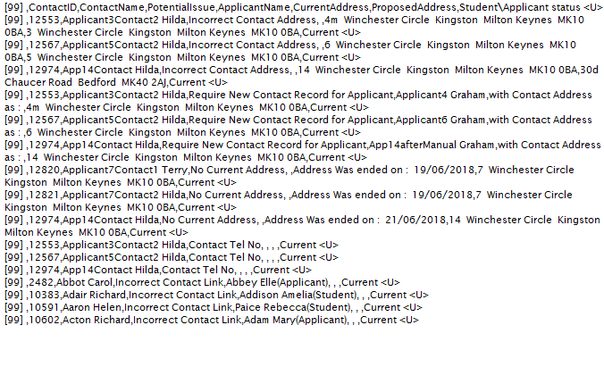
Dealing with Contact Data Issues
We can use Click and Shift-Click to highlight the check 99 rows and then use Ctrl-C to copy them to the clipboard

Slide 35
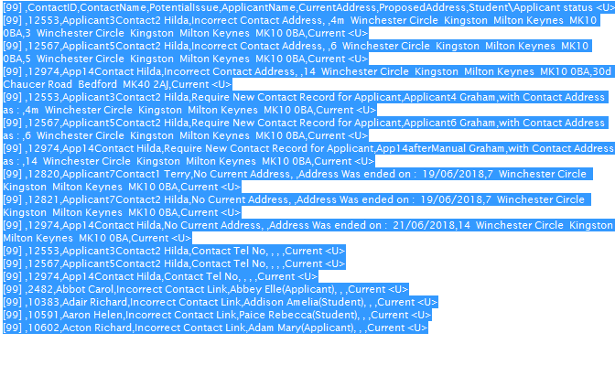
Dealing with Contact Data Issues
We can use Click and Shift-Click to highlight the check 99 rows and then use Ctrl-C to copy them to the clipboard

Slide 36
Dealing with Contact Data Issues
We can use Click and Shift-Click to highlight the check 99 rows and then use Ctrl-C to copy them to the clipboard

Slide 37
Dealing with Contact Data Issues
Having opened MS Notepad when can use Crtl-V to paste in the text from the clipboard

Slide 38
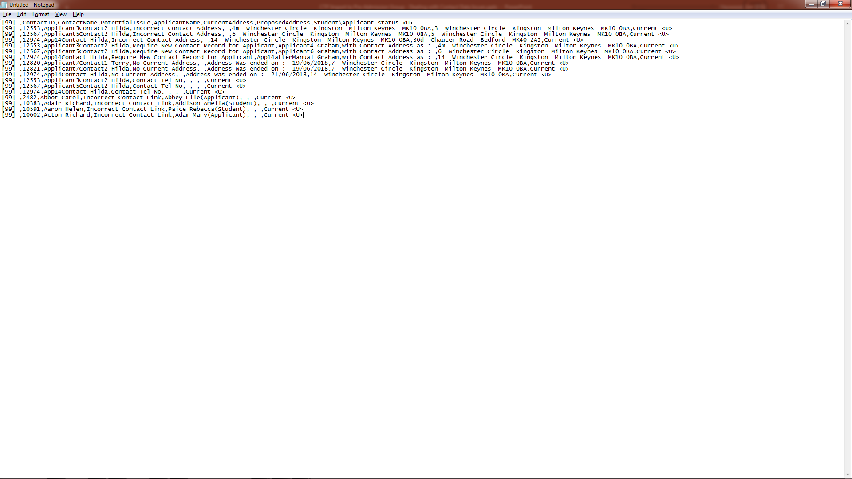
Dealing with Contact Data Issues
Having opened MS Notepad when can use Crtl-V to paste in the text from the clipboard

Slide 39
Dealing with Contact Data Issues
We can now save as a CSV file read for opening in a spreadsheet

Slide 40
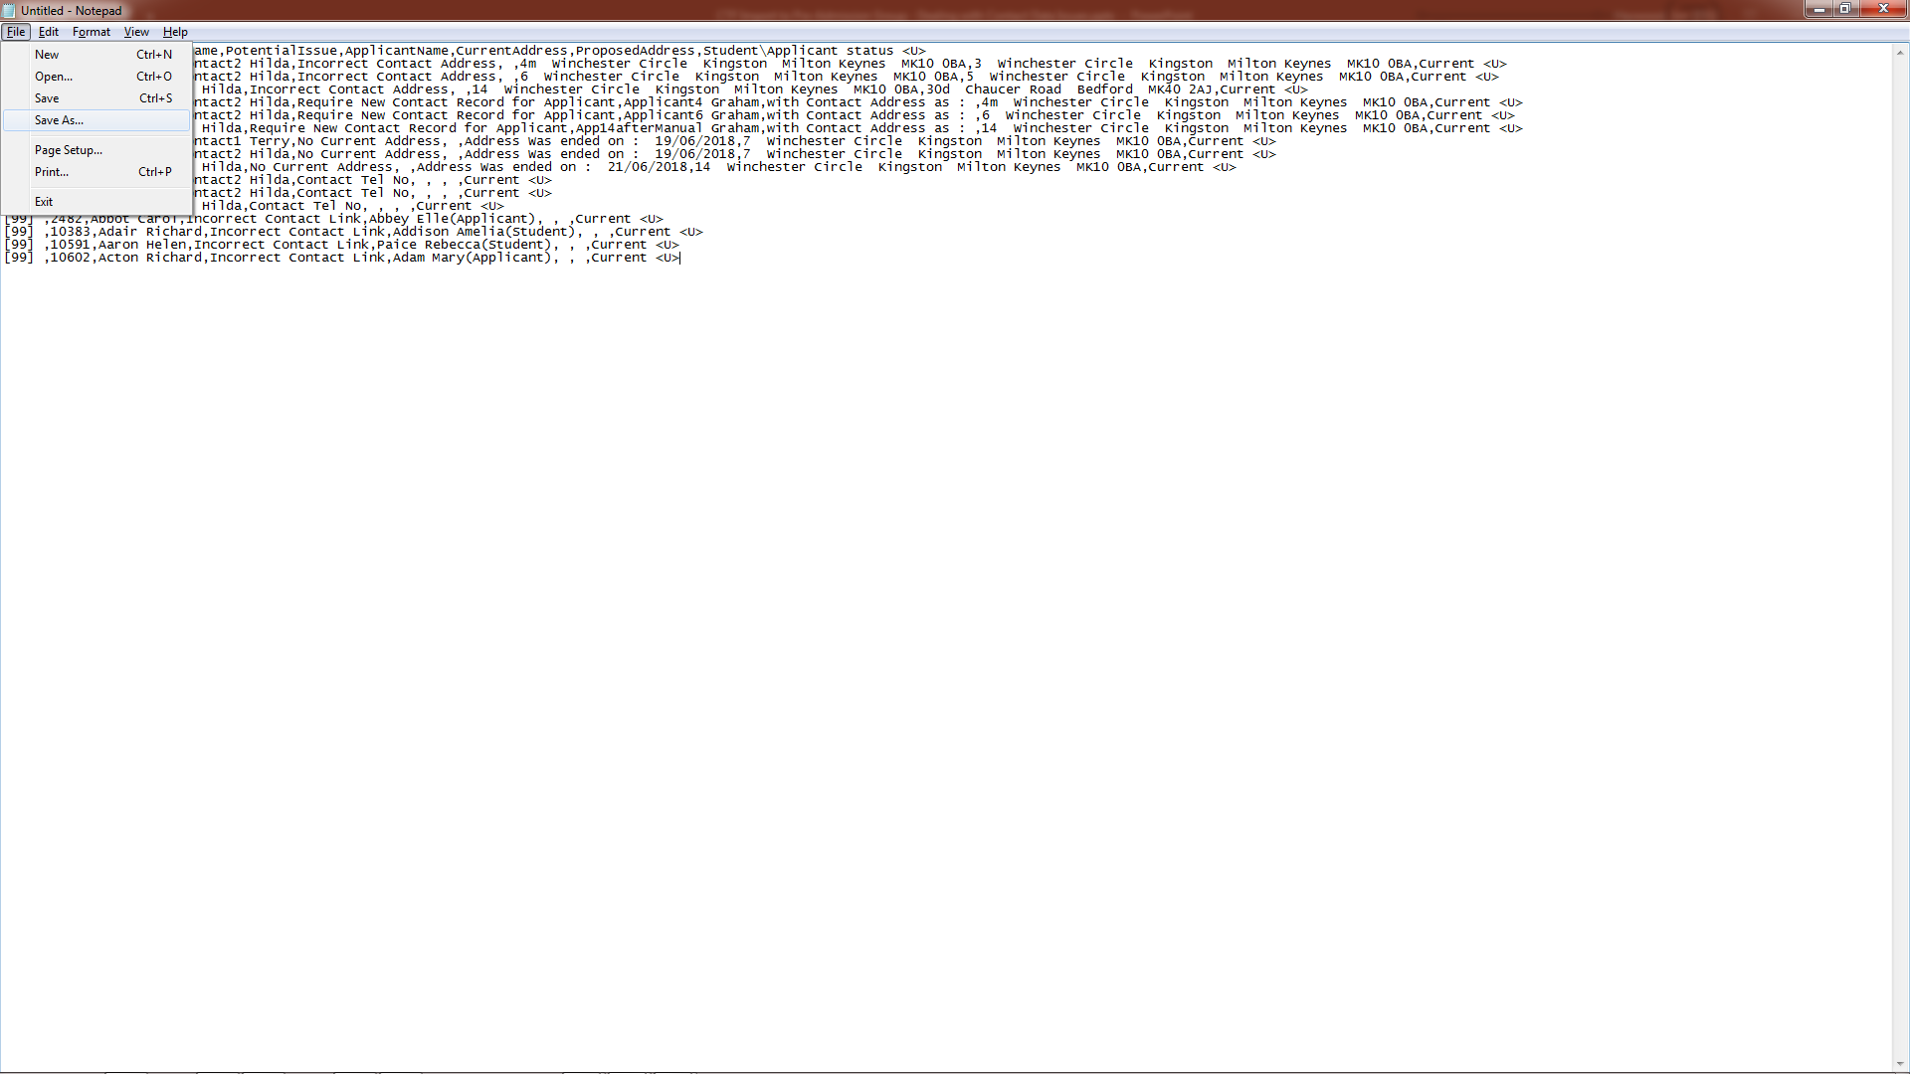
Dealing with Contact Data Issues
We can now save as a CSV file read for opening in a spreadsheet

Slide 41
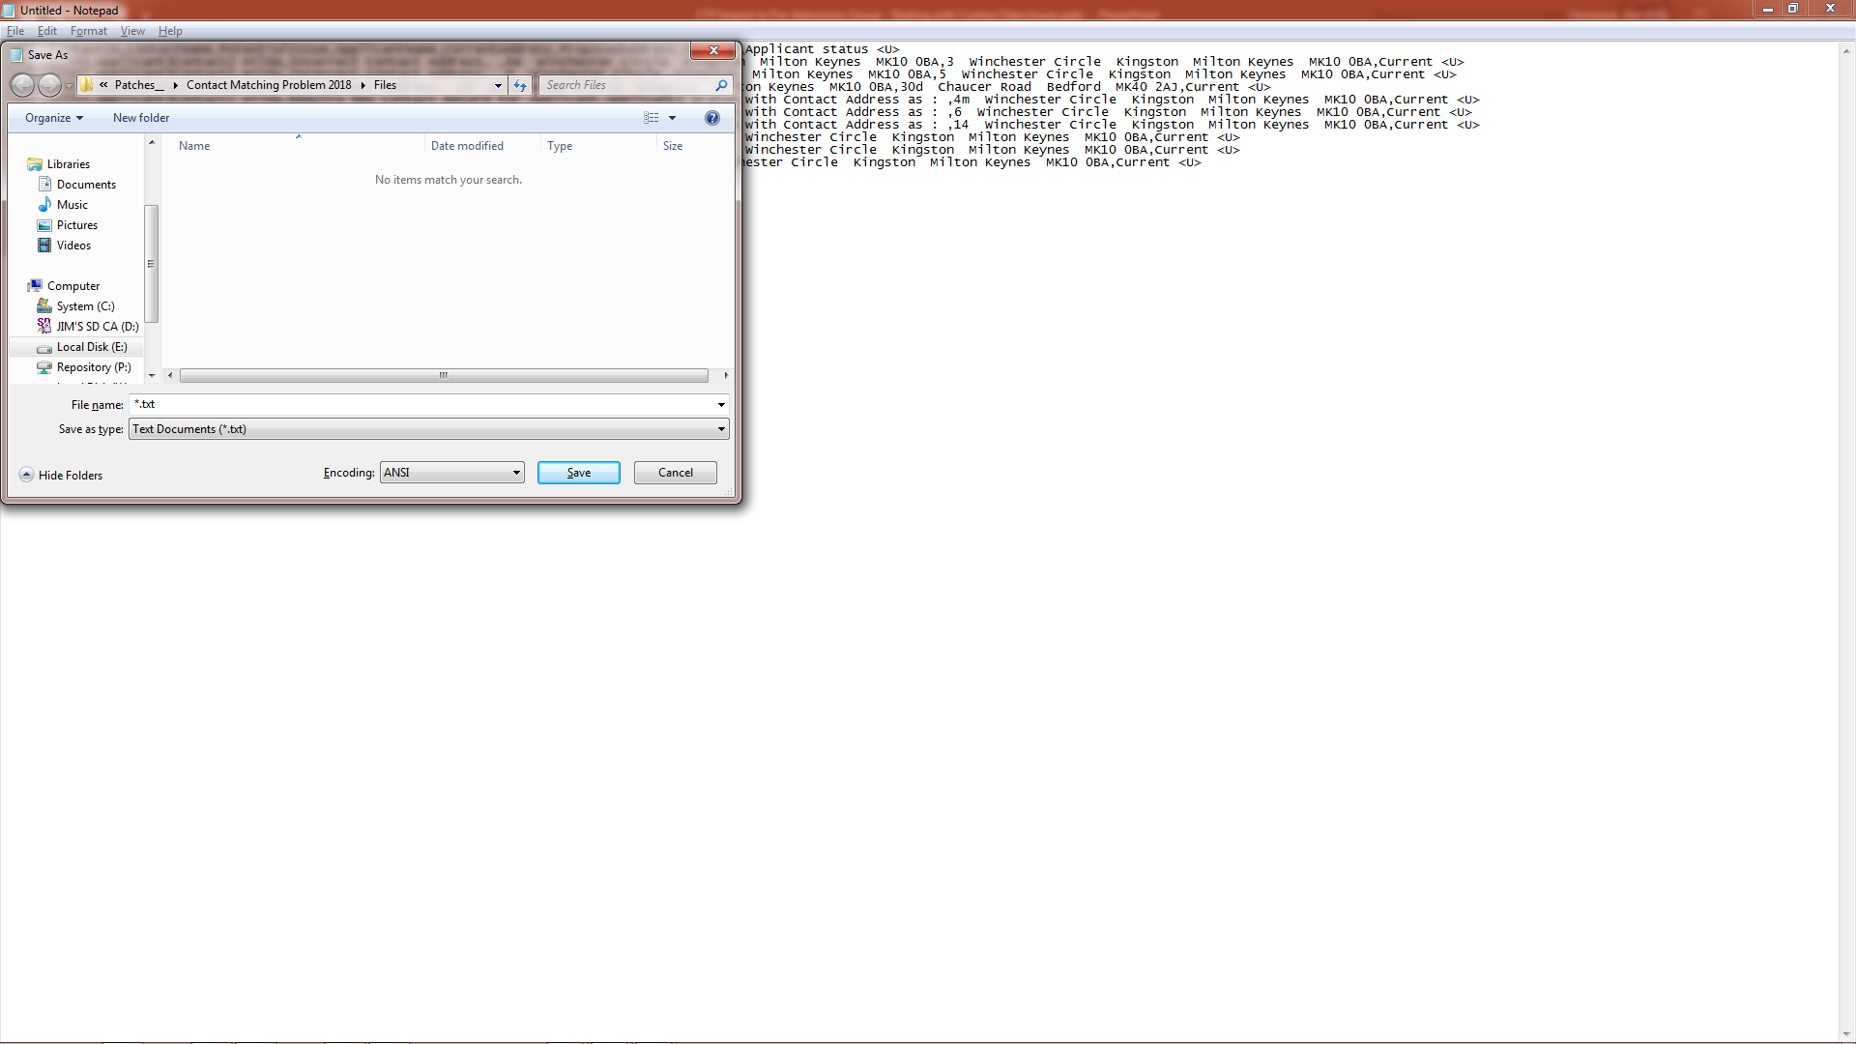
Dealing with Contact Data Issues
We can now save as a CSV file read for opening in a spreadsheet

Slide 42
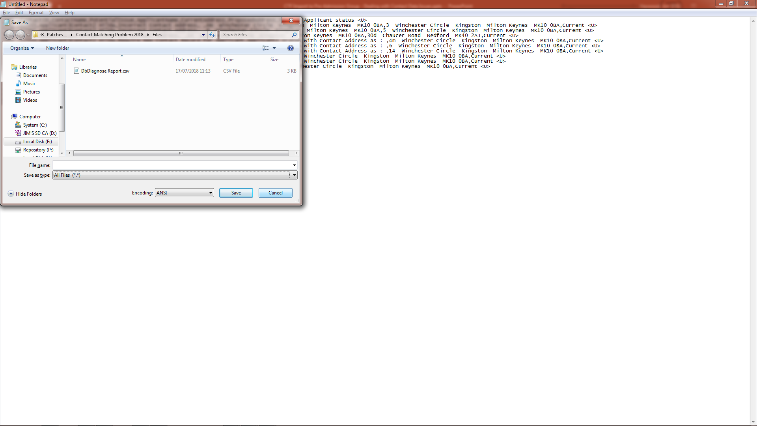
Dealing with Contact Data Issues
We can now save as a CSV file read for opening in a spreadsheet

Slide 43
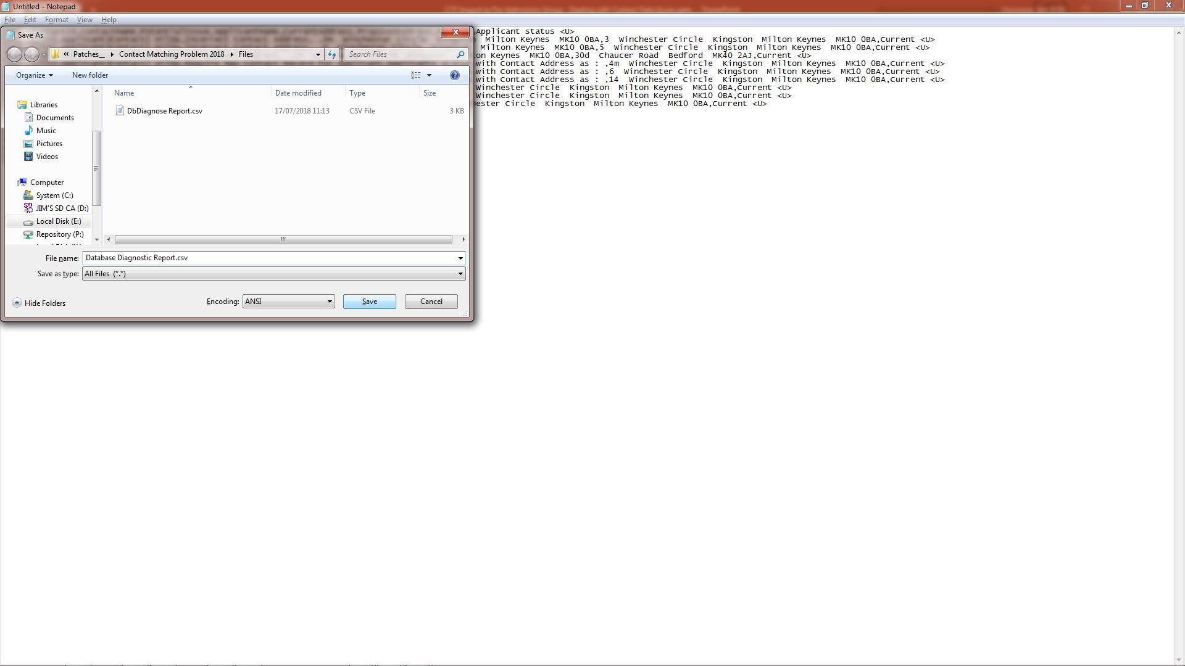
Dealing with Contact Data Issues
We can now save as a CSV file read for opening in a spreadsheet

Slide 44
Dealing with Contact Data Issues
We can now open the CSV file in a spreadsheet programme such as MS Word

Slide 45
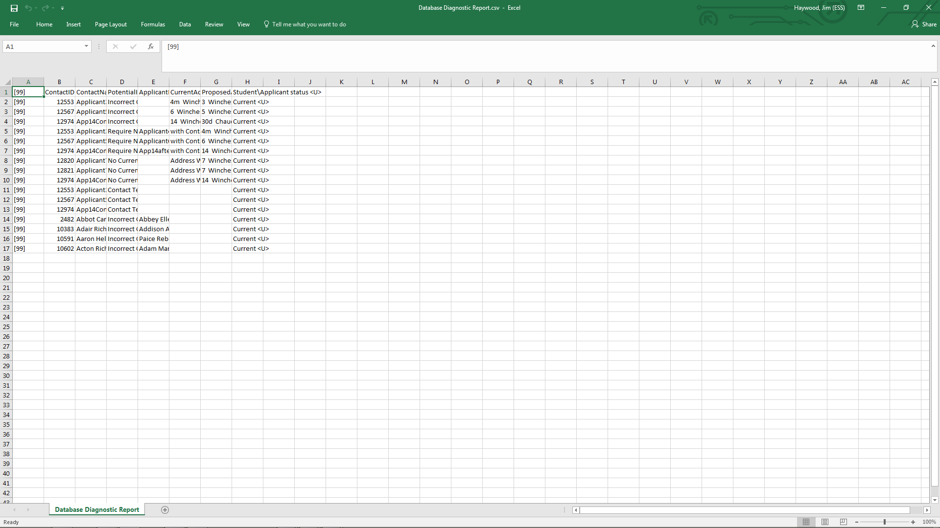
Dealing with Contact Data Issues
We no longer need the check number, as it is always 99. So we can delete that column

Slide 46
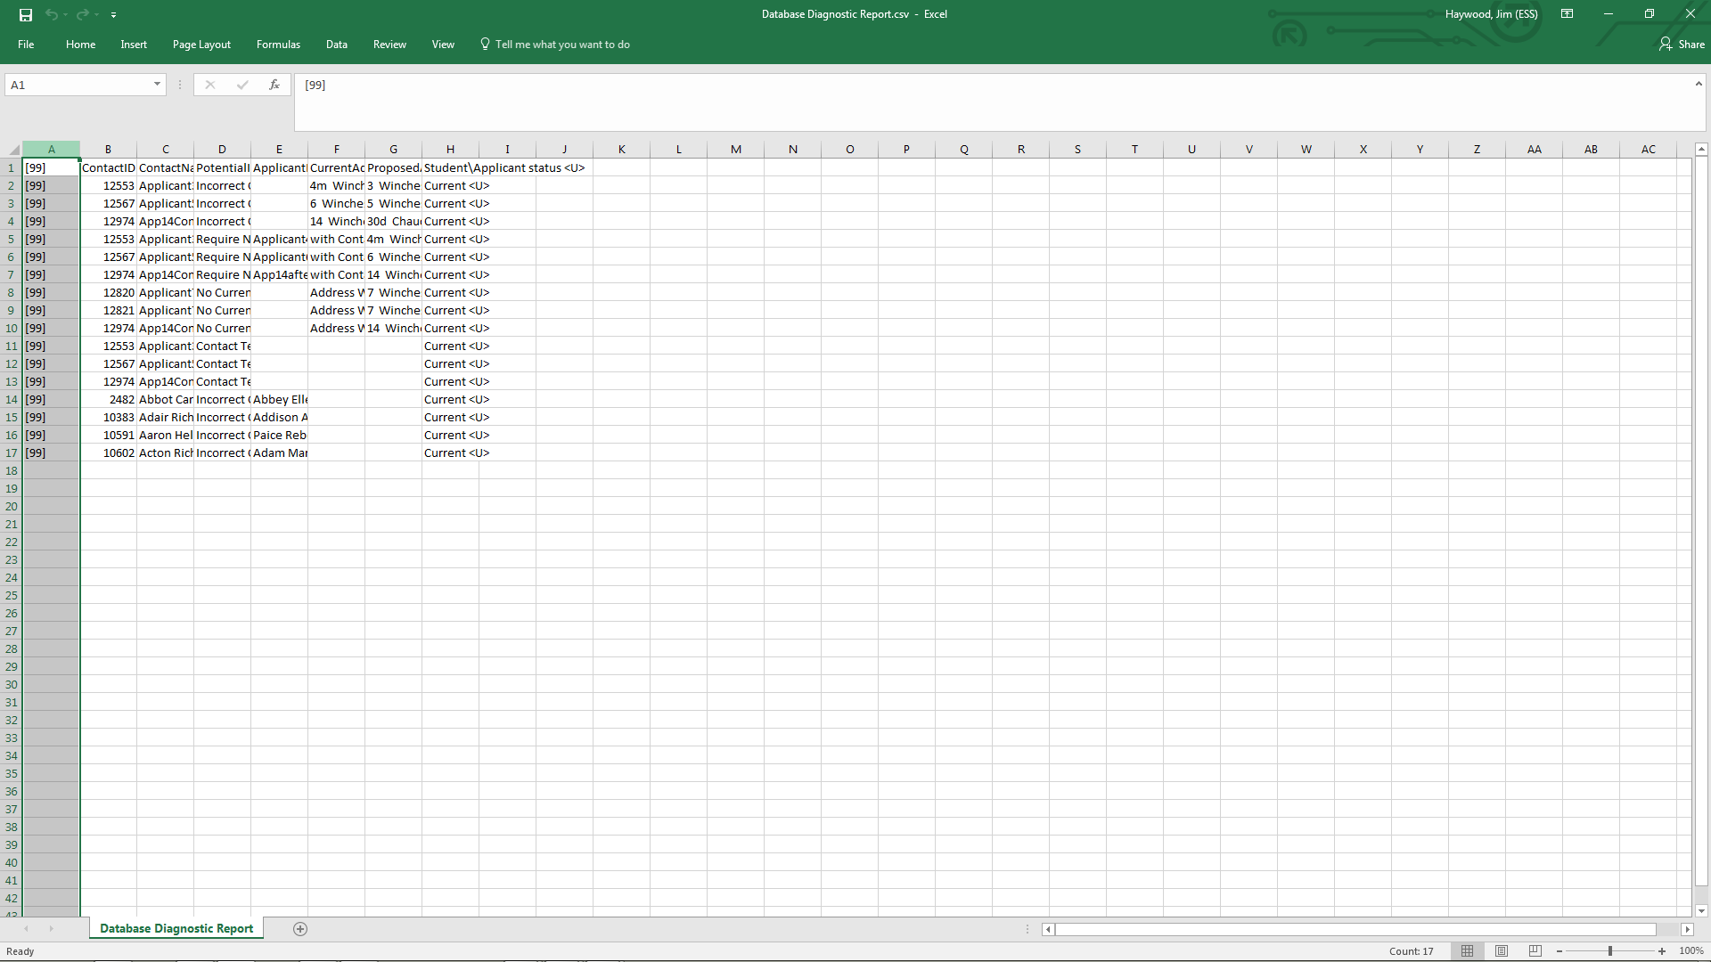
Dealing with Contact Data Issues
We no longer need the check number, as it is always 99. So we can delete that column.

Slide 47
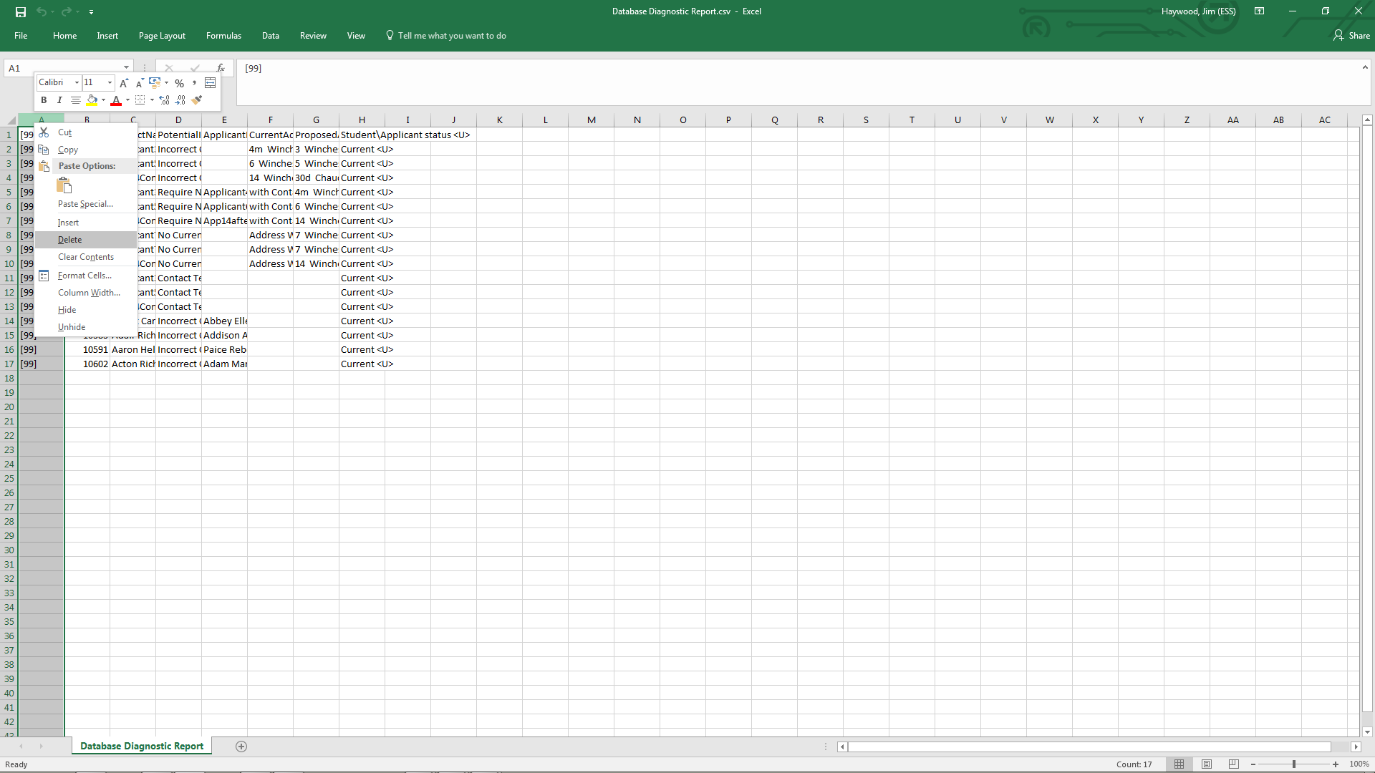
Dealing with Contact Data Issues
We no longer need the check number, as it is always 99. So we can delete that column.

Slide 48
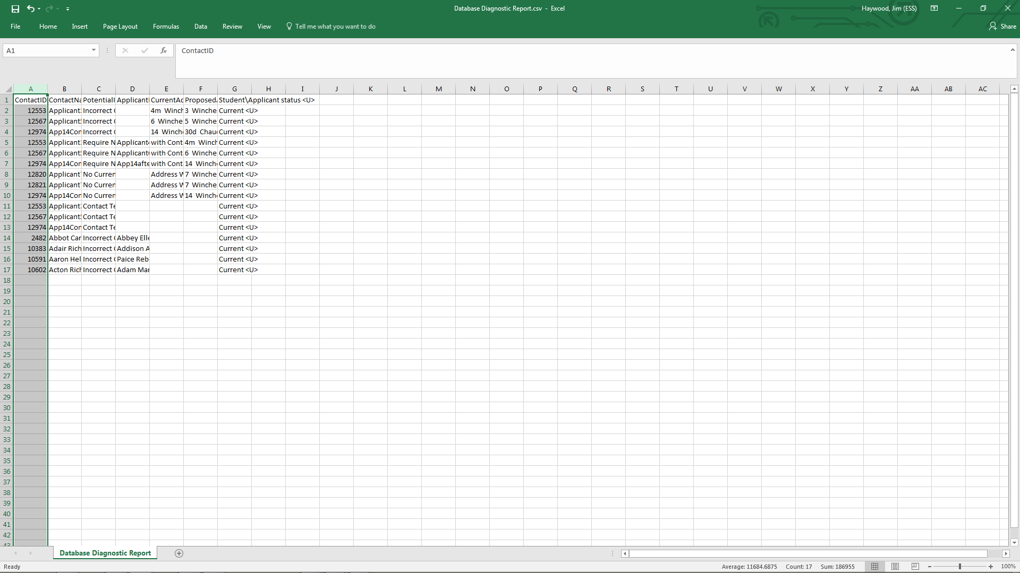
Dealing with Contact Data Issues
As you would expect, use of the Database Diagnostics report has provided exactly the same spreadsheet as did the DbDiagnose EXE report ..

Slide 49
Dealing with Contact Data Issues
As you would expect, use of the Database Diagnostics report has provided exactly the same spreadsheet as did the DbDiagnose EXE report ..
and from this point we can take the same approach to reformatting the columns for interrogating the data

Slide 50
Dealing with the Contact Data Issues
Using the spreadsheet for correcting the contact data
Back to Content

Slide 51
Dealing with Contact Data Issues
Reformatting the spreadsheet will make it easier to interrogate the list of possible data issues

Slide 52
Dealing with Contact Data Issues
Shift-Click
Reformatting the spreadsheet will make it easier to interrogate the list of possible data issues

Slide 53
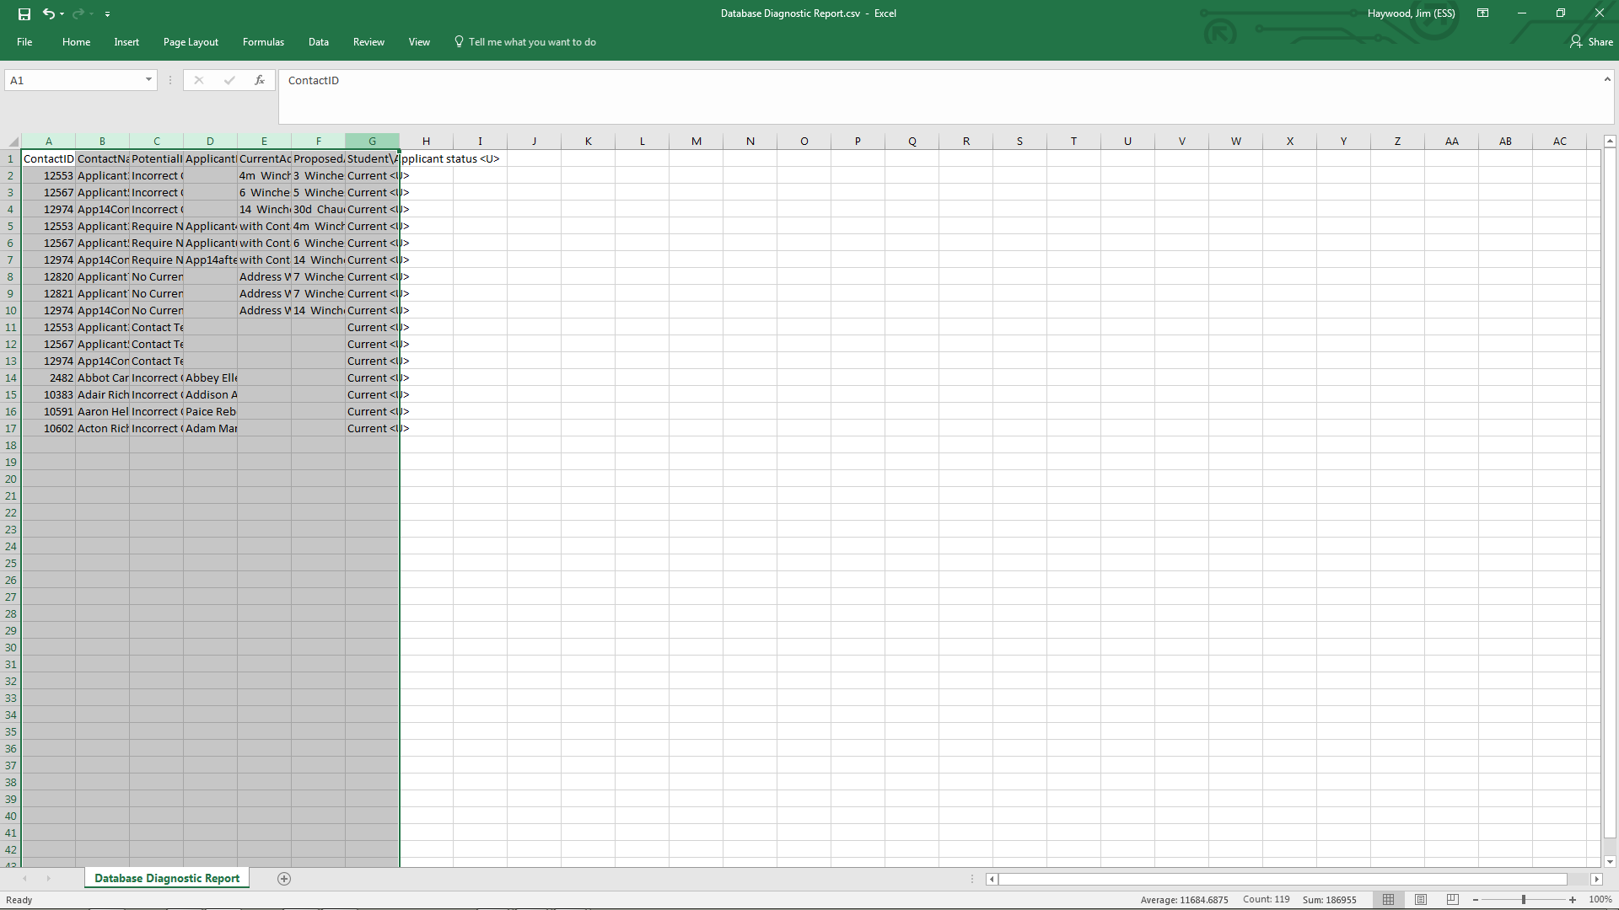
Dealing with Contact Data Issues
Right - Click
Reformatting the spreadsheet will make it easier to interrogate the list of possible data issues

Slide 54
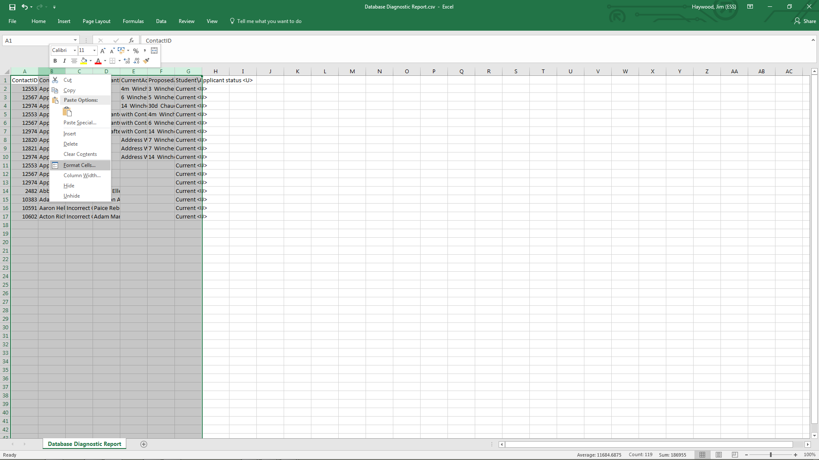
Dealing with Contact Data Issues
Reformatting the spreadsheet will make it easier to interrogate the list of possible data issues

Slide 55
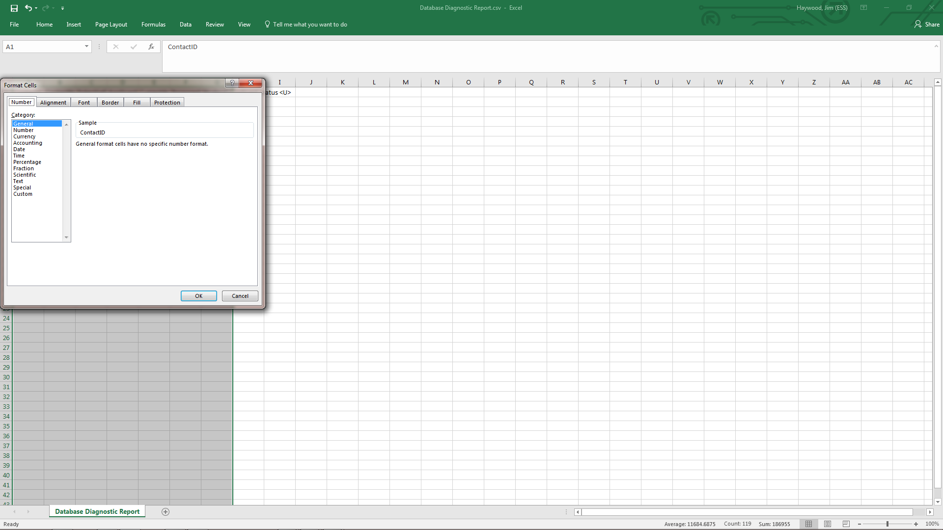
Dealing with Contact Data Issues
Reformatting the spreadsheet will make it easier to interrogate the list of possible data issues

Slide 56
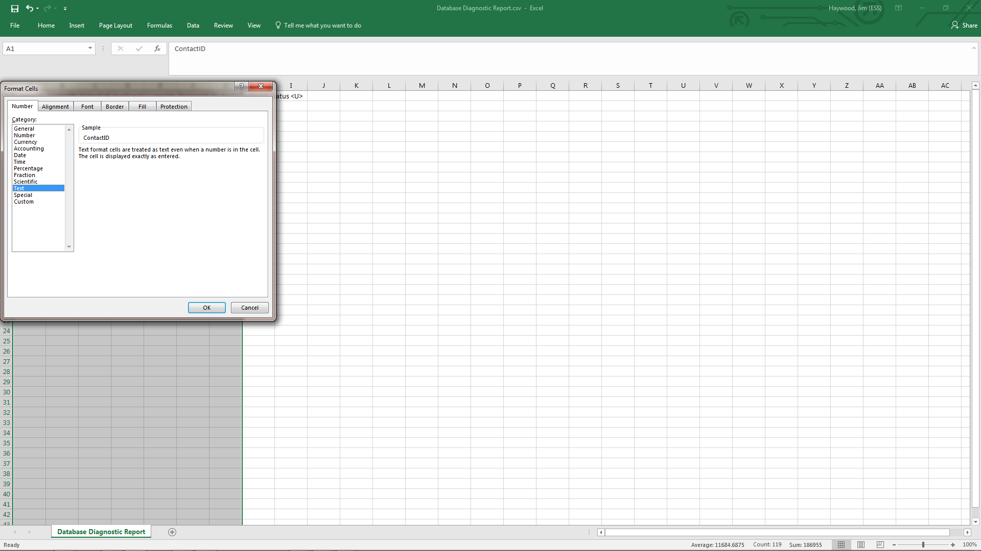
Dealing with Contact Data Issues
Reformatting the spreadsheet will make it easier to interrogate the list of possible data issues

Slide 57
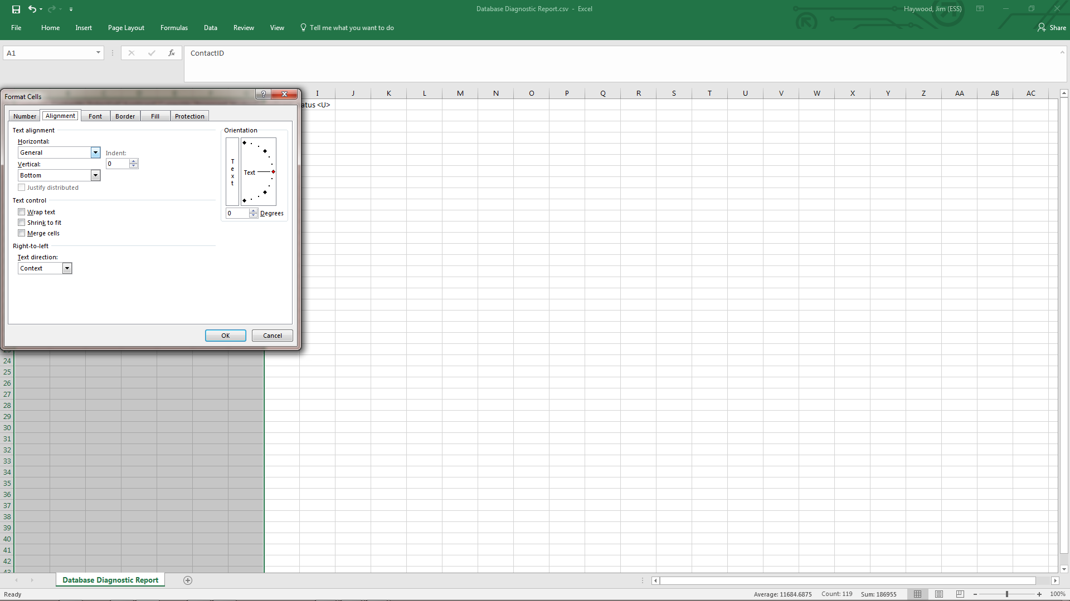
Dealing with Contact Data Issues
Reformatting the spreadsheet will make it easier to interrogate the list of possible data issues

Slide 58
Dealing with Contact Data Issues
Reformatting the spreadsheet will make it easier to interrogate the list of possible data issues

Slide 59
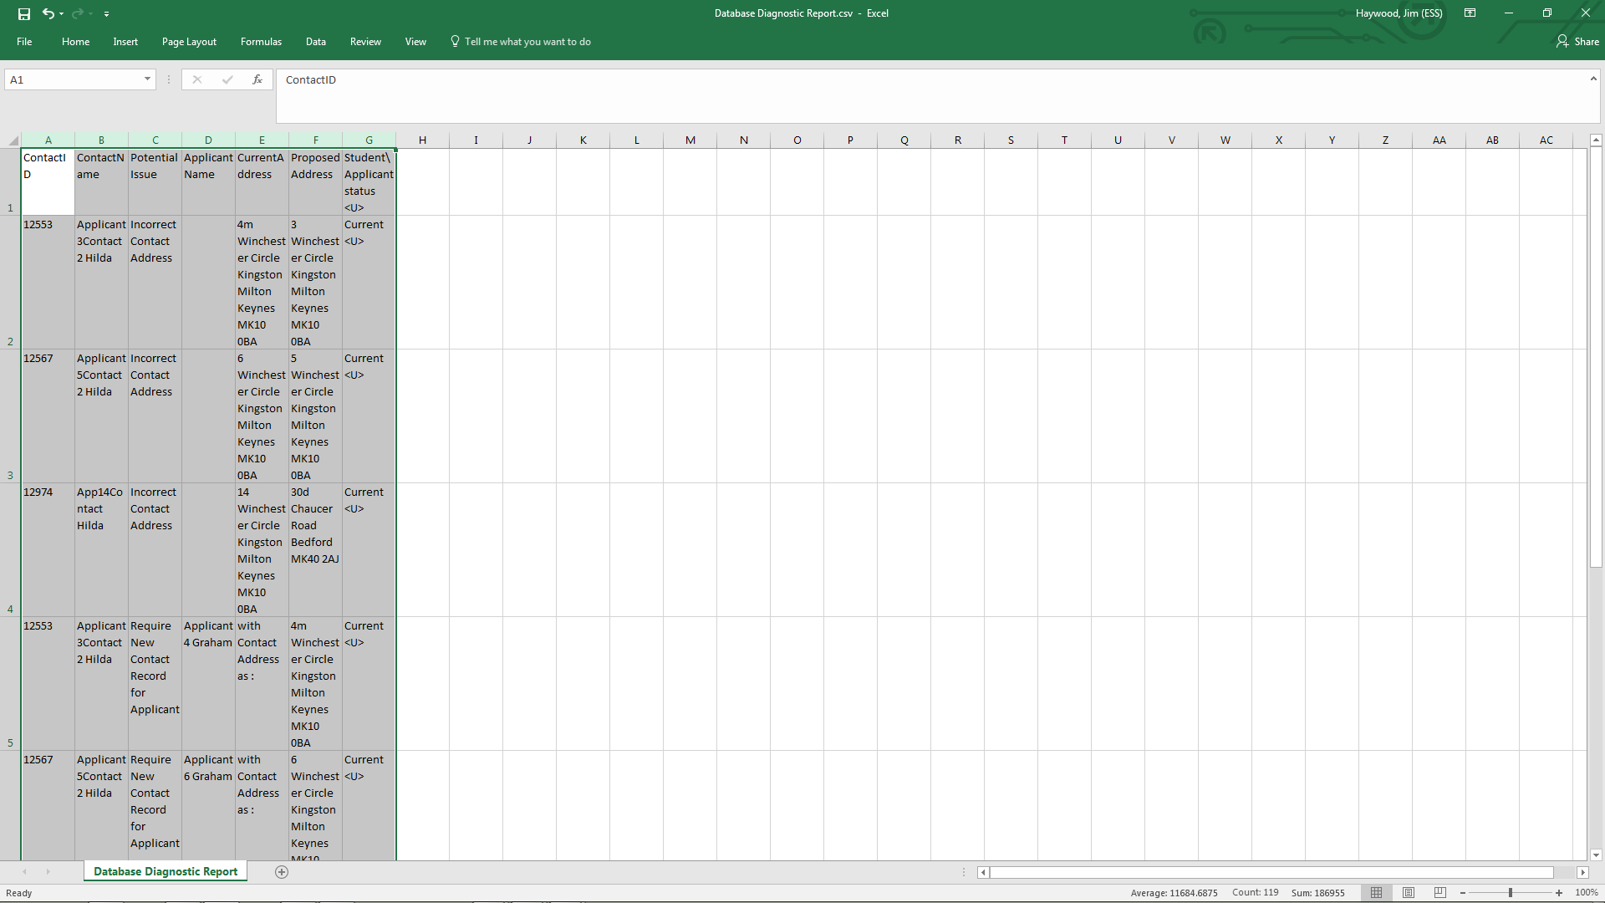
Reformatting the spreadsheet will make it easier to interrogate the list of possible data issues
Reformatting the spreadsheet will make it easier to interrogate the list of possible data issues

Slide 60
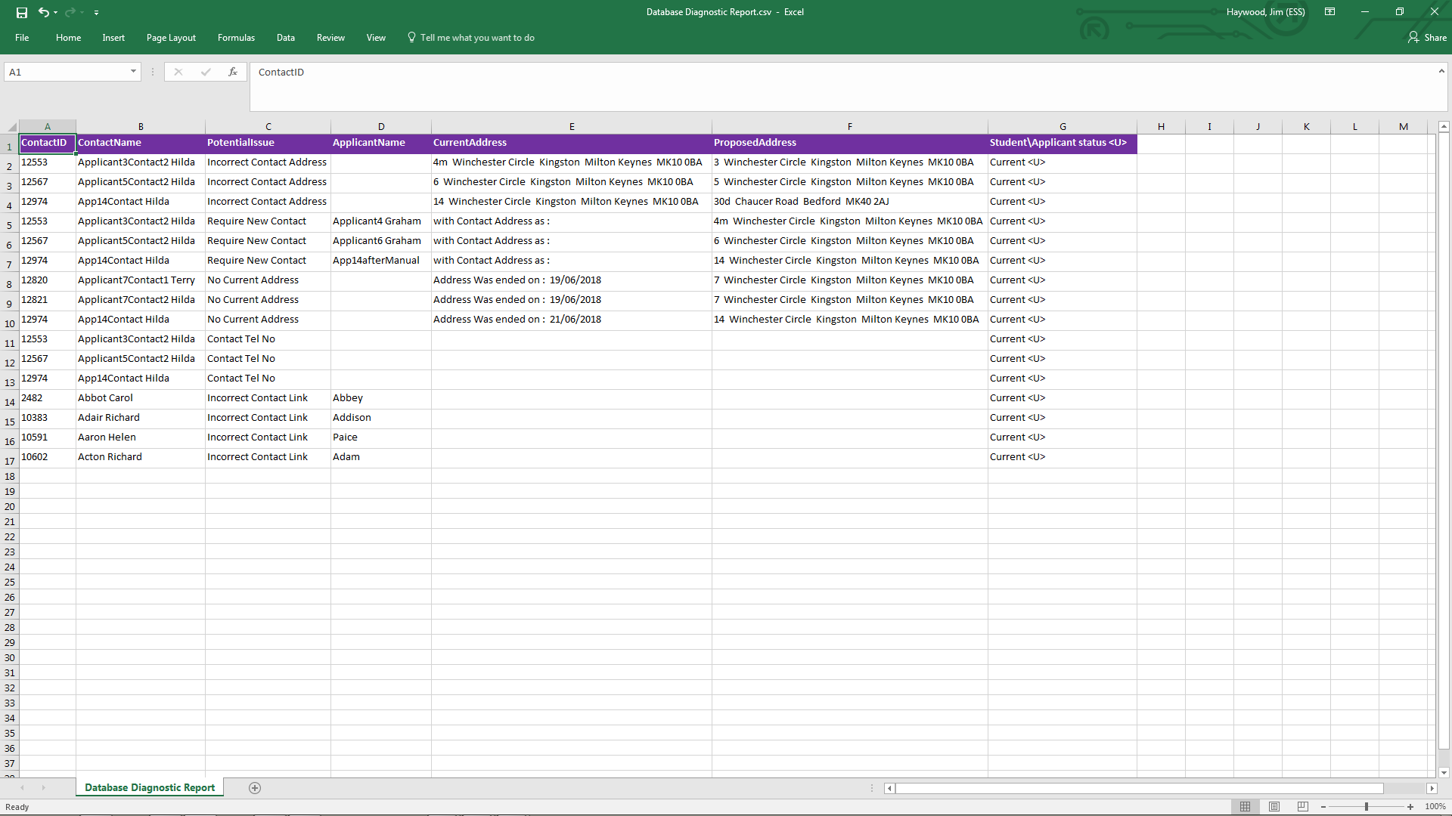
Dealing with Contact Data Issues
Reformatting the spreadsheet will make it easier to interrogate the list of possible data issues

Slide 61
Dealing with Contact Data Issues
Contact Identifier
These can be very helpful for gathering more information about the contact when used with Quick Search on the home page

Slide 62
Contact Name
The name of the contact. This is test data, so the names are a bit strange.

Slide 63
Dealing with Contact Data Issues
Potential Issue
In most case items listed are very likely to be actual issues, but it is sometimes conceivable that the data is correct. For example, it could be true that a contact has an address the no longer applies without having an address that now applies, but this seems very unlikely.

Slide 64
Dealing with Contact Data Issues
Potential Issue
Incorrect Contact Address
Applicant contacts whose address appears to have been updated by CTF where we believe CTF has made an incorrect link to an existing contact.

Slide 65
Dealing with Contact Data Issues
Potential Issue
Require New Contact Record for Applicant
This always mean that the applicant is not linked to the correct contact and we may need to create a new contact record ..

Slide 66
Dealing with Contact Data Issues
Potential Issue
No Current Address
This contact has no current address but does have an address with an end date. This only happens when CTF's are re-imported and may or may not have been caused by CTF and should be reviewed.

Slide 67
Dealing with Contact Data Issues
Potential Issue
Contact Tel No
This will no longer be identified after running the data fix. You will need to refer to the original diagnostic output.

Slide 68
Dealing with Contact Data Issues
Potential Issue
Incorrect Contact Link
This occurs where a contact exists in the CTF but has no address, the applicants/student is linked to the first contact record that CTF import finds with the same surname, forename and title.

Slide 69
Dealing with Contact Data Issues
Current Address
This is the address currently stored for the contact, …

Slide 70
Dealing with Contact Data Issues
Current Address
This is the address currently stored for the contact, …
with ‘special cases’ indicating where the address is the same as the Proposed Address and …

Slide 71
Dealing with Contact Data Issues
Current Address
This is the address currently stored for the contact, …
with ‘special cases’ indicating where the address is the same as the Proposed Address and …
where there is no current address but there was one previously up to a specified date.

Slide 72
Dealing with Contact Data Issues
Proposed Address
This is the address that the script has identified as being more likely to be the correct address then the current address for the contact.

Slide 73
Dealing with Contact Data Issues
Proposed Address
This is the address that the script has identified as being more likely to be the correct address then the current address for the contact.
We recommend double checking this before changing the contact address.

Slide 74
Dealing with Contact Data Issues
Student/Applicant Status
In this example it is only current students and applicants that can be involved, but it is also possible for leavers to be involved.

Slide 75
Dealing with Contact Data Issues
It is also helpful to add filters.

Slide 76
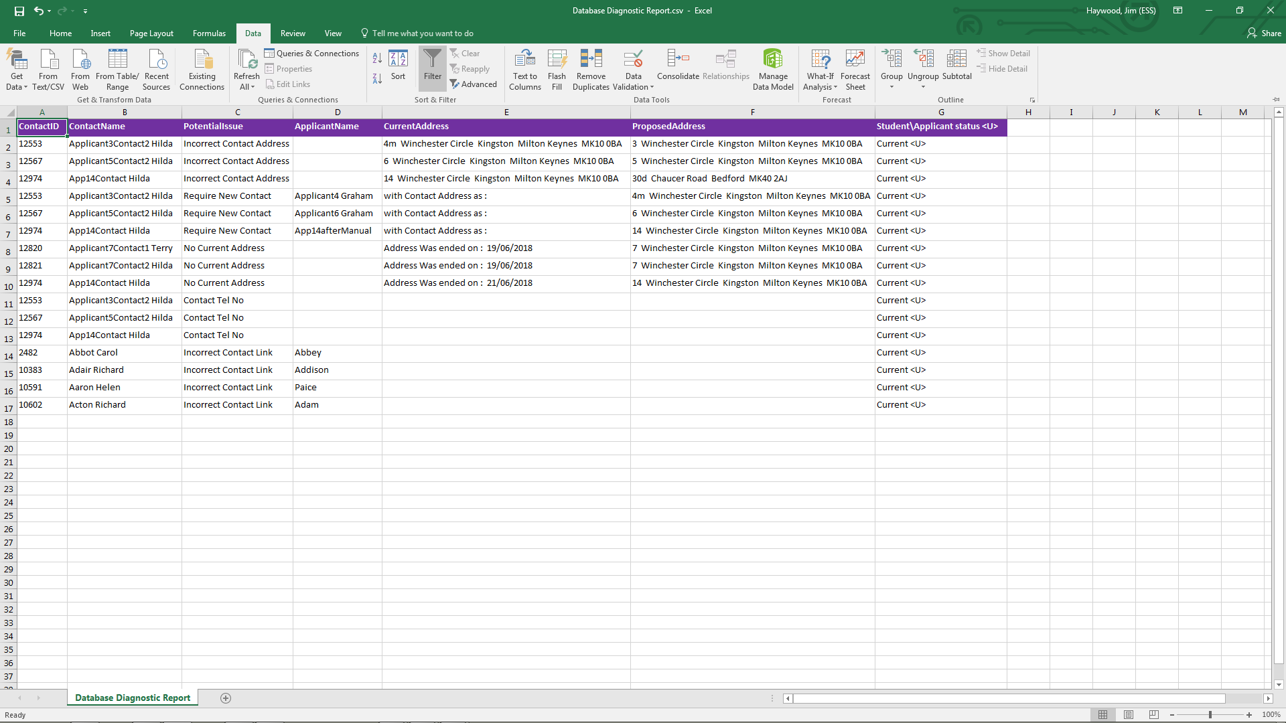
Dealing with Contact Data Issues
It is also helpful to add filters.

Slide 77
It is also helpful to add filters.

Slide 78
Dealing with Contact Data Issues
We can add a filter on Potential Issue

Slide 79
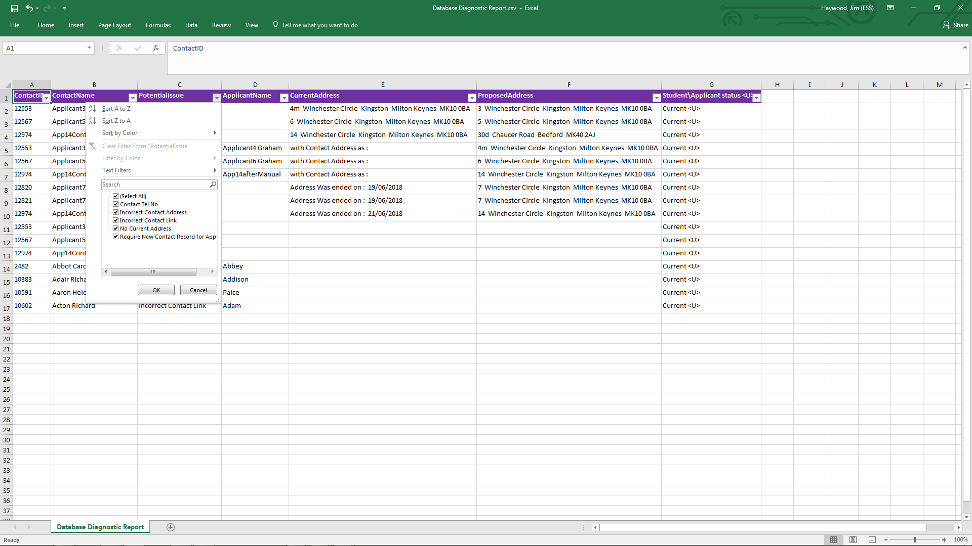
Dealing with Contact Data Issues
We can add a filter on Potential Issue

Slide 80
Dealing with Contact Data Issues
We can add a filter on Potential Issue

Slide 81
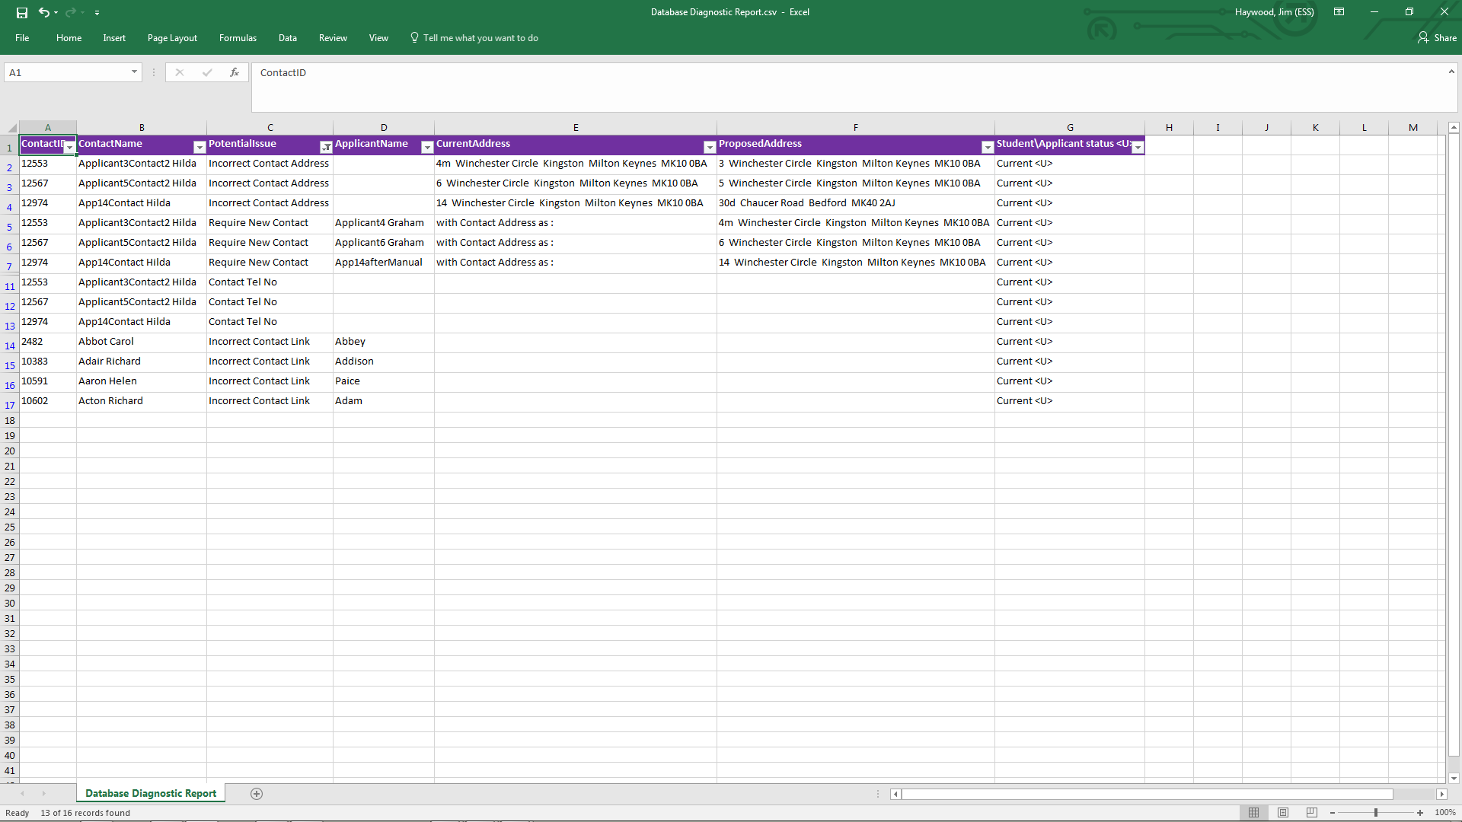
Dealing with Contact Data Issues
Having set the filter to all potential issues except no current address, we are likely to be seeing only issues whose root cause was the import of a CTF for a pre-admission group.

Slide 82
Dealing with Contact Data Issues
Having set the filter to all potential issues except no current address, we are likely to be seeing only issues whose root cause was the import of a CTF for a pre-admission group.
No current address may still need to be dealt with, but it was almost certainly not cause by the import of a CTF for a pre-admission group.

Slide 83
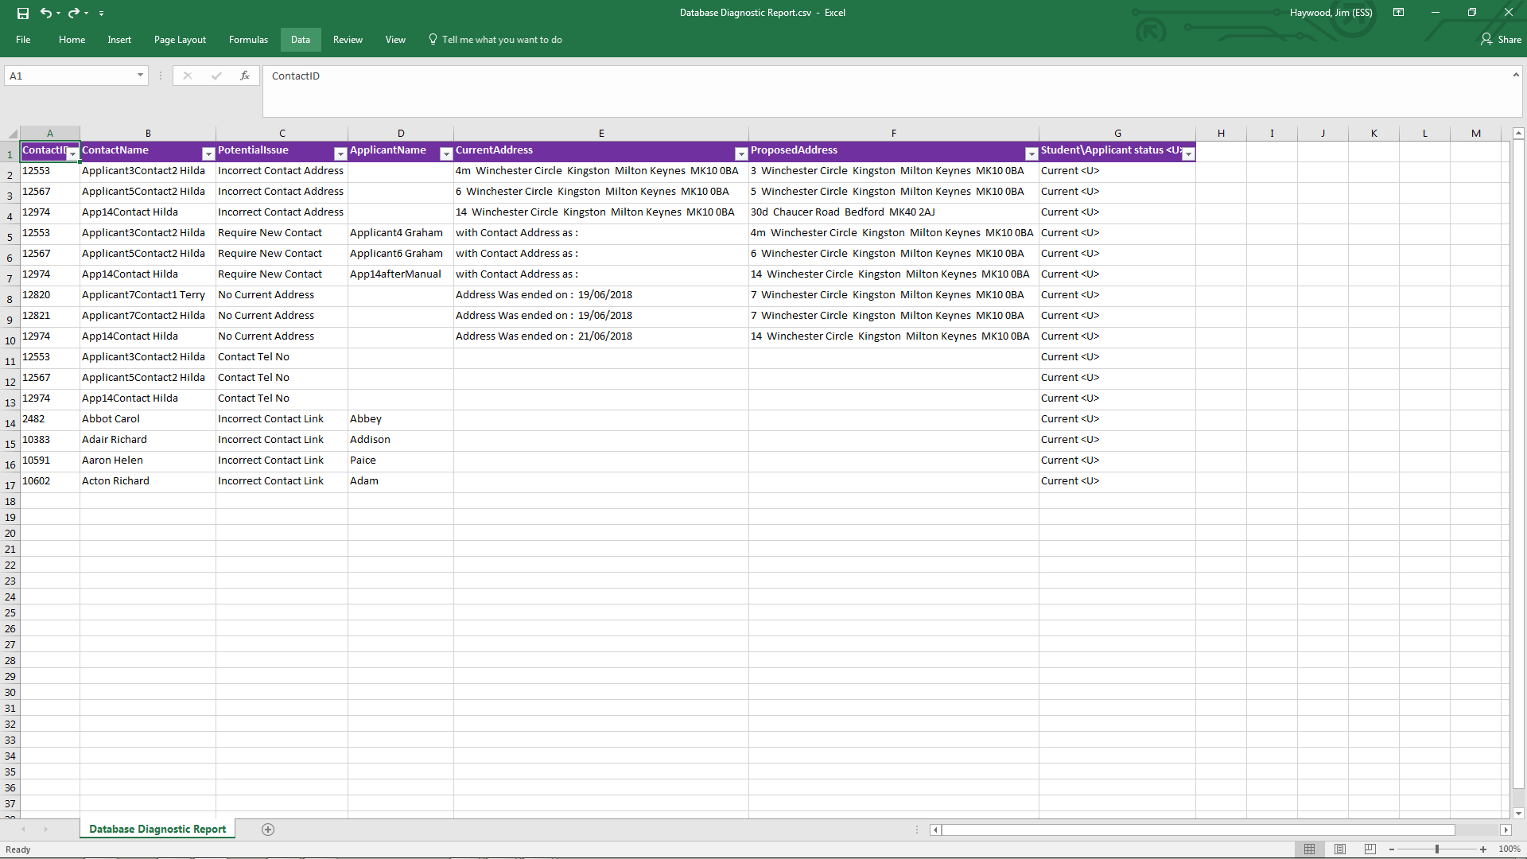
Dealing with Contact Data Issues
Sorting on Potential Issue within Contact Name, will give a clearer picture of what items related to a particular contact may need to be fixed

Slide 84
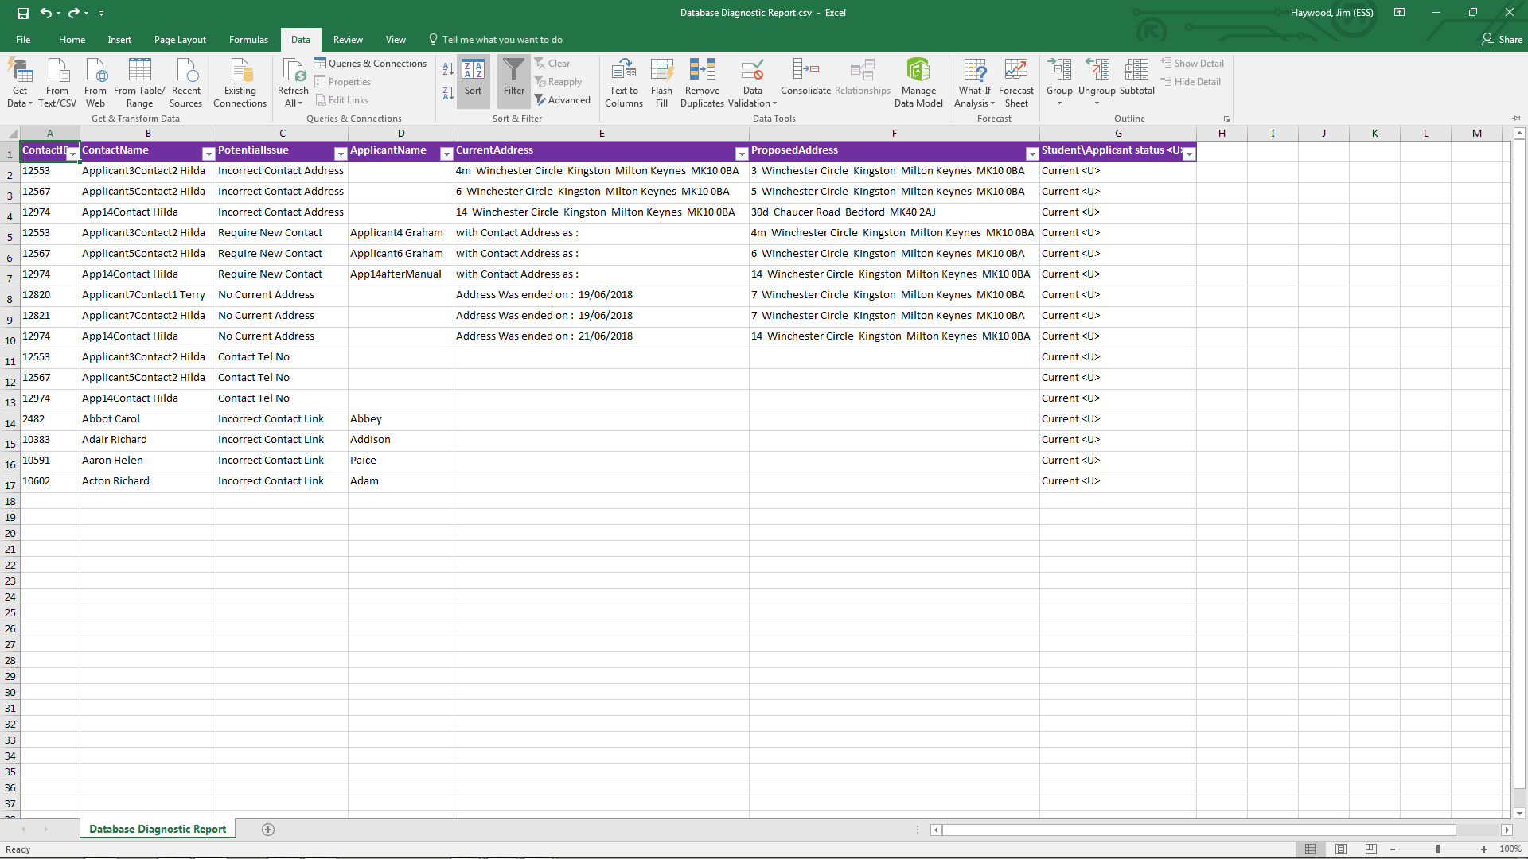
Dealing with Contact Data Issues
Sorting on Potential Issue within Contact Name, will give a clearer picture of what items related to a particular contact may need to be fixed

Slide 85
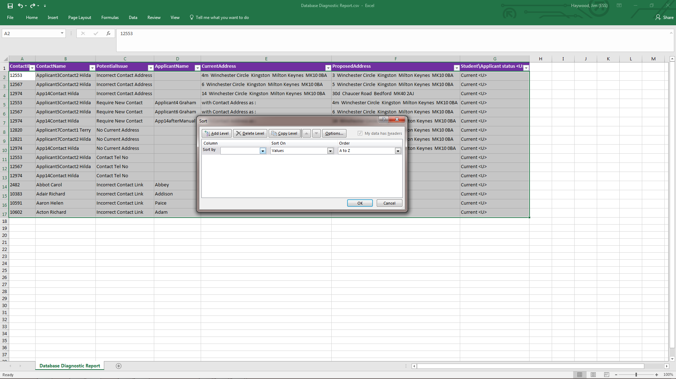
Dealing with Contact Data Issues
Sorting on Potential Issue within Contact Name, will give a clearer picture of what items related to a particular contact may need to be fixed

Slide 86
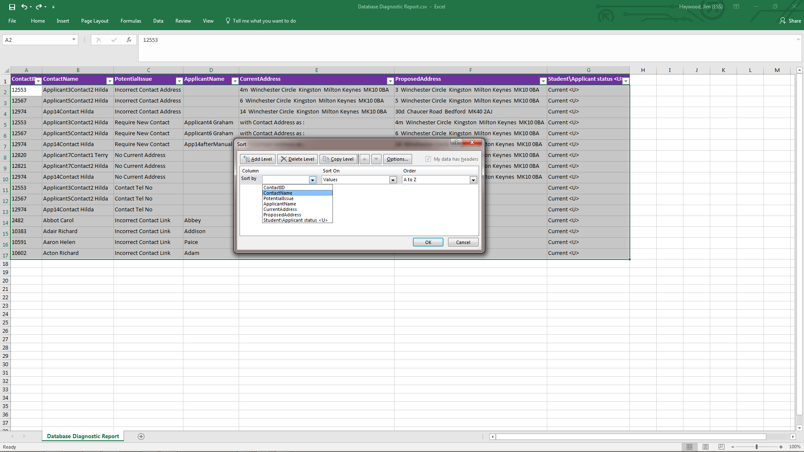
Dealing with Contact Data Issues
Sorting on Potential Issue within Contact Name, will give a clearer picture of what items related to a particular contact may need to be fixed

Slide 87
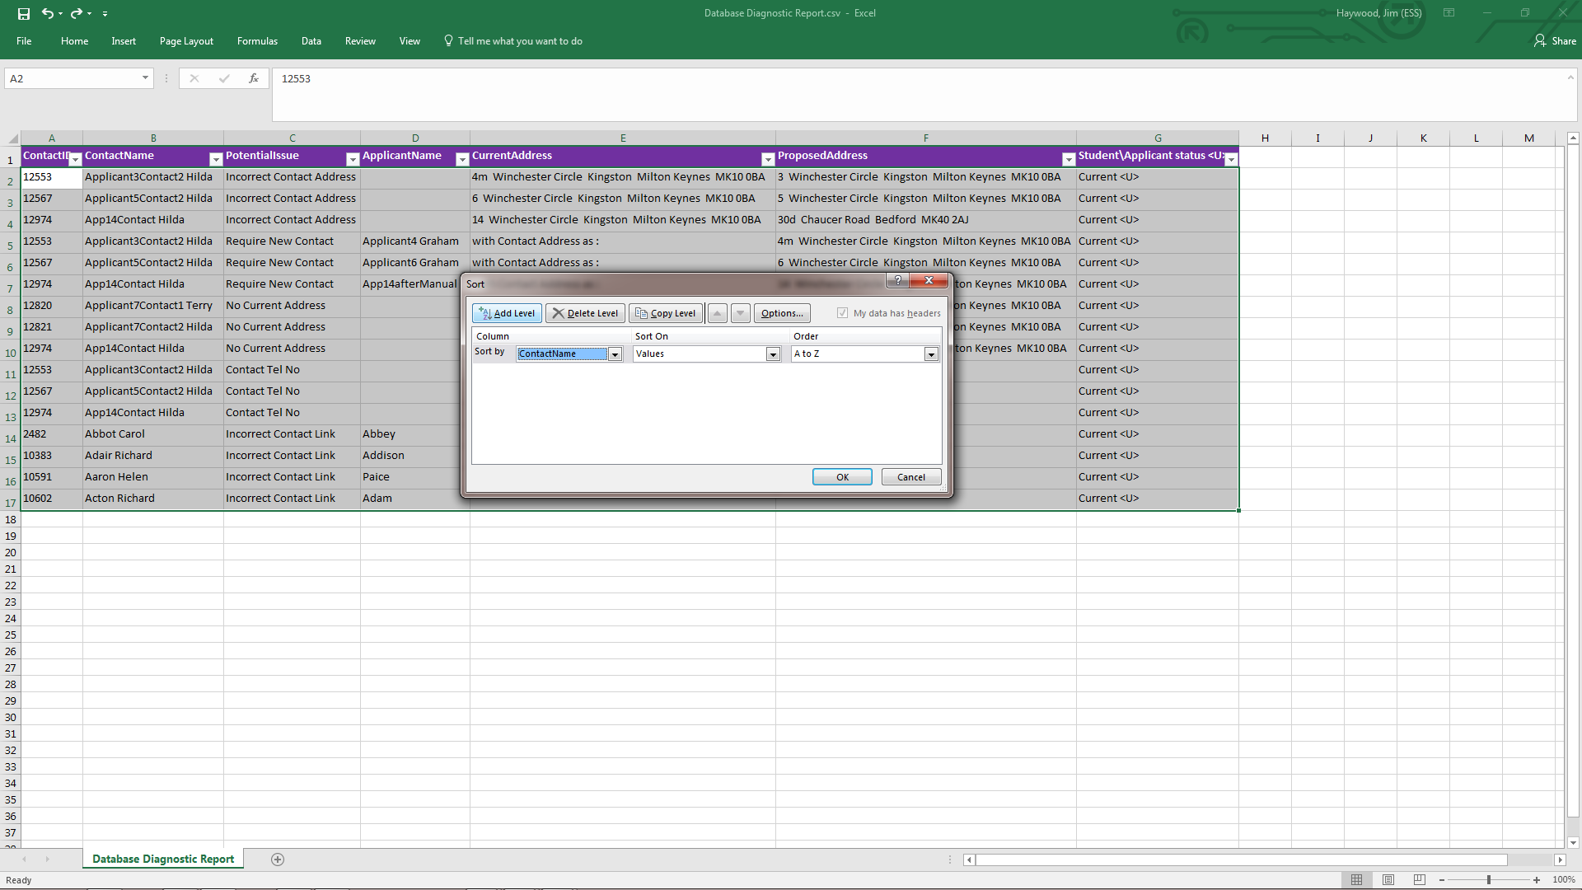
Dealing with Contact Data Issues
Sorting on Potential Issue within Contact Name, will give a clearer picture of what items related to a particular contact may need to be fixed

Slide 88
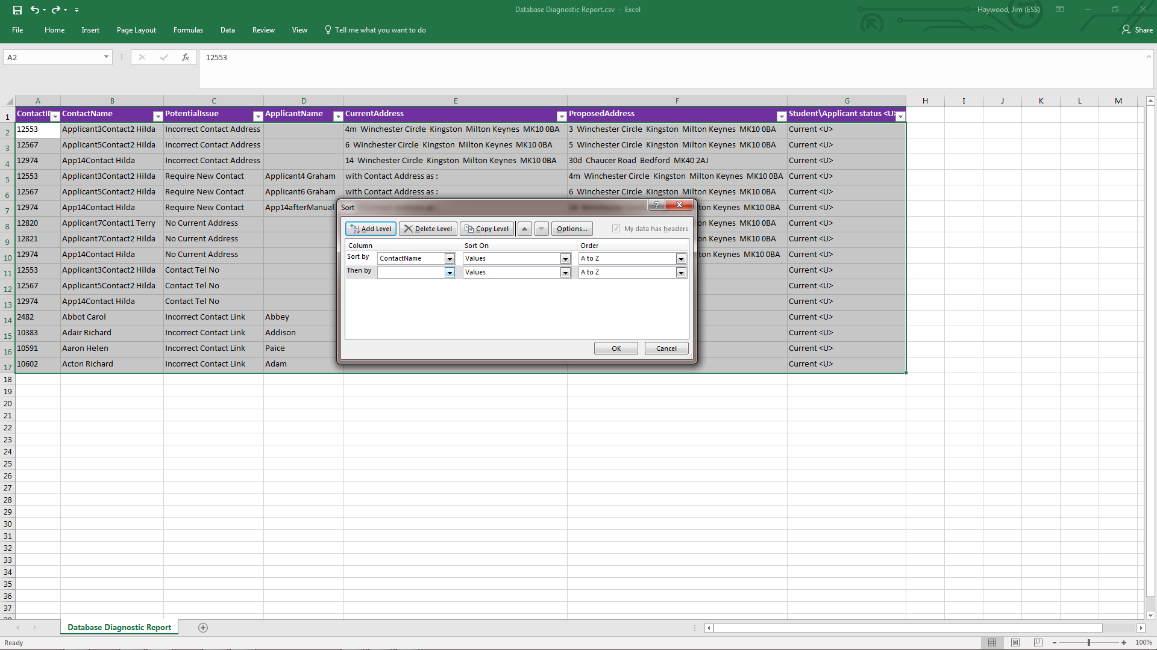
Dealing with Contact Data Issues
Sorting on Potential Issue within Contact Name, will give a clearer picture of what items related to a particular contact may need to be fixed

Slide 89
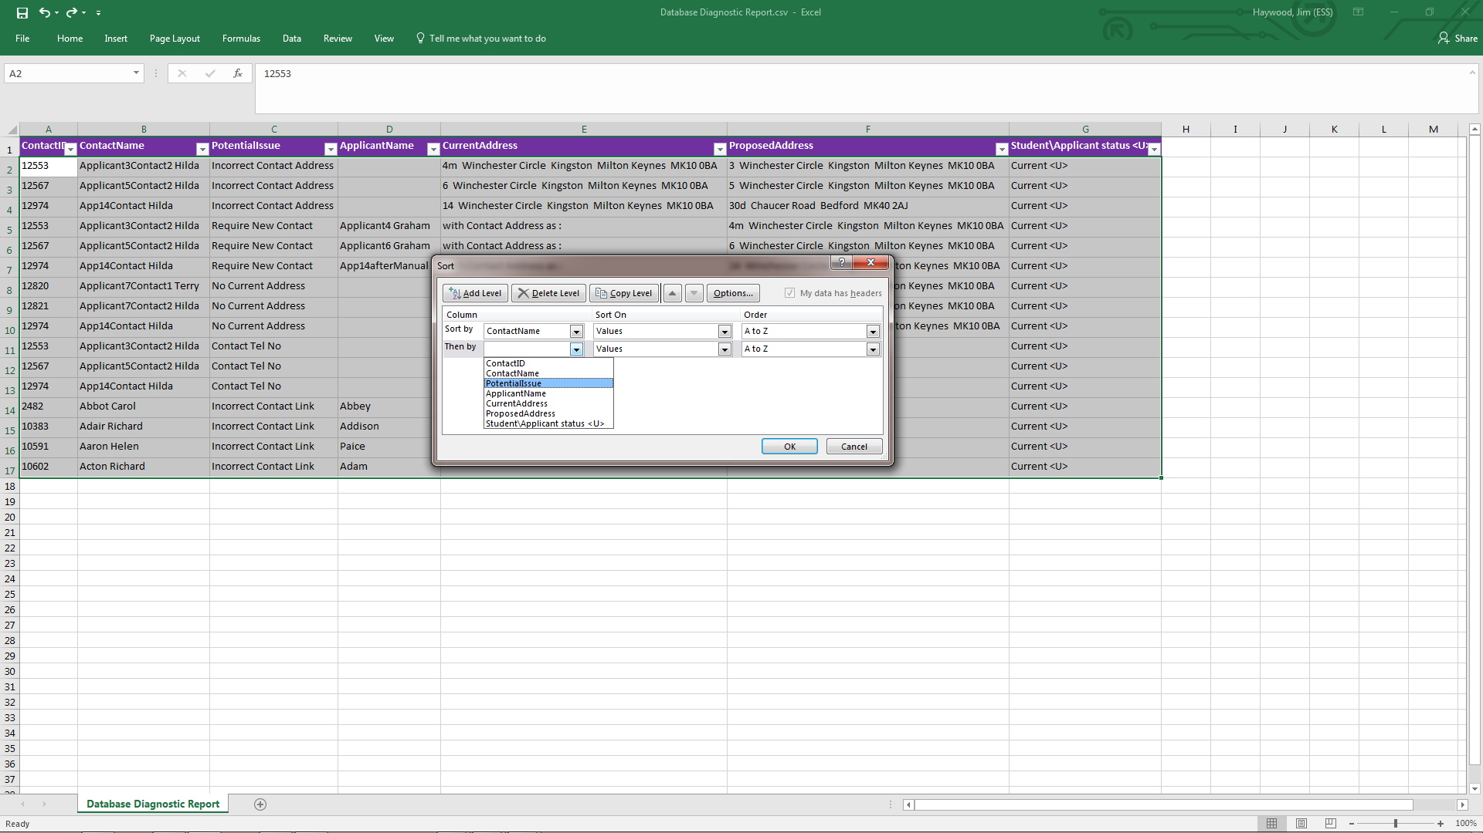
Dealing with Contact Data Issues
Sorting on Potential Issue within Contact Name, will give a clearer picture of what items related to a particular contact may need to be fixed

Slide 90
Dealing with Contact Data Issues
Sorting on Potential Issue within Contact Name, will give a clearer picture of what items related to a particular contact may need to be fixed
Sorting on Potential Issue with Contact Name, will give a clearer picture of what will be fixed for each contact

Slide 91
Dealing with Contact Data Issues
Armed with this spreadsheet we should be able to deal with contact data issues

Slide 92
Dealing with Contact Data Issues
Thank you for your time

